Slide 1
Horizontally Fused Training Array: An Effective Hardware Utilization Squeezer For Training Novel Deep Learning Models
https://github.com/UofT-EcoSystem/hfta
Shang Wang^{4,1,2}, Peiming Yang*^{3,2}, Yuxuan Zheng*⁵, Xin Li*², Gennady Pekhimenko^{1,2}
¹
²
³
⁴
⁵

Slide 2
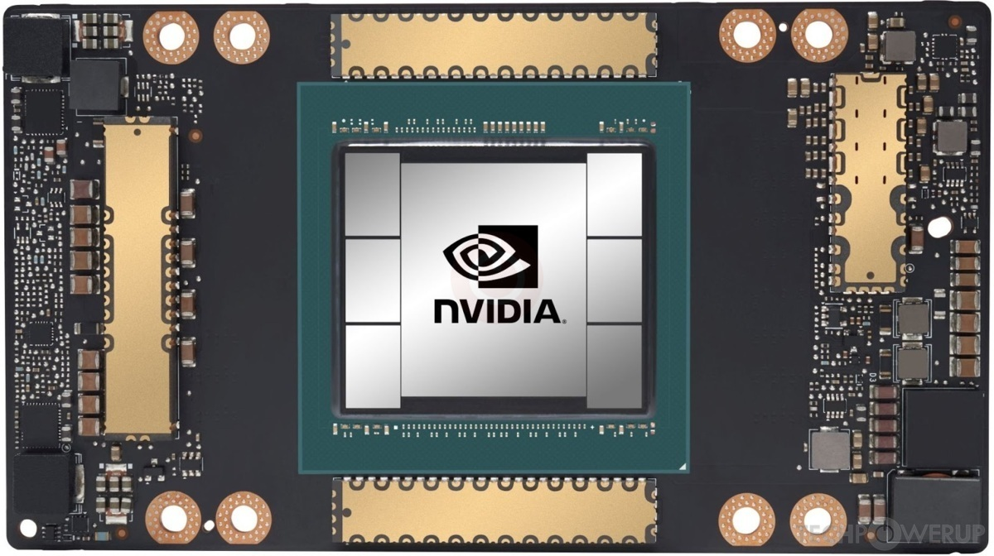
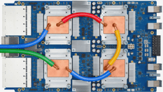
Executive Summary
Training cost for developing new deep learning (DL) models.
Problem: Repetitive single-accelerator training jobs (e.g., for hyper-param. tuning):
Dominate resource consumption (e.g., 46.2% @ ).
Have extremely low hardware utilization.
Key idea: Horizontally Fused Training Array (HFTA):
Horizontally fuses the models/jobs deeply down to ops.
Trains those models simultaneously on a shared accelerator.
X
Linear
ReLU
Linear
Loss
Key Results:
X
Fused
Linear
Fused
ReLU
Fused
Linear
Fused
Loss
11.5×
15.1×
X
Linear
ReLU
Linear
Loss
A100
TPU v3

Slide 3
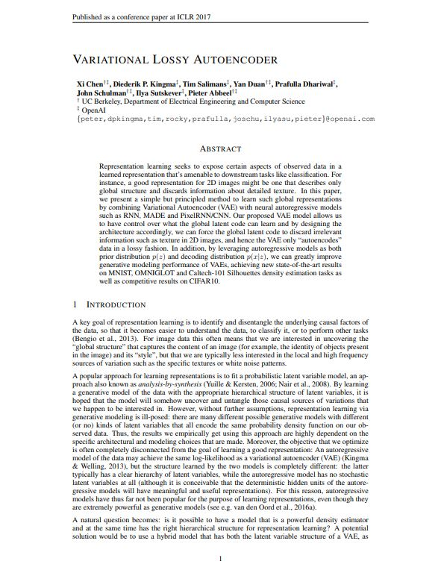
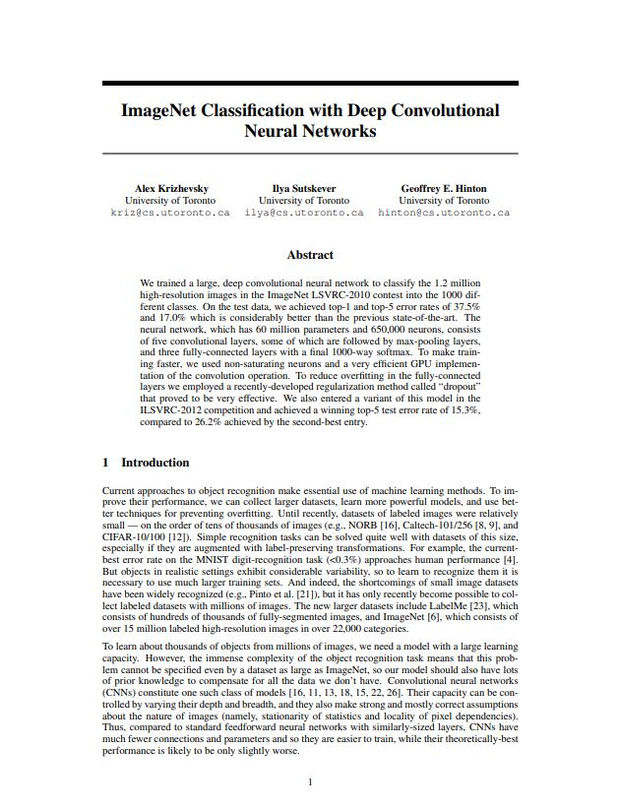
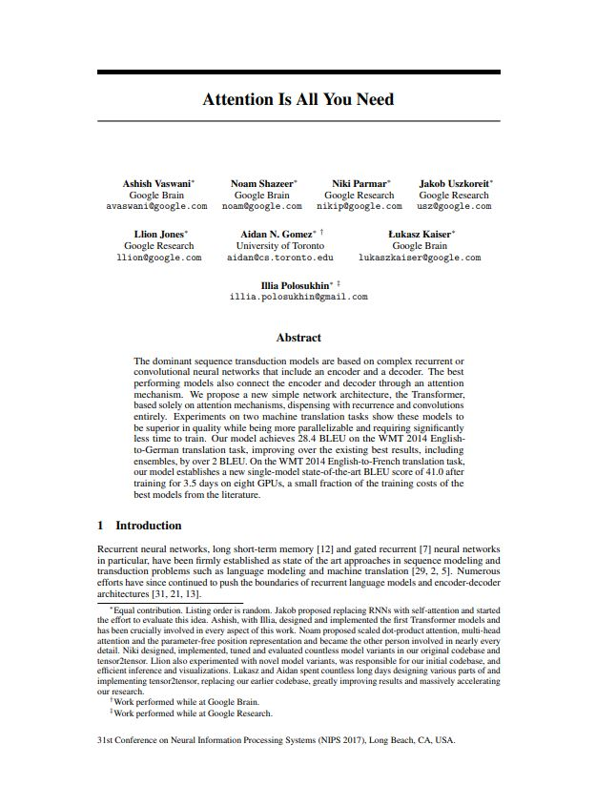
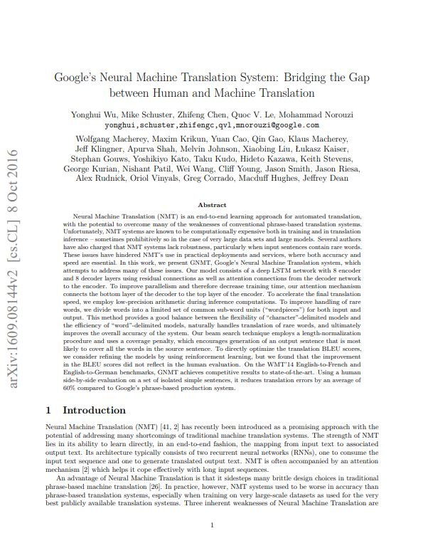
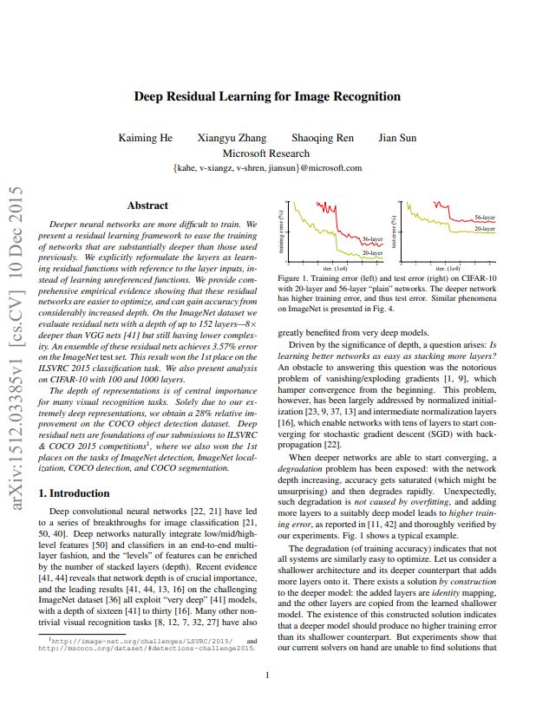
Deep Learning (DL) “Growing Wild”
DL Research → Train Diverse DL Models
# Researchers
Q
K
V
Compute Resource Demand for Training
¹https://medium.com/@dcharrezt/neurips-2019-stats-c91346d31c8f
²https://medium.com/criteo-engineering/neurips-2020-comprehensive-analysis-of-authors-organizations-and-countries-a1b55a08132e

Slide 4
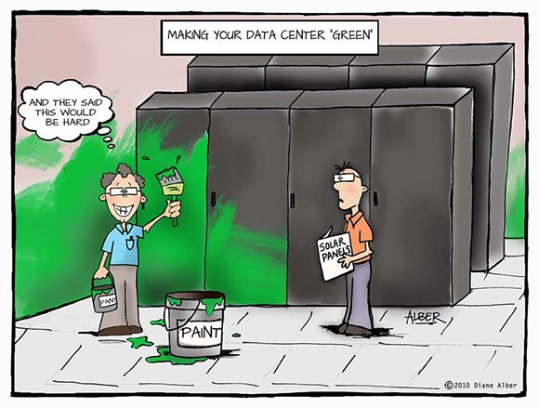
Does Training Utilize the Hardware Well?

Slide 5
Hardware Resource Usage @
Monitored over 2 months: 51K jobs, 472K GPU hours.
Single-GPU training:
Dominates the GPU hour usage.

Slide 6
Hardware Resource Usage @
Repetitive single-GPU training:
Dominates the GPU hour usage.
Concurrent jobs; same program; different configs.
For hyper-param. tuning or convergence stability testing.

Slide 7
Hardware Resource Usage @
Repetitive single-GPU training:
Often have low hardware utilization.
Why?

Slide 8
Why Hardware Underutilization?
DL
Hardware
?
?

Slide 9
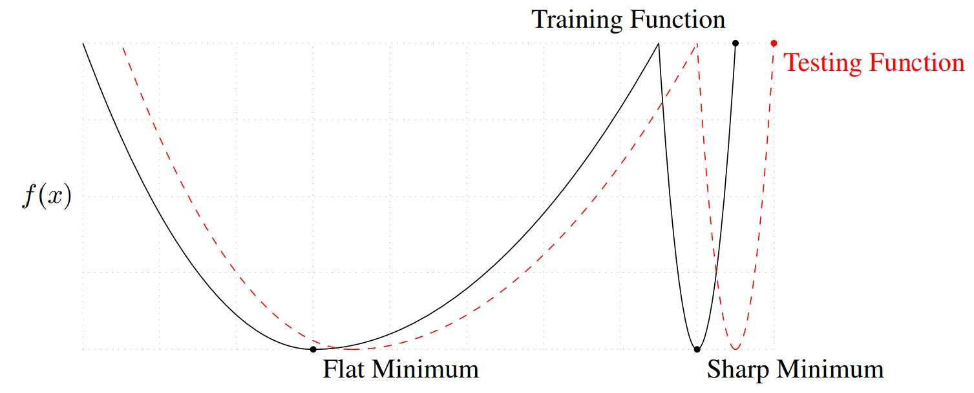
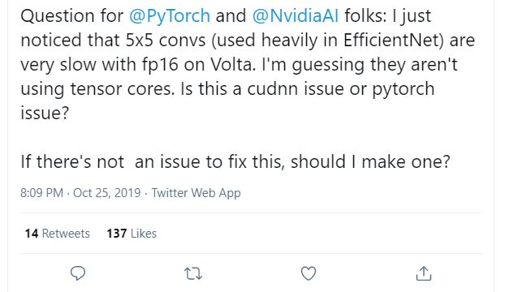
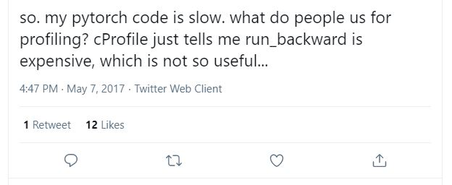
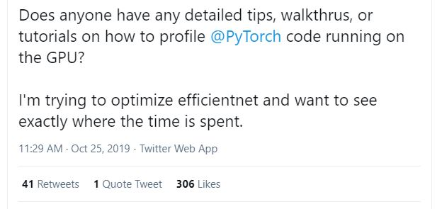
Performance Optimization is Hard.
More so for system & architecture “novices”.
Increasing the batch size?
Steps
Does not work universally:
Batch Size
Generalization gap.
Batch size scaling limit.
³Keskar et al. On large-batch training for deep learning: Generalization gap and sharp minima. ICLR, 2017
⁴Shallue et al. Measuring the effects of data parallelism on neural network training. J. Mach. Learn. Res., 20:112:1–112:49, 2019

Slide 10
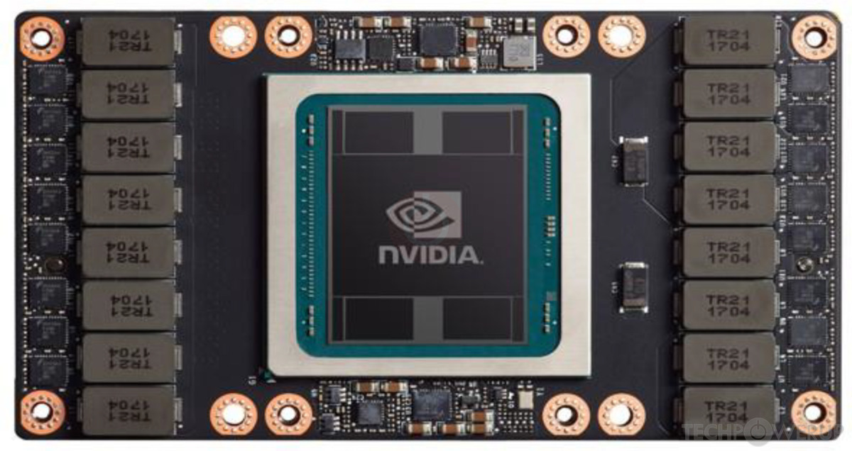
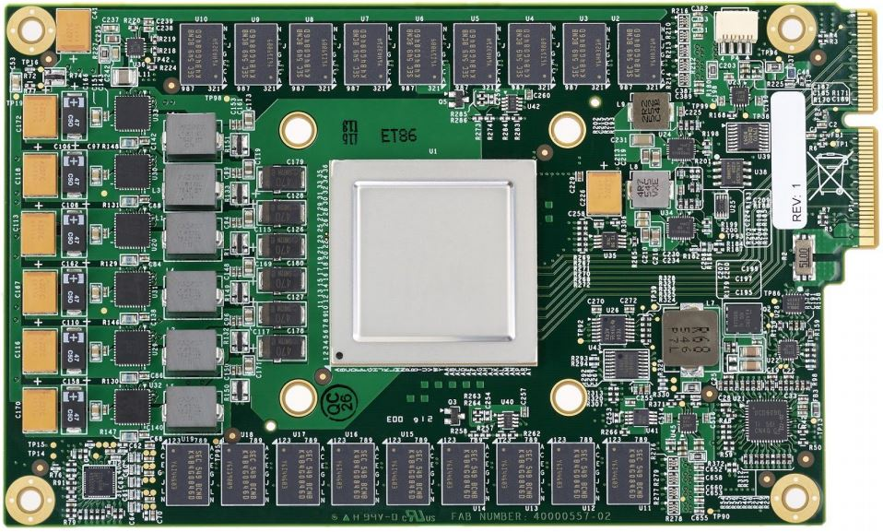
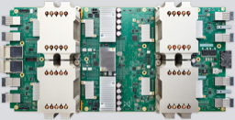
Accelerators Get More Powerful.
Compute
Power
P100
V100
A100
Year
TPU v1
TPU v2
TPU v3
Unoptimized workload → Harder to utilize well.

Slide 11
Why Hardware Underutilization?
DL
Hardware
Performance optimization is hard.
Accelerators get more powerful.
How to improve hardware utilization?

Slide 12
Train >1 Models on 1 Accelerator Simultaneously?
Special features for sharing among arbitrary processes.
(e.g., MPS and MIG on NVIDIA GPUs)
MPS
MIG
SGEMM
HMMA
SGEMM
HMMA
Less effective for repetitive training jobs.
Other accelerators (e.g., TPUs) do not possess such features.
What to do instead?

Slide 13
Key Ideas

Slide 14
Model Similarity
Launched repetitively (e.g., hyper-parameter tuning)
Learning Rate₁ = 0.01
Model
Learning Rate₂ = 0.03
Model

Slide 15
Model Similarity
Launched repetitively (e.g., hyper-parameter tuning)
Learning Rate₁ = 0.01
Model
Learning Rate₂ = 0.03
Model

Slide 16
Model Similarity
Launched repetitively (e.g., hyper-parameter tuning)
Learning Rate₁ = 0.01
Linear
ReLU
Linear
Learning Rate₂ = 0.03
Linear
ReLU
Linear
Same types of ops.

Slide 17
Model Similarity
Launched repetitively (e.g., hyper-parameter tuning)
Learning Rate₁ = 0.01
Linear
ReLU
Linear
Learning Rate₂ = 0.03
Linear
ReLU
Linear
Same types of ops with the same shapes.

Slide 18
Model Similarity
Launched repetitively (e.g., hyper-parameter tuning)
Learning Rate₁ = 0.01
X
Linear
ReLU
Linear
Learning Rate₂ = 0.03
X
Linear
ReLU
Linear
Same types of ops with the same shapes.
What to do with it?

Slide 19
Inter-model Horizontal Operator Fusion
Learning Rate₁ = 0.01
X
Linear
ReLU
Linear
Learning Rates
= {0.01, 0.03}
X
Fused
Linear
Fused
ReLU
Fused
Linear
We propose:
Learning Rate₂ = 0.03
X
Linear
ReLU
Linear
But, DL stack
→ training single models on separate accelerators.
How to ?

Slide 20
Implementation Reuse
Horizontally fused ops → other existing mathematically equivalent ops.
MatMul
SoftMax
bmm
Mask
Scale
MatMul
Q
K
V
What about other ops?

Slide 21
Horizontally Fused Training Array (HFTA)
Different ops → different rules → tools required.
X
Fused
Linear
Fused
ReLU
Fused
Linear
HFTA

Slide 22
Horizontally Fused Training Array (HFTA)
We choose PyTorch for its popularity, but the idea is general.
X
Fused
Linear
Fused
ReLU
Fused
Linear
HFTA

Slide 23
Horizontally Fused Training Array (HFTA)
Support all DL framework’s hardware backends.
X
Fused
Linear
Fused
ReLU
Fused
Linear
HFTA
PyTorch/XLA
V100
A100
TPU v3

Slide 24
HFTA Components
Operators
Optimizers
Learning Rate Schedulers
HFTA
PyTorch/XLA
V100
A100
TPU v3

Slide 25
HFTA: Fused Operators
Conv1d, Conv2d, ConvTranspose2d
Linear
MaxPool2d, AdaptiveAvgPool2d
Dropout, Dropout2d,
BatchNorm1d, BatchNorm2d, LayerNorm,
Embedding
ReLU, ReLU6, Tanh, LeakyReLU,
MultiheadAttention, TransformerEncoderLayer
Filters
Inputs
Outputs
Channel
Grouped Conv2d
Height
Conv2d
Width
Conv2d
What else can we fuse?

Slide 26
HFTA: Fused Optimizers and LR Schedulers
Adadelta, Adam
StepLR
For Model #1
Learning Rate
Gradients
#2
#3
#4
#5
#6
#7
What else can we fuse?

Slide 27
HFTA: Fused Loss
Scaling by # models if the loss is mean-reduced.
Model₁
Model₁
Y
Y
Model₂
Fused Loss
X
Model
Loss
$$𝓛$$
X
Model₃
$$𝓛$$
$$\frac{1}{N}\sum_{n=1}^{N}{l_{n}}$$
…
b
Model_{b}

Slide 28
No Impact on Convergence
Mathematically Equivalent Transformations
What about training throughputs?

Slide 29
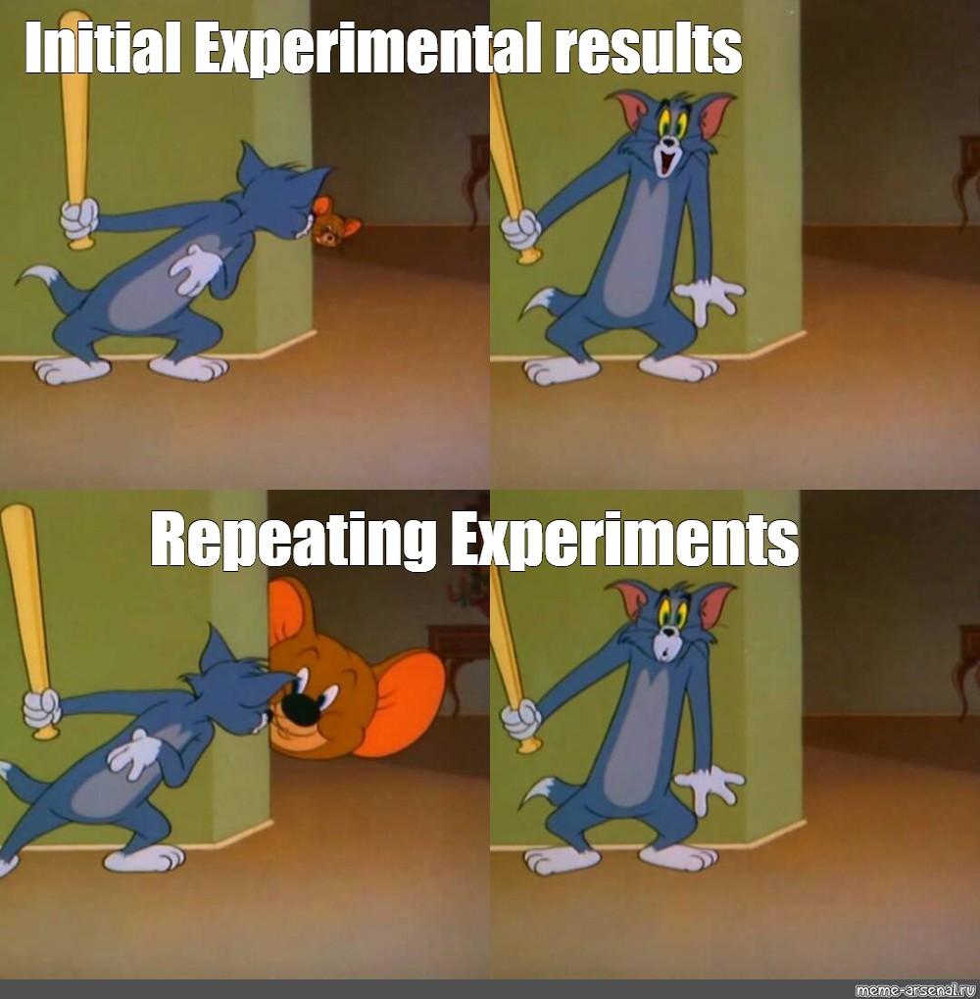
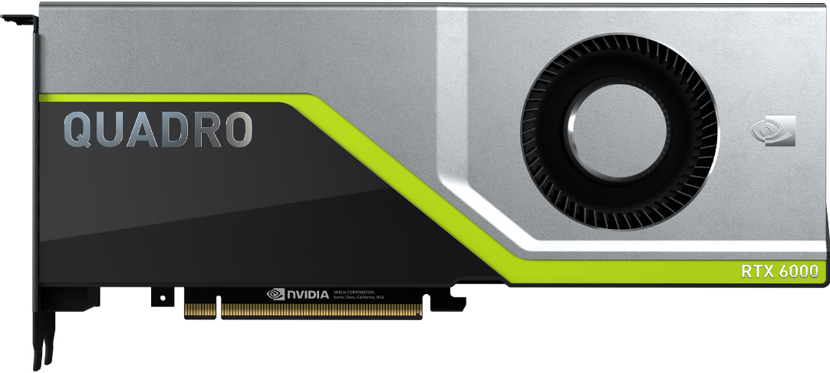
Methodology: Environment
Accelerators:
V100
RTX6000
A100
TPU v3
From:
Versions:
1.6
1.7
1.7
10.2
11.0.3
7.6.5
8.0.2

Slide 30
Methodology: Baselines
One model per accelerator.
Serial
GEMM
The common practice in hyper-param. tuning frameworks.

Slide 31
Methodology: Baselines
Some accelerators (e.g. NVIDIA GPUs) support running >1 processes.
Serial
Concurrent
SGE
MM
GEMM
SGE
MM
Kernels are time-multiplexed.

Slide 32
Methodology: Baselines
Some accelerators (e.g. NVIDIA GPUs) support running >1 processes.
Serial
Concurrent
MPS
SGE
MM
SGEMM
GEMM
SGE
MM
SGEMM
Co-run >1 kernels if a single kernel underutilizes the GPU.

Slide 33
Methodology: Baselines
Some accelerators (e.g. NVIDIA GPUs) support running >1 processes.
Serial
Concurrent
MPS
MIG
SGE
MM
SGEMM
HMMA
GEMM
SGE
MM
SGEMM
HMMA
Slice (only) A100 into (≤ 7) partitions.

Slide 34
Methodology: Workloads
Model
PointNet
DCGAN
ResNet₁₈
MobileNet_{V3L}
Transformer
BERT_{Medium}
Point Cloud
Classification
Point Cloud
Segmentation
Images Generation
Language
Modeling (LM)
Task
Image Classification
Mask LM
Dataset
ShapeNet part
LSUN
CIFAR-10
WikiText-2
Not intensively optimized → realistically reflect novel DL research workloads.

Slide 35
V100 Results
Keep sharing with more models until OOM.
HFTA achieves significantly higher peak throughput than all baselines:
Serial
Concurrent
MPS

Slide 36
V100 Results
Fixed memory budget, HFTA co-trains more models than MPS and concurrent.

Slide 37
V100 Results
Same # of models & same GPU, HFTA achieves higher throughput than all baselines.
Mixed Precision?

Slide 38
How About Mixed Precision?
HFTA can better exploit tensor cores during AMP training than all baselines.
Different GPUs?

Slide 39
How About Fancier GPUs?
Since Mem(A100) > Mem(RTX6000), HFTA can fit more models on A100.

Slide 40
How About Fancier GPUs?
Since Compute(A100) > Compute(RTX6000), HFTA achieves higher speedups on A100.

Slide 41
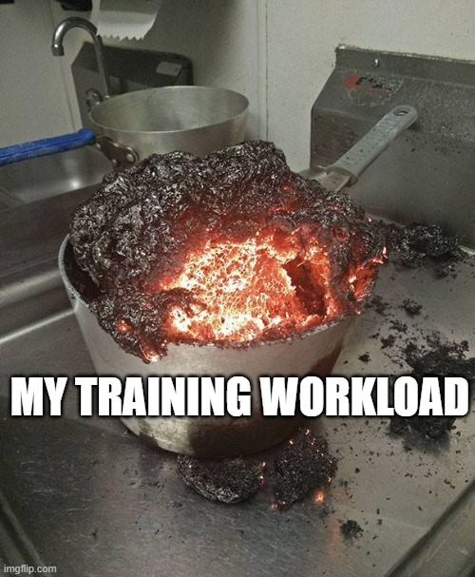
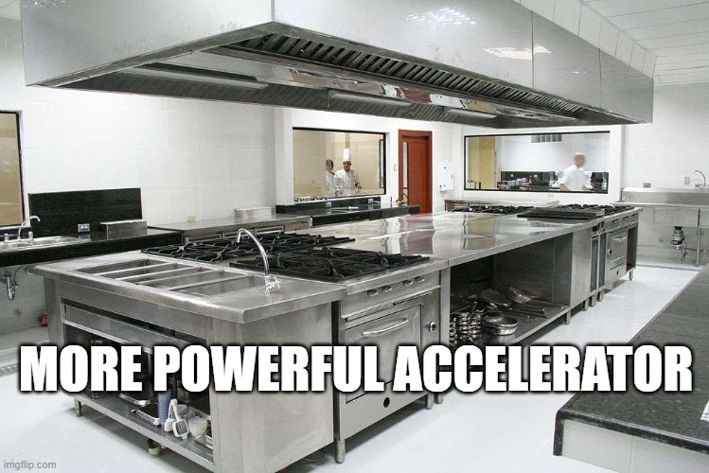
How About Fancier GPUs?
For an already unoptimized workload, better hardware → more under-utilization.

Slide 42
How About Fancier GPUs?
MIG’s partitioning is too coarse-grained.
Completely different accelerator?

Slide 43
How About TPUs?
HFTA achieves 4.93× over Serial.
Why is HFTA effective?

Slide 44
Performance Analysis: Memory
MPS
HFTA
GPU Memory Footprint
1
2
1
2
Number of Training Models
Number of Training Models
Why?

Slide 45
Performance Analysis: Memory
Overhead:
(reserved by DL framework stacks)
MPS duplicates the overhead.
MPS
HFTA
GPU Memory Footprint
1
2
1
2
Number of Training Models
Number of Training Models
Any other reason why HFTA is effective?

Slide 46
Performance Analysis: Compute

Slide 47
Performance Analysis: Compute
sm_active: Fraction of cycles when SMs have resident warps.
sm_occupancy: Ratio of # resident warps over SM’s max. # warps.
tensor_active: Fraction of cycles when tensor cores are active.
Proxy metrics for different aspects of GPU utilization.

Slide 48
Performance Analysis: Compute
While MPS & MIG does improve utilization, HFTA is more effective!

Slide 49
More Results in the Paper
PointNet Segmentation, DCGAN, ResNet-18, MobileNet_{V3Large}, Transformer, BERT_{Medium}
On GPUs, HFTA achieves:
2.42× to 11.50× over Serial.
1.25× to 4.72× over MPS.
1.33× to 4.88× over MIG.
On TPUs, HFTA achieves 2.98× to 15.13× over Serial.
> $15,000
HFTA’s Integration with hyper-parameter tuning algorithms.
Reduce total GPU hour cost by up to 5.10×.
Performance sensitivity study on partially fused ResNet-18.

Slide 50
Conclusion
Problem: Repetitive single-accelerator training jobs (e.g., for hyper-param. tuning):
Dominate resource consumption.
Have extremely low hardware utilization.
Key idea: Horizontally Fused Training Array (HFTA):
Horizontally fuses the models/jobs deeply down to ops.
Trains those models simultaneously on a shared accelerator.
Inspire on making hardware usage optimization easier for the ML community.
https://github.com/UofT-EcoSystem/hfta

Slide 51
Frequently Asked Questions

Slide 52
Batch/Layer Norm
weightsbias
N: Batch Size
B: # Horizontally Fused Ops
C: Channel
H: Height
W: Width
L: Length
F: Features
η: Normalized Shape
[B, F]
[B × F]
[N, B, C, H, W]
[N, B × C, H, W]
BatchNorm2d
[N, B × C, H, W]
[N, B, C, H, W]
[B, F]
[B × F]
[B, N, C, L]
[N, B, C, L]
[N, B × C, L]
BatchNorm1d
[N, B × C, L]
[N, B, C, L]
[B, N, C, L]
[B, η₁, …, η_{n}]
[B, 1, …, 1, η₁, …, η_{n}]
[B, …, η₁, …, η_{n}]
LayerNorm
[B, …, η₁, …, η_{n}]
addcmul
[B, …, η₁, …, η_{n}]

Slide 53
Transpose
Conv2d
Conv2d
[N, B, C, H, W]
ReLU
Transpose
[B, N, C, H, W]
MaxPool2d
Transpose
[N, B, C, H, W]
[N, B, C, H, W]
Conv2d
ReLU
[N, B, C, H, W]
ReLU
Transpose
Transpose
[B, N, C, H, W]
Transpose
[B, N, F]
Linear
[N, B, C, H, W]
MaxPool2d
ReLU

Slide 54
Integration with Tuning Algorithms
Hyper-parameters:
Fusible
Different values can be co-evaluated in a fused job.
Algorithm
Infusible
Horizontally Fused Hyper-parameter Tuning:
Lightweight hyper-parameter tuning framework.
Algorithms: random search and Hyperband.
Schedulers: HFTA and hardware-based sharing.
Partitioning Hyper-parameter Sets
Results
Hyper-parameter Sets
Job Scheduler

Slide 55
nvidia-smi’s GPU Utilization

Slide 56
Performance Analysis: Memory
HFTA’s linear regression lines have lower slopes than MPS’ with positive intercepts.
MPS duplicates the GPU memory overhead reserved by the DL framework stacks.

Slide 57
Partially Fused ResNet-18

Slide 58
MobileNet_{V3Large}

Slide 59
PointNet Segmentation

Slide 60
ResNet-18

Slide 61
DCGAN

Slide 62
BERT_{Medium}

Slide 63
Transformer

