Slide 1
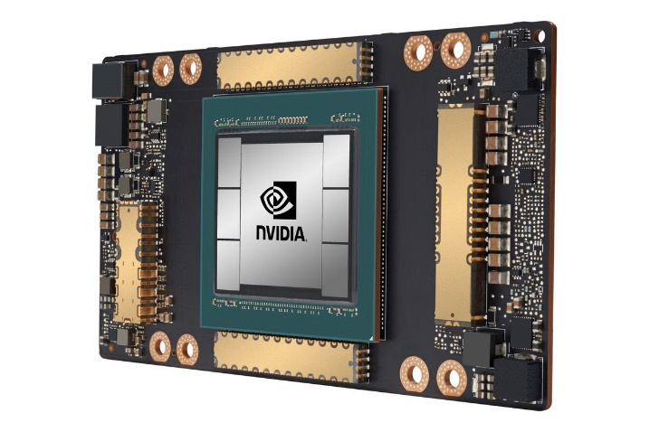
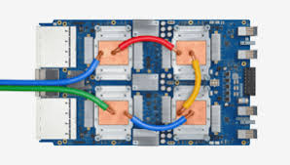
CSCB58: Computer Organization
Prof. Gennady Pekhimenko
University of Toronto
Fall 2020
The content of this lecture is adapted from the lectures of
Larry Zheng and Steve Engels

Slide 2
CSCB58 Week 12

Slide 3
B58 Evaluation
Please check your e-mail for a link to your evaluations
Or go to: http://uoft.me/openevals

Slide 4
Execution Stages
Fetch: Updating the PC and locating the instruction to execute.
Decode: Translating the instruction and reading inputs from the register file.
Execute / Address Computation: Using the ALU to compute an operation or calculate an address.
Memory Read or Write: Memory operations must access memory. Non-memory operations skip this.
Register Writeback: The result is written to the register file.

Slide 5
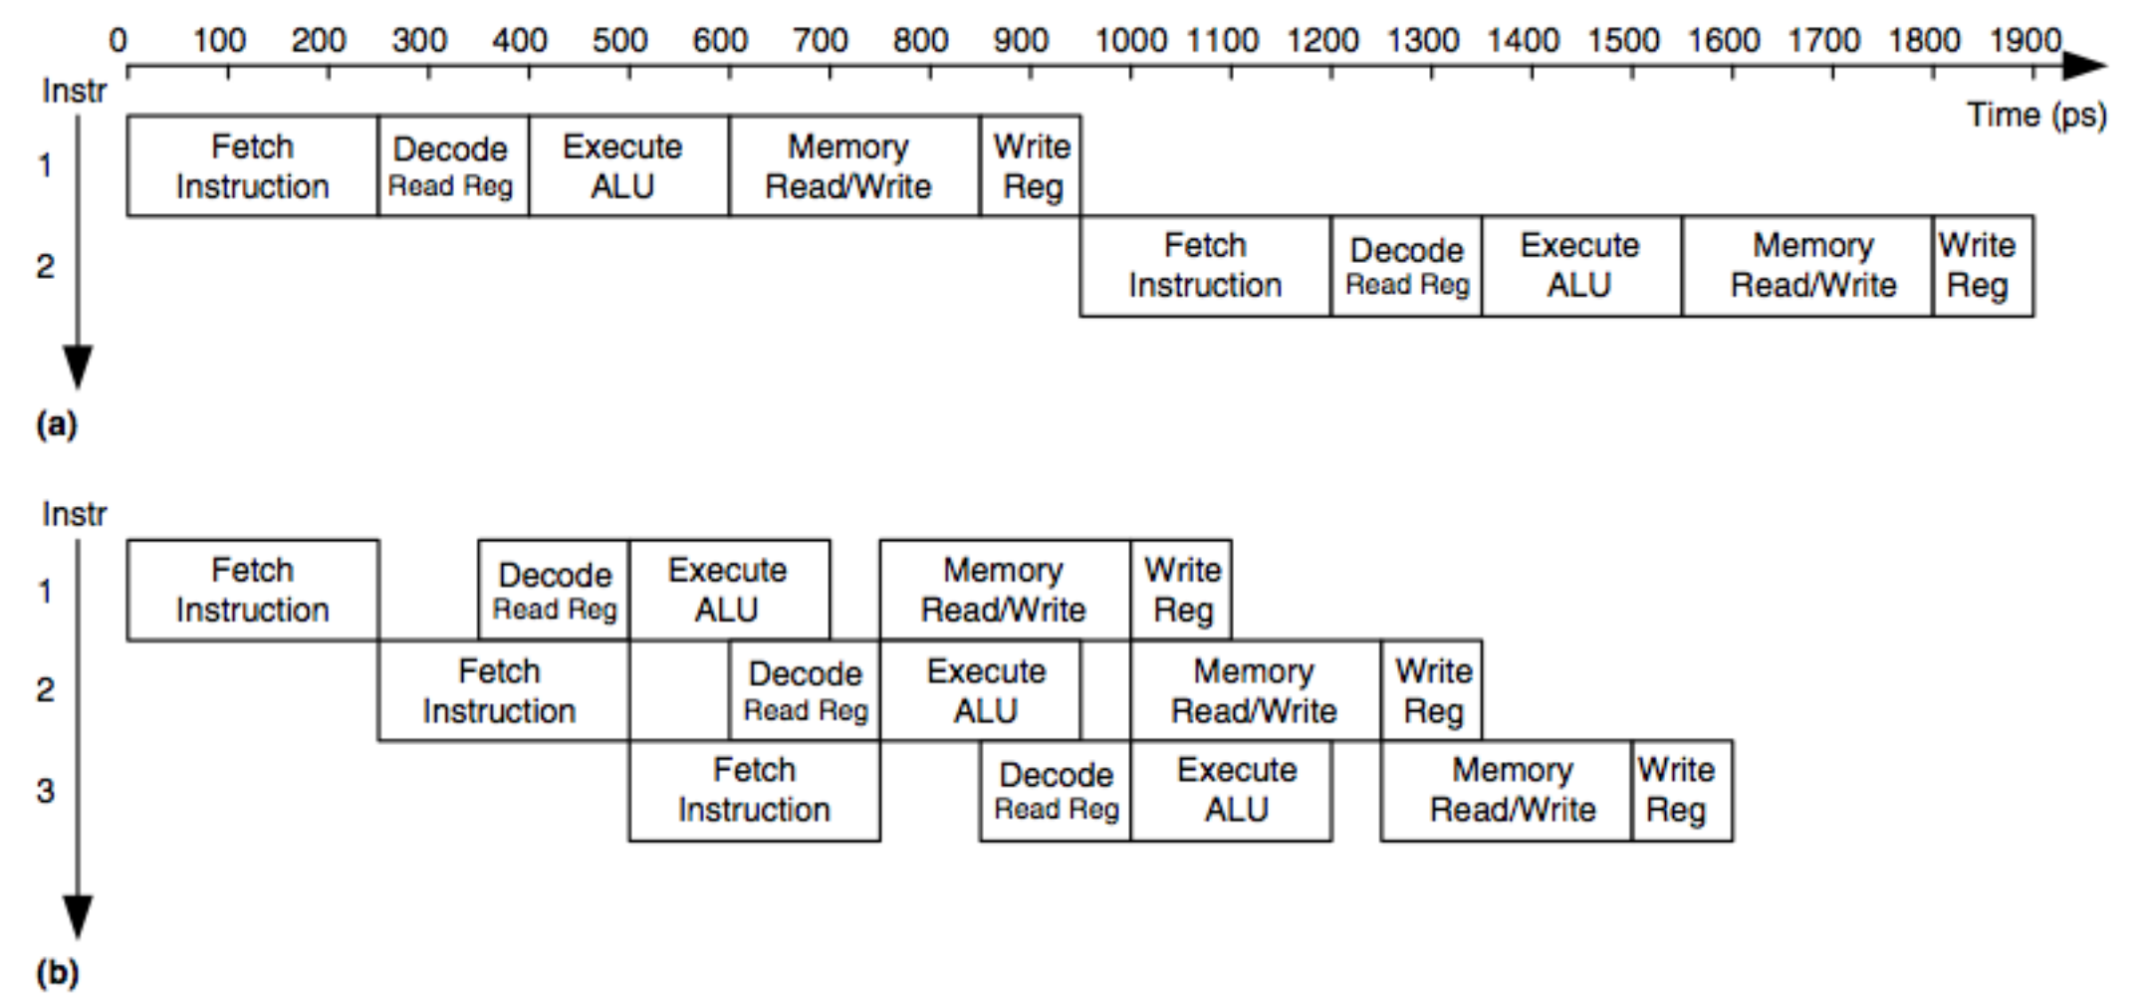
Pipelining the Execution Stages
without pipelining
latency: 950 ps
throughput: 1 instr. per 950 ps = ~1 billion / sec
Fixed-length stages
latency: 5 x 250 = 1250 ps
throughput: 1 instr. per 250 ps = ~4 billion / sec
with pipelining

Slide 6
fibonacci(int n)
int fib (int n){
if (n <= 1)
return n;
else
return fib (n - 1) + fib (n - 2);
}

Slide 7
fibonacci(int n)
Assign register names to variables and determine which is base case and which is recursive.
Only one input, n is passed in register $a0. The base case is the “then” clause. The recursive case is the “else” clause.
Convert the code for the base case.
fib:
bgt $a0, 1, recurse
move $v0, $a0
jr $ra$t0, 0($sp)
Note: codes on the slides are not guaranteed to be correct. You need to be able to find the errors and fix them.

Slide 8
fibonacci(int n)
Save callee- and caller-saved registers on the stack.
fib:
bgt $a0, 1, recurse
move $v0, $a0
jr $ra$t0, 0($sp)
recurse:
sub $sp, $sp, 12 # We need to store 3 registers # to stack
sw $ra, 0($sp) # $ra is the first register
sw $a0, 4($sp) # $a0 is the second register, # we cannot assume $a # registers will not be
# overwritten by callee
Note: codes on the slides are not guaranteed to be correct. You need to be able to find the errors and fix them.

Slide 9
fibonacci(int n)
Call fib recursively
fib: …
recurse: …
addi $a0, $a0, -1 # N-1
jal fib
sw $v0, 8($sp) # store $v0, the third register
# to be stored on the stack so # it doesn’t get overwritten by # callee
Note: codes on the slides are not guaranteed to be correct. You need to be able to find the errors and fix them.

Slide 10
fibonacci(int n)
Call fib recursively again
fib: …
recurse: …
…
lw $a0, 4($sp) # retrieve original value of N
addi $a0, $a0, -2 # N-2
jal fib
Note: codes on the slides are not guaranteed to be correct. You need to be able to find the errors and fix them.

Slide 11
fibonacci(int n)
Clean up the stack and return the result.
fib: …
recurse: …
…
…
lw $t0, 8($sp) # retrieve first function result
add $v0, $v0, $t0
lw $ra, 0($sp) # retrieve return address
addi $sp, $sp, 12
jr $ra
Note: codes on the slides are not guaranteed to be correct. You need to be able to find the errors and fix them.

Slide 12
CSCB58: Computer Organization
Prof. Gennady Pekhimenko
University of Toronto
Fall 2020
The content of this lecture is adapted from the lectures of
Larry Zheng and Steve Engels

