Slide 1
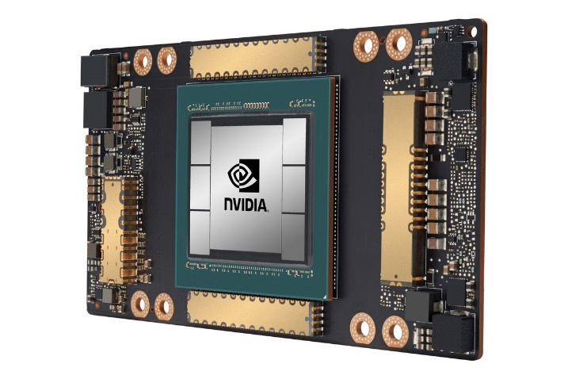
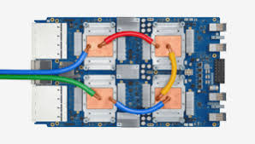
CSCB58: Computer Organization
Prof. Gennady Pekhimenko
University of Toronto
Fall 2020
The content of this lecture is adapted from the lectures of
Larry Zheng and Steve Engels

Slide 2
CSCB58 Week 10:
Summary

Slide 3
Week 10 Summary
It is all about Assembly:
Basic instructions
Decoding
Interpretation

Slide 4
Question #1
What are the following assembly language instructions doing?
sub $t7, $t0, $t1
Subtract register $t1 from $t0
and placing the result into $t7
andi $t7, $t0, 15
Bitwise AND between register
$t0 and 15 (1111), with the
result placed into register $t7
sra $t2, $t1, 2
Arithmetic shift of register $t1
two bits to the right, with the
result stored in $t2

Slide 5
As a reminder…
MIPS register values:
Register 0 ($zero): value 0 -- always.
Register 1 ($at): reserved for the assembler.
Registers 2-3 ($v0, $v1): return values
Registers 4-7 ($a0-$a3): function arguments
Registers 8-15, 24-25 ($t0-$t9): temporaries
Registers 16-23 ($s0-$s7): saved temporaries
Registers 28-31 ($gp, $sp, $fp, $ra): memory and function support
Registers 27-28: reserved for OS kernel

Slide 6
Question #2
How do you translate the following assembly language instruction into machine code?
add $t7, $t0, $t1
R-type instruction!
opcode
rs
rt
rd
shamt
funct
6
5
5
5
5
6

Slide 7
Question #2
add $t7, $t0, $t1
Step #1: The opcode
Arithmetic operations start with six 0’s, and have the function identifier at the end.
Step #2: The register values
Remember that $t0 does not translate to register 0
The temporary registers start at register 8, so $t0 → 8, $t1 → 9 and $t7 →15
000000 sssss ttttt ddddd XXXXX 100000
000000 01000 01001 01111 XXXXX 100000

Slide 8
Question #3
What are the following assembly language instructions doing?
beq $t2, $zero, top
Jump to the line with label “top” if
register $t2 is equal to 0 ($zero)
jalr $t0
Store the current PC location into
$ra (register $31) and jump to the
location stored in register $t0

Slide 9
Question #4
How do you translate the following assembly language instruction into machine code?
xori $t7, $t0, -1
I-type instruction!
opcode
rs
rt
immediate
6
5
5
16

Slide 10
Question #4
xori $t7, $t0, -1
Step #1: The opcode
I-type instructions start with the opcode value:
Step #2: The register values
Register $t0 translates to register 8, and register $t7 translates to register 15
16-bit immediate value is -1.
001110 sssss ttttt iiiiiiiiiiiiiiii
001110 01000 01111 1111111111111111

Slide 11
Question #5
How do you write an assembly language program that can swap the values in $t0 and $t1, using $t2 as a temp value?
add $t2, $zero, $t0
add $t0, $zero, $t1
add $t1, $zero, $t2

Slide 12
CSCB58: Computer Organization
Prof. Gennady Pekhimenko
University of Toronto
Fall 2020
The content of this lecture is adapted from the lectures of
Larry Zheng and Steve Engels

