Slide 1
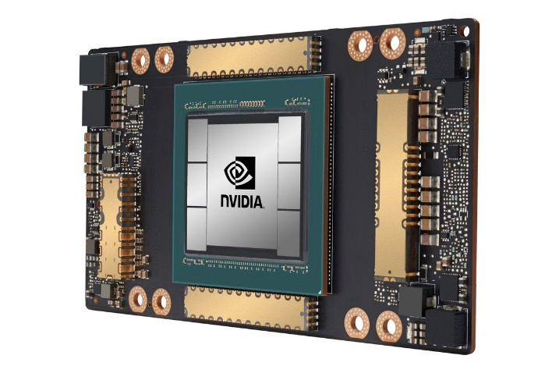
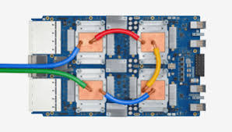
CSCB58: Computer Organization
Prof. Gennady Pekhimenko
University of Toronto
Fall 2020
The content of this lecture is adapted from the lectures of
Larry Zheng and Steve Engels

Slide 2
CSCB58 Week 9:
Summary

Slide 3
Week 9 Summary
We learned
Processor components
Control flow
Data flow path

Slide 4
Question #1
Your RAM unit has 6 address bits going into it. Given a 32-bit architecture, how many integers is your RAM unit able to store?
Be careful here!
6 address bits → 2⁶ memory slots = 64 bytes.
32-bit architecture → 4 bytes per integer.
RAM capacity = 64 / 4 = 16 integers in memory.

Slide 5
Question #2
Can you identify the components in the datapath above?

Slide 6
Question #3
Where are instructions stored?
In memory, along with the data values
How long is a single instruction?
4 bytes (32 bits)
What is the role of the Program Counter (PC)?
Store the location of the current instruction.
What do we mean by instruction fetch?
Retrieve an instruction from memory.
Where does the processor keep the instruction that is currently being executed?
In the Instruction Register.

Slide 7
CSCB58: Computer Organization
Prof. Gennady Pekhimenko
University of Toronto
Fall 2020
The content of this lecture is adapted from the lectures of
Larry Zheng and Steve Engels

