Slide 1
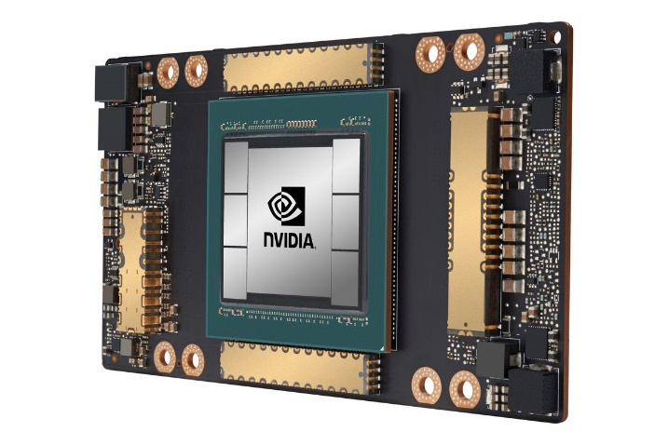
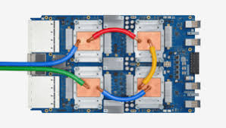
CSCB58: Computer Organization
Prof. Gennady Pekhimenko
University of Toronto
Fall 2020
The content of this lecture is adapted from the lectures of
Larry Zheng and Steve Engels

Slide 2
CSCB58 Week 4:
Summary

Slide 3
Week 4 Summary
We learned
Sequential circuits – circuits with memory
Latches
Flip-flops

Slide 4
Latches
If multiple gates of these types (NAND or NOR with feedback) are combined, you can get more steady behaviour.
These circuits are called latches.
A
A
Q
Q
Q
Q
B
B

Slide 5
S’R’ Latch
S
Q
R
Q

Slide 6
S’R’ latch
S | R | Q_{T} | Q_{T} | Q_{T+1} | Q_{T+1}
0 | 0 | X | X | 1 | 1
0 | 1 | X | X | 1 | 0
1 | 0 | X | X | 0 | 1
1 | 1 | 0 | 1 | 0 | 1
1 | 1 | 1 | 0 | 1 | 0
S
Q
Q
R
S and R are called “set” and “reset” respectively.
When S’ = 0, R’ = 1, Q is 1
When S’ = 1, R’ = 0, Q is 0
When S’R’ = 11, same as previous state (01 or 10)
How about going from 00 to 11
Depends on whether it changes from 00 to 01 to 11, or from 00 to 10 to 11 (race condition)
unstable behaviour

Slide 7
Clocked SR latch
S
Q
C
Q
R
By adding another layer of NAND gates to the SR latch, we end up with a clocked SR latch circuit.
The clock is often connected to a pulse signal that alternates regularly between 0 and 1.

Slide 8
D latch
D
Q
D
Q
C
C
Q
Q

Slide 9
Edge-triggered flip-flop
Positive-edge triggered flip-flops
These are the most commonly-used flip-flop circuits (and our choice for the course).
D
D
Q
S
Q
Q
D
Q
C
C
C
Q
C
Q
R
Q
Q

Slide 10
Question #1
S
Q
What are the output values from Q and Q given the following inputs on S, R and C?
C
Q
R
S | R | C | Q | Q
0 | 0 | 1
1 | 0 | 1
1 | 0 | 0
0 | 0 | 0
0 | 1 | 0
0 | 1 | 1
Time

Slide 11
1
0
1
0
1
0
1
S
S
?
Q
1
0
1
Q
C
C
Q
Q
R
0
R
0
1
?
0
1
0
1
S | R | C | Q | Q
0 | 0 | 1 | Z | Z
1 | 0 | 1 | 1 | 0
1 | 0 | 0 | 1 | 0
0 | 0 | 0 | 1 | 0
0 | 1 | 0 | 1 | 0
0 | 1 | 1 | 0 | 1
1
1
S
0
0
Q
1
C
Q
R
0
0
1
1
1

Slide 12
Question #2
D
D_{L}
Q_{L}
Q_{L}
C
C
Q_{L}
Given the circuit on the right and the input waveform below, what will the outputs be on Q_{L} and Q_{F}?
What other info do you need?
D_{F}
Q_{F}
Q_{F}
C
Q_{F}
C
D
Q_{L}
Q_{F}

Slide 13
Question #3
D
Q
X
Assuming the Q outputs of both flip-flops start off low, what will the value of X & Y be over the next few clock cycles?
also assume positive edge trigger.
C
Q
D
Q
Y
C
Q
Clock
X
Y

Slide 14
CSCB58: Computer Organization
Prof. Gennady Pekhimenko
University of Toronto
Fall 2020
The content of this lecture is adapted from the lectures of
Larry Zheng and Steve Engels

