Slide 1
CSCB58: Computer Organization
Prof. Gennady Pekhimenko
University of Toronto
Fall 2020
The content of this lecture is adapted from the lectures of
Larry Zheng and Steve Engels

Slide 2
CSCB58 Week 3:
Summary

Slide 3
Week 3 review
Building
Mux/demux
Decoders
Adders
Subtractors
Comparators

Slide 4
Comparators

Slide 5
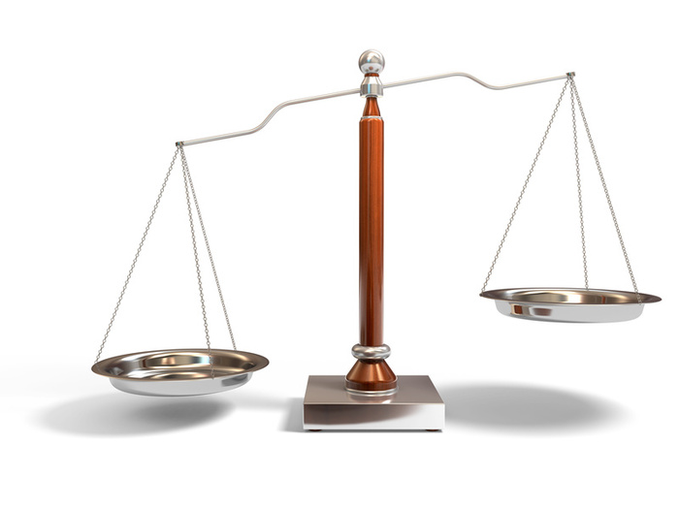
Comparators
A circuit that takes in two input vectors, and determines if the first is greater than, less than or equal to the second.
How does one make that in a circuit?

Slide 6
Basic Comparators
A
B
Comparator
A=B
A>B
Consider two binary numbers A and B, where A and B are one bit long.
The circuits for this would be:
A==B:
A>B:
A<B:
A<B
A | B
0 | 0
0 | 1
1 | 0
1 | 1
A·B + A·B
A·B
A·B

Slide 7
Basic Comparators
A₁
A₀
B₁
B₀
What if A and B are two bits long?
The terms for this circuit for have to expand to reflect the second signal.
For example:
A==B:
Comparator
A=B
A>B
A<B
(A₁·B₁+A₁·B₁)·(A₀·B₀+A₀·B₀)
Make sure that the values of bit 1 are the same
Make sure that the values of bit 0 are the same

Slide 8
Basic Comparators
A₁
A₀
B₁
B₀
Comparator
What about checking if A is greater or less than B?
A>B:
A<B:
A=B
A>B
A<B
A₁·B₁ + (A₁·B₁+A₁·B₁)·(A₀·B₀)
Check if first bit satisfies condition
If not, check that the first bits are equal…
…and then do the 1-bit comparison
A₁·B₁ + (A₁·B₁+A₁·B₁)·(A₀·B₀)
A > B if and only if A1 > B1 or (A1 = B1 and A0 > B0)

Slide 9
General Comparators
The general circuit for comparators requires you to define equations for each case.
Case #1: Equality
If inputs A and B are equal, then all bits must be the same.
Define X_{i} for any digit i:
(equality for digit i)
Equality between A and B is defined as:
X_{i} = A_{i}·B_{i} + A_{i}·B_{i}
A==B : X₀·X₁·…·X_{n}

Slide 10
Comparators
Case #2: A > B
The first non-matching bits occur at bit i, where A_{i}=1 and B_{i}=0. All higher bits match.
Using the definition for X_{i} from before:
Case #3: A < B
The first non-matching bits occur at bit i, where A_{i}=0 and B_{i}=1. Again, all higher bits match.
n
A>B = A_{n}·B_{n} + X_{n}·A_{n-1}·B_{n-1} + … + A₀·B₀·Π X_{k}
k=1
n
A<B = A_{n}·B_{n} + X_{n}·A_{n-1}·B_{n-1} + … + A₀·B₀·Π X_{k}
k=1

Slide 11
Comparator truth table
Given two input vectors of size n=2, output of circuit is shown at right.
Inputs |  |  |  | Outputs
A₁ | A₀ | B₁ | B₀ | A < B | A = B | A > B
0 | 0 | 0 | 0 | 0 | 1 | 0
0 | 0 | 0 | 1 | 1 | 0 | 0
0 | 0 | 1 | 0 | 1 | 0 | 0
0 | 0 | 1 | 1 | 1 | 0 | 0
0 | 1 | 0 | 0 | 0 | 0 | 1
0 | 1 | 0 | 1 | 0 | 1 | 0
0 | 1 | 1 | 0 | 1 | 0 | 0
0 | 1 | 1 | 1 | 1 | 0 | 0
1 | 0 | 0 | 0 | 0 | 0 | 1
1 | 0 | 0 | 1 | 0 | 0 | 1
1 | 0 | 1 | 0 | 0 | 1 | 0
1 | 0 | 1 | 1 | 1 | 0 | 0
1 | 1 | 0 | 0 | 0 | 0 | 1
1 | 1 | 0 | 1 | 0 | 0 | 1
1 | 1 | 1 | 0 | 0 | 0 | 1
1 | 1 | 1 | 1 | 0 | 1 | 0

Slide 12
Comparator example (cont’d)
A<B:
 | B₀·B₁ | B₀·B₁ | B₀·B₁ | B₀·B₁
A₀·A₁ | 0 | 1 | 1 | 1
A₀·A₁ | 0 | 0 | 1 | 1
A₀·A₁ | 0 | 0 | 0 | 0
A₀·A₁ | 0 | 0 | 1 | 0
LT = B₁·A₁ + B₀·B₁·A₀ + B₀·A₀·A₁

Slide 13
Comparator example (cont’d)
A=B:
 | B₀·B₁ | B₀·B₁ | B₀·B₁ | B₀·B₁
A₀·A₁ | 1 | 0 | 0 | 0
A₀·A₁ | 0 | 1 | 0 | 0
A₀·A₁ | 0 | 0 | 1 | 0
A₀·A₁ | 0 | 0 | 0 | 1
EQ = B₀·B₁·A₀·A₁ + B₀·B₁·A₀·A₁ + B₀·B₁·A₀·A₁ + B₀·B₁·A₀·A₁

Slide 14
Comparator example (cont’d)
A>B:
 | B₀·B₁ | B₀·B₁ | B₀·B₁ | B₀·B₁
A₀·A₁ | 0 | 0 | 0 | 0
A₀·A₁ | 1 | 0 | 0 | 0
A₀·A₁ | 1 | 1 | 0 | 1
A₀·A₁ | 1 | 1 | 0 | 0
GT = B₁·A₁ + B₀·B₁·A₀ + B₀·A₀·A₁

Slide 15
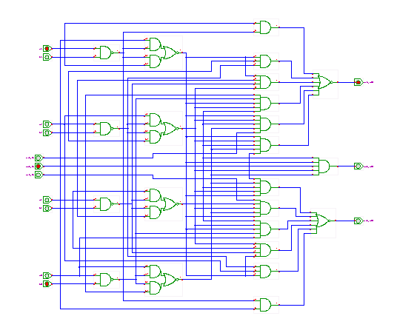
Comparing larger numbers
As numbers get larger, the comparator circuit gets more complex.
At a certain level, it can be easier sometimes to just process the result of a subtraction operation instead.
Easier, less circuitry, just not faster.

Slide 16
Question #1
How do you write the number 78 as an 8-bit binary number?
What is the two’s complement of 01101101?
What is the sum of 01101101 and 01101101?
128 64 32 16 8 4 2 1
0 1 0 0 1 1 1 0
10010011
11011010
Note what’s happening here!

Slide 17
Question #2
 | C·D | C·D | C·D | C·D
A·B | 1 | 1 | X | 1
A·B | X | 0 | X | 1
A·B | 1 | X | X | 1
A·B | 1 | X | 0 | X
What groupings are in the K-map on the right?
What logic equations do these groupings represent?
A·B + C

Slide 18
CSCB58: Computer Organization
Prof. Gennady Pekhimenko
University of Toronto
Fall 2020
The content of this lecture is adapted from the lectures of
Larry Zheng and Steve Engels

