Slide 1
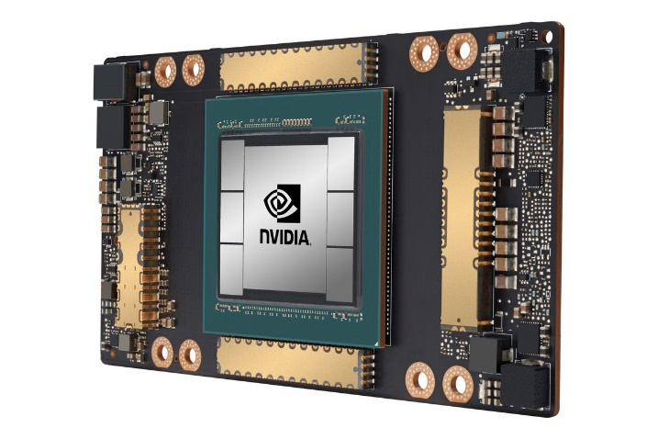
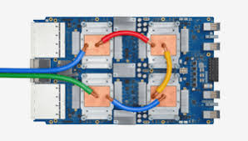
CSCB58: Computer Organization
Prof. Gennady Pekhimenko
University of Toronto
Fall 2020
The content of this lecture is adapted from the lectures of
Larry Zheng and Steve Engels

Slide 2
CSCB58 Week 2:
Summary

Slide 3
Week 2 review
Using logic gates
Combinational circuits
Circuit reduction
Karnaugh maps

Slide 4
Question #1
How can you express a two-input XOR gate as a combination of NAND and NOT gates?
Draw the circuit using only these two logic gates.
Remember De Morgan’s!
(W + Z) = (W Z)
A | B | Y
0 | 0 | 0
0 | 1 | 1
1 | 0 | 1
1 | 1 | 0
A
B
Y
A
B
A
B
Y
A
B

Slide 5
Question #2
How can you implement a NOT gate from a 2-input NAND gate?
A
A
?

Slide 6
Question #2
How can you implement a NOT gate from a 2-input NAND gate?
A
A
?
A
A
A
A
1

Slide 7
Question #3 - Minterms
Write Y in SOM (Sum Of Minterms) form.
A | B | C | Y
0 | 0 | 0 | 0
0 | 0 | 1 | 1
0 | 1 | 0 | 1
0 | 1 | 1 | 0
1 | 0 | 0 | 1
1 | 0 | 1 | 0
1 | 1 | 0 | 0
1 | 1 | 1 | 1
Y = A·B·C + A·B·C + A·B·C + A·B·C
Y = m₁ + m₂ + m₄ + m₇

Slide 8
Question #4
A | B | C | D | Y
0 | 0 | 0 | 0 | 0
0 | 0 | 0 | 1 | 0
0 | 0 | 1 | 0 | 1
0 | 0 | 1 | 1 | 1
0 | 1 | 0 | 0 | 0
0 | 1 | 0 | 1 | 0
0 | 1 | 1 | 0 | 0
0 | 1 | 1 | 1 | 1
1 | 0 | 0 | 0 | 0
1 | 0 | 0 | 1 | 1
1 | 0 | 1 | 0 | 0
1 | 0 | 1 | 1 | 0
1 | 1 | 0 | 0 | 1
1 | 1 | 0 | 1 | 0
1 | 1 | 1 | 0 | 1
1 | 1 | 1 | 1 | 0
Given the minterms below, can you fill in the truth table on the right?
Y = m₂ + m₃ + m₇ + m₉ + m₁₂ + m₁₄

Slide 9
Question #5
A | B | C | D | Y
0 | 0 | 0 | 0 | 1
0 | 0 | 0 | 1 | 1
0 | 0 | 1 | 0 | 1
0 | 0 | 1 | 1 | 0
0 | 1 | 0 | 0 | 0
0 | 1 | 0 | 1 | 1
0 | 1 | 1 | 0 | 0
0 | 1 | 1 | 1 | 1
1 | 0 | 0 | 0 | 1
1 | 0 | 0 | 1 | 1
1 | 0 | 1 | 0 | 1
1 | 0 | 1 | 1 | 0
1 | 1 | 0 | 0 | 0
1 | 1 | 0 | 1 | 1
1 | 1 | 1 | 0 | 0
1 | 1 | 1 | 1 | 1
What is the most reduced form, in sum of products form, of the function from the truth table on the right?
Y = m₀ + m₁ + m₂ + m₅ + m₇ + m₈ + m₉ + m₁₀ + m₁₃ + m₁₅

Slide 10
Question #5 (cont’d)
 | C·D | C·D | C·D | C·D
A·B | m_{o} | m₁ | m₃ | m₂
A·B | m₄ | m₅ | m₇ | m₆
A·B | m₁₂ | m₁₃ | m₁₅ | m₁₄
A·B | m₈ | m₉ | m₁₁ | m₁₀
1
1
0
1
0
1
1
0
0
1
1
0
1
1
0
1
Y = C·D + B·D + B·D

Slide 11
Question #5 (alternative)
An alternative grouping:
 | C·D | C·D | C·D | C·D
A·B | m_{o} | m₁ | m₃ | m₂
A·B | m₄ | m₅ | m₇ | m₆
A·B | m₁₂ | m₁₃ | m₁₅ | m₁₄
A·B | m₈ | m₉ | m₁₁ | m₁₀
1
1
0
1
0
1
1
0
0
1
1
0
1
1
0
1
Y = B·C + B·D + B·D

Slide 12
Helpful Hint
C
CD
AB
00
01
11
10
00
1 | 1 | 0 | 1
0 | 1 | 1 | 0
0 | 1 | 1 | 0
1 | 1 | 0 | 1
01
B
11
A
10
D

Slide 13
CSCB58: Computer Organization
Prof. Gennady Pekhimenko
University of Toronto
Fall 2020
The content of this lecture is adapted from the lectures of
Larry Zheng and Steve Engels

