Slide 1
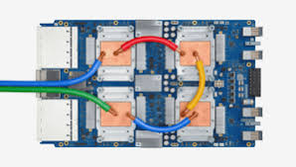
CSCB58: Computer Organization
Prof. Gennady Pekhimenko
University of Toronto
Fall 2020
The content of this lecture is adapted from the lectures of
Larry Zheng and Steve Engels

Slide 2
CSCB58 Week 1:
Summary

Slide 3
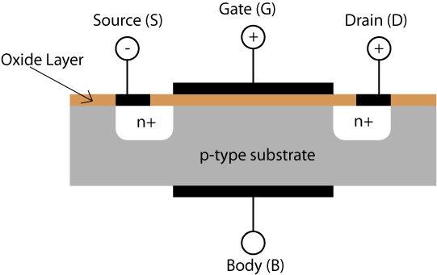
Week 1 Review
Properties of electricity
Semiconductor materials
Doping (n-type and p-type)
p-n junctions
Transistors
MOSFETs

Slide 4
The architecture of a computer hardware, level by level, bottom-up
Assembly Language
Processors
compute stuff
Arithmetic Logic Units
Finite State Machines
remember stuff
Devices
Flip-flops
Circuits
Gates
Transistors

Slide 5
Transistors

Slide 6
Outline of the story
Electricity, basic concepts
Insulators, conductors, in between …, Semiconductors
Impure semiconductors, p-type / n-type
Put p-type and n-type together -- pn-junction
Apply voltage to a pn-junction – principle of transistors
A real-world manufacturing of transistor -- MOSFET

Slide 7
Where do transistors fit?
Logic Gates
made from
Transistors
based on
pn-junctions
made from
Semiconductors
that conduct
Electricity

Slide 8
PN-junctions

Slide 9
Bringing p and n together
What happens if you brought some p-type material into contact with some n-type material?
The electrons at the surface of the n-type material are drawn to the holes in the p-type.
Si
Si
Si
Si
P
Si
Si
P
Si
Si
P
Si
-
-
-
n-type
Si
P
-
Si
Si
Si
Si
Si
Si
Si
Si
Si
P
-
Si
Si
Si
Si
Si
B
Si
Si
B
Si
Si
Si
p-type
-
-
-
Si
Si
-
B
Si
Si
Si
Si
B
-
Si
Si
Si
B

Slide 10
Electrons’ initial movement (attracted by holes)
Because lost electron
n-type
Si
Si
Si
Si
P
Si
Si
P
Si
Si
P
Si
-
-
-
Si
P
-
Si
Si
Si
Si
Si
Si
Si
Si
Si
P
-
Si
Si
Si
Si
Si
B
Si
Si
B
Si
Si
Si
-
-
-
Si
Si
-
B
Si
Si
Si
Si
B
-
Si
Si
Si
B
Because gained electron
p-type

Slide 11
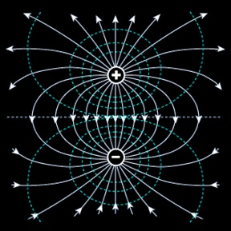
Diffusion increases the width of depletion layer, and drift draws it back. An equilibrium is reached, when the depletion layer is of a certain width.
“Diffusion”
Electrons’ initial movement (attracted by holes)
n-type
Electron’s movement drawn by the electric field
Electric field
p-type
“Drift”

Slide 12
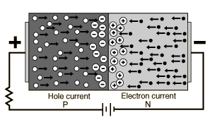
Summary of pn-junction
P
N
When we put p and n together, they will form a depletion layer with electric field in it.
The depletion layer grows up to a certain width, until equilibrium is reached.

Slide 13
Apply voltage to a PN-junction
It could be applied in two possible directions
Positive voltage to the P side
Positive voltage to the N side

Slide 14
Apply forward bias
Depletion layer narrower
Easier to travel through
Better conductivity
Like switch connected
Apply reverse bias
Depletion layer wider
Harder to travel through
Worse conductivity
Like switch disconnected
That’s how transistors work!

Slide 15
Metal Oxide Semiconductor Field Effect Transistor

Slide 16
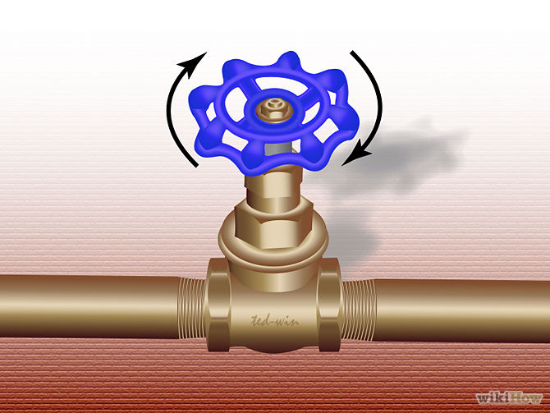
Gate
Source
Drain

Slide 17
Metal
Oxide
Insulator
Conductor, can apply electric charge to it
N-type
P-type
Semiconductors, doped
Source
Gate
Drain

Slide 18
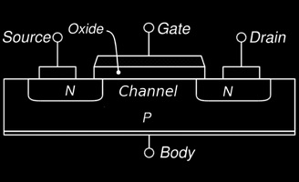
The MO of MOSFETs
Metal Oxide Semiconductor Field Effect Transistors are composed of a layer of semiconductor material, with two layers on top of the semiconductor:
An oxide layer that doesn’t conduct electricity,
A metal layer (called the gate), that can have an electric charge applied to it
These are the M and O components of MOSFETs.

Slide 19
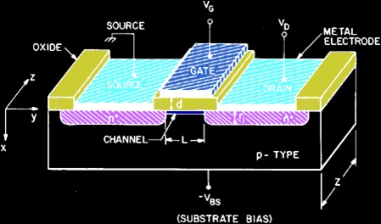
The S of MOSFETs
The semiconductor sections are two pockets of n-type material, resting on a substrate layer of p-type material.
A voltage is applied across the two n-type sections, called the drain and the source. No current will pass between them though, because the p section in between creates at least one reverse-biased pn junction.

Slide 20
Applying voltage to NPN
+ –
n
n
p
n
n
p
depletion layer
reverse biased
+ –
n
n
p
depletion layer

Slide 21
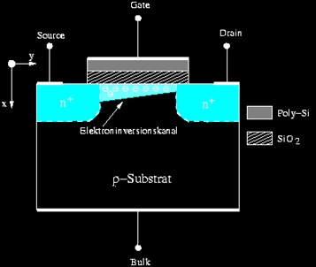
n-channel MOSFETs
However, when a voltage is applied between the source and the metal plate (the gate), positive charges are built up in the metal layer, which attracts a layer of negative charge to the surface of the p-type material.
This layer of electrons creates an n-type channel between the drain and the source, connecting the two and allowing current to flow between them.
the wider the channel, the higher the current

Slide 22
Applying voltage to NPN
Gate (metal layer over oxide layer)
+ –
+ –
+ –
n
n
n
+
+
+
+
+
+
+
n
p
p
-
-
-
-
-
-
-
-
-
-
-
-
-
reverse biased
n-type channel
n-type channel creates path between source and drain for current to conduct!

Slide 23
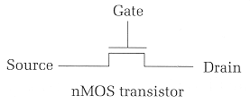
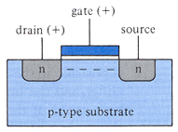
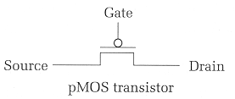
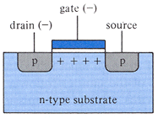
nMOS vs pMOS
Two types of MOSFETs exist, based on the semiconductor type in the drain and source, and the channel formed.
nMOS transistors (the design described so far) conduct electricity when a positive voltage (5V) is applied to the gate.
pMOS transistors (indicated by a small circle above the gate) conduct electricity (i.e., act as a closed switch) when the gate voltage is logic-zero.

Slide 24
Transistors to Logic Gates

Slide 25
Transistors to Gates
MOSFET Truth Table
MOSFETs can make current flow, based on the voltage values in the gate and drain.
i.e. the truth table on the right.
One final step: combining MOSFETS to create high and low voltage outputs, based on high and low voltage inputs.
General approach: create transistor circuits that make current flow to outputs from high or low voltage, based on transistor input values.
V_{DS} | V_{GS} | I_{DS}
Low | Low | Low
Low | High | Low
High | Low | Low
High | High | High

Slide 26
Create gates using a combination of transistors
V_{cc}
Physical data:
“High” input = 5V (aka V_{cc})
“Low” input = 0V
Switching time: ~20 picoseconds
Switching interval ~10 ns
A
Y
A
Y
NOT Gate

Slide 27
Transistors into gates
Note: Vcc = “Common Collector Voltage”
= high voltage (5 V)
V_{cc}
V_{cc}
V_{cc}
V_{cc}
V_{cc}
A
A
B
A
A
B
B
B
Y
Y
B
Y
A
B
A
A
A
B
B
AND
OR
XOR

Slide 28
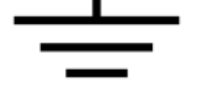
NAND is the most awesome logic gate
It’s cheaper to build
All other logic functions (AND, OR, …) can be implemented using only NAND, i.e., it is functionally complete
Challenge for home: implement AND, OR, NOT, XOR using only NAND.

Slide 29
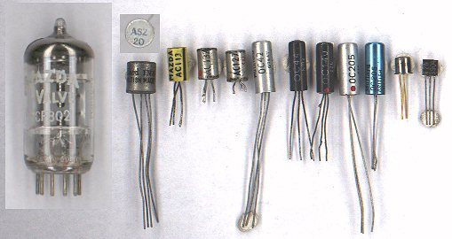
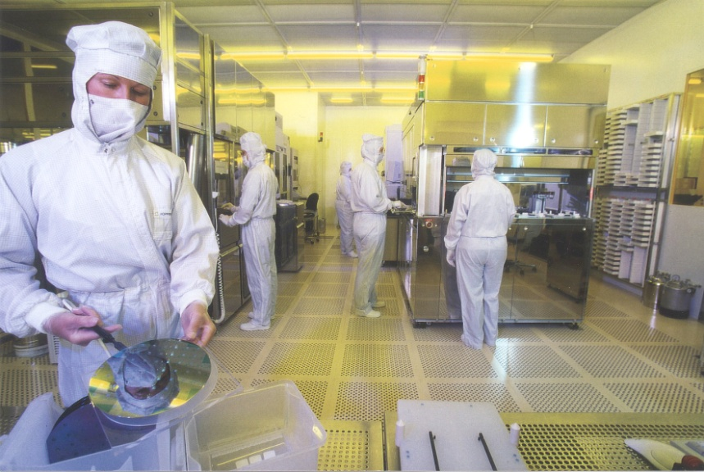
Transistor Fabrication
Transistors are not formed by pushing large chunks of n- and p-type semiconductors together.
Transistors are now made by bombarding silicon with doping substances to create the layers for each junction
Surface is oxidized in between stages to ensure that only the necessary sections are doped.

Slide 30
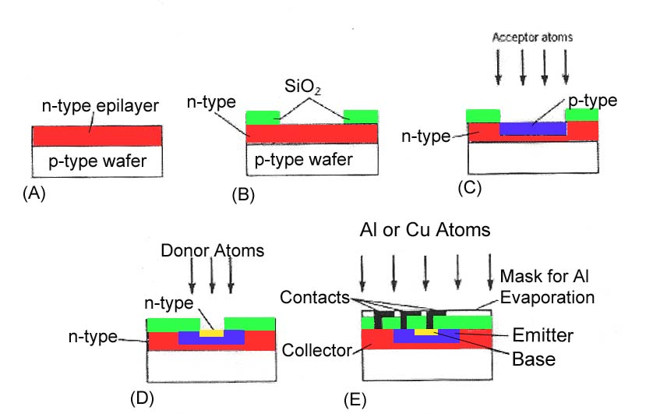
Fabrication Process

Slide 31
Example Questions

Slide 32
Short Answer Q’s
True or False? Doping gives a semiconductor an overall positive or negative charge.
What kind of bias on a pn junction causes the depletion layer to expand?
Phosphorus has 5 electrons in its outer valence shell. When added in small amounts to silicon, the result is a ___________ semiconductor.
False
Reverse bias
Doped or N-Type

Slide 33
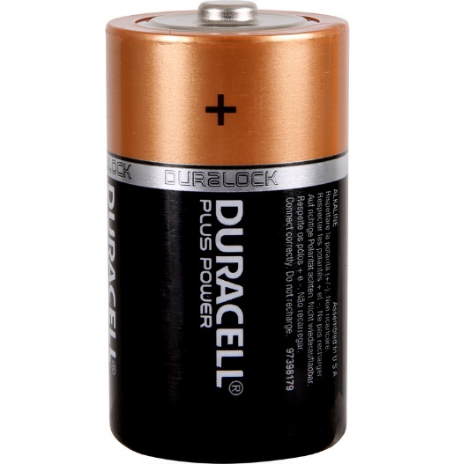
Electricity review
If electrons are traveling from the bottom of the battery to the top, which way is current said to be traveling?
Current is measured as the movement of positive charges.
current

Slide 34
Transistor review
transistors
Logic gates are built from
This transistor is called
It conducts (i.e., acts as a closed switch) if
we apply Volts (logic-1) at its gate.
This transistor is called
It conducts (i.e., acts as a closed switch,
if we apply Volts (logic-0 , Gnd) at its gate.
nMOS
5
pMOS
0

Slide 35
More Transistor Questions
What gate is created by the following?
Vcc
Vcc
Remember: transistors that look like
are activated
when the gate
input is high, whereas
transistors that look like
are activated
when the gate
input is low.
A
B
X
A
B

Slide 36
CSCB58: Computer Organization
Prof. Gennady Pekhimenko
University of Toronto
Fall 2020
The content of this lecture is adapted from the lectures of
Larry Zheng and Steve Engels

