Slide 1
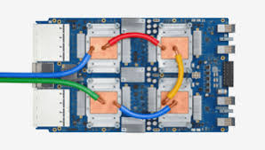
CSCB58: Computer Organization
Prof. Gennady Pekhimenko
University of Toronto
Fall 2020
The content of this lecture is adapted from the lectures of
Larry Zheng and Steve Engels

Slide 2
CSCB58 Week 12

Slide 3
Logistics
Exam details
90 mins over Quercus
Multiple choice, answers typed in, and writing on the paper -> upload image
Selective oral verification (after the exam) to avoid plagiarism

Slide 4
Resources
We ask that you restrict yourself to:
Materials linked from the course website (slides, reading guides, the textbook)
Our Zoom chat (for clarifications or if you have technical problems)
In particular, please don’t:
Frantically google or search stack overflow (you shouldn’t need them)
Discuss the exam with anyone (except your cat, if you must)

Slide 5
Types of questions
It’s a Quercus quiz, similar to what we had already (just longer)
In addition to conceptual questions, we could ask you to:
Analyze a combinational circuit (including transistor diagrams)
Design a combinational circuit
Analyze a sequential circuit (or waveform)
Design a sequential circuit or FSM

Slide 6
Types of questions (2)
Set signals on processor datapath
i.e., explain how an operation is performed on the processor
Translate assembly to machine code and vice versa
Write assembly code according to requirement
Translate between assembly and pseudocode (C-like)
Count hits in a cache
Calculate throughput on a pipelined processor

Slide 7
How to study for final exam
1. Review lecture slides
2. Review what you did for labs
3. Review quizzes
4. Whenever confused, ask on piazza or come to office hours

Slide 8
Exam tips
Pay attention to details
Don’t just skim over the slides and labs and “get the idea”.
Find a way to test yourself …
The quiz questions are the best examples of the questions we’ll use.
The questions in the textbook are the next best.
Identify a process for solving each kind of problem.
Ex: for assembly language questions, write in pseudocode and translate
Ex: for design questions, create a truth table, then go to a k-map

Slide 9
Let’s do some practice

Slide 10
Cache Parameters
128 B cache, 12-bit address, direct-mapped, 32 B blocks
#offset bits = log2(32) = 5
#sets = 128/32 = 4 sets
#set/index bits = log2(4) = 2
#tags bits = 12 - 5 – 2 = 5

Slide 11
Cache Parameters (example)
Example: 0x600
In binary: 0000 0110 0000
0000 0|11|0 0000
tag idx offset

Slide 12
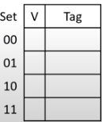
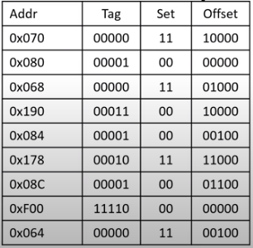
Cache Operation
1st
2nd
M
H
M
M
H
H
M
M
M
M
M
M
H
H
M
M
M
M

Slide 13
Cache Parameters - 2
128 B cache, 12-bit address, 2-way/LRU, 32 B blocks
#offset bits = log2(32) = 5
#sets = 128/(32*2) = 2 sets
#set/index bits = log2(2) = 1
#tags bits = 12 - 5 – 2 = 6

Slide 14
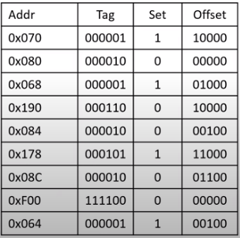
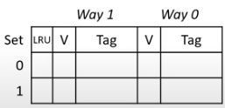
Cache Operation (yet again ;)
1st
2nd
M
H
M
H
H
H
M
M
H
H
M
H
H
H
M
M
H
H

Slide 15
K-Maps -> Truth table
A | B | C | D | Y
0 | 0 | 0 | 0
0 | 0 | 0 | 1
0 | 0 | 1 | 0
0 | 0 | 1 | 1
0 | 1 | 0 | 0
0 | 1 | 0 | 1
0 | 1 | 1 | 0
0 | 1 | 1 | 1
1 | 0 | 0 | 0
1 | 0 | 0 | 1
1 | 0 | 1 | 0
1 | 0 | 1 | 1
1 | 1 | 0 | 0
1 | 1 | 0 | 1
1 | 1 | 1 | 0
1 | 1 | 1 | 1
Y | C D | C D | C D | C D
A B | 1 | 1 | 0 | 1
A B | 0 | 1 | 0 | 0
A B | 0 | X | X | X
A B | 1 | 0 | 1 | 1
Fill in the truth table on the right, given the Karnaugh map values above.

Slide 16
K-Maps -> Truth table
A | B | C | D | Y
0 | 0 | 0 | 0 | 1
0 | 0 | 0 | 1 | 1
0 | 0 | 1 | 0 | 1
0 | 0 | 1 | 1 | 0
0 | 1 | 0 | 0 | 0
0 | 1 | 0 | 1 | 1
0 | 1 | 1 | 0 | 0
0 | 1 | 1 | 1 | 0
1 | 0 | 0 | 0 | 1
1 | 0 | 0 | 1 | 0
1 | 0 | 1 | 0 | 1
1 | 0 | 1 | 1 | 1
1 | 1 | 0 | 0 | 0
1 | 1 | 0 | 1 | X
1 | 1 | 1 | 0 | X
1 | 1 | 1 | 1 | X
Y | C D | C D | C D | C D
A B | 1 | 1 | 0 | 1
A B | 0 | 1 | 0 | 0
A B | 0 | X | X | X
A B | 1 | 0 | 1 | 1
Fill in the truth table on the right, given the Karnaugh map values above.

Slide 17
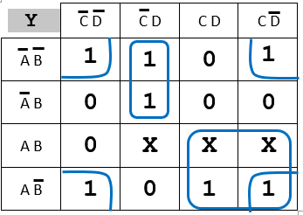
K-Maps -> Truth table
Y | C D | C D | C D | C D
A B | 1 | 1 | 0 | 1
A B | 0 | 1 | 0 | 0
A B | 0 | X | X | X
A B | 1 | 0 | 1 | 1
On the Karnaugh map above, draw the minterm groupings that would result in the most optimized circuit possible.

Slide 18
K-Maps -> Truth table
Y = B’D’ + A’C’D + AC
Write the Boolean equation for the optimized groupings.

Slide 19
Binary numbers: add/sub
Perform 10 – 17 in 6-bit binary numbers using 2’s complement.
Show each step of converting decimal to binary, converting to 2’s complement, performing the subtraction, then converting the result back to decimal.
001010 - 010001 =
= 001010 + 101111
= 111001
= -7

Slide 20
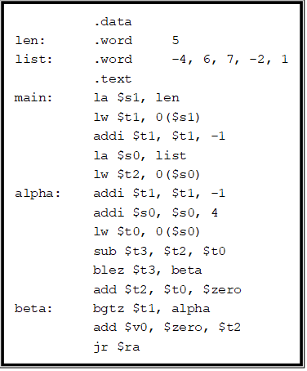
Decrypt assembly
Write the operation performed by an assembly program
Return the minimum item of an array

Slide 21
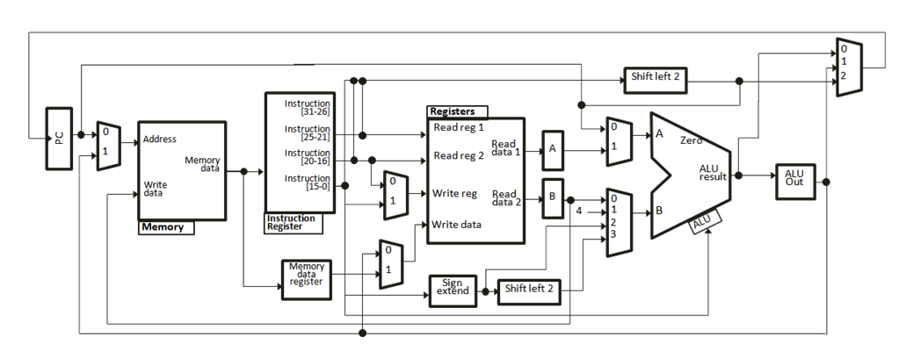
Datapath
Consider the datapaths below, highlight the path that the data needs to take, from start to finish:
Increment the program counter by the value in $s0.

Slide 22
Small Assembly
push $t: Push the value in $t onto the stack

Slide 23
CSCB58: Computer Organization
Prof. Gennady Pekhimenko
University of Toronto
Fall 2020
The content of this lecture is adapted from the lectures of
Larry Zheng and Steve Engels

