Slide 1
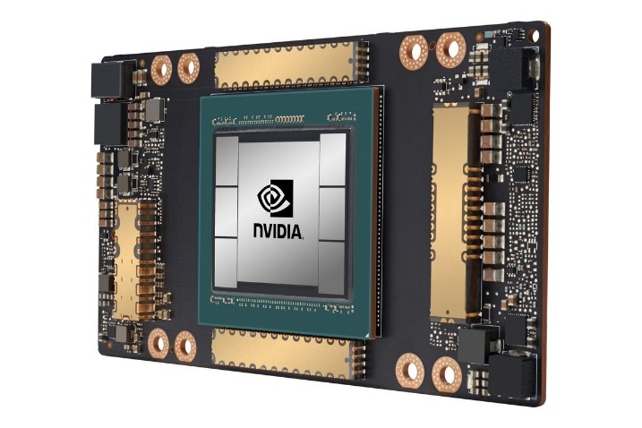
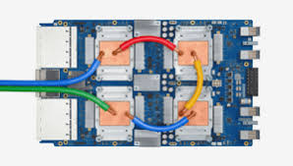
CSCB58: Computer Organization
Prof. Gennady Pekhimenko
University of Toronto
Fall 2020
The content of this lecture is adapted from the lectures of
Larry Zheng and Steve Engels

Slide 2
CSCB58 Week 12

Slide 3
Logistics
Next week’s lecture:
wrapping up and exam review
Exam details
90 mins over Quercus
Multiple choice, answers typed in, and writing on the paper -> upload image
Selective oral verification (after the exam) to avoid plagiarism

Slide 4
Recap
Function calls
Stack, push, pop

Slide 5
Next one
int factorial (int n) {
if (n == 0)
return 1;
else
return n * factorial(n-1);
}
Recursion!

Slide 6
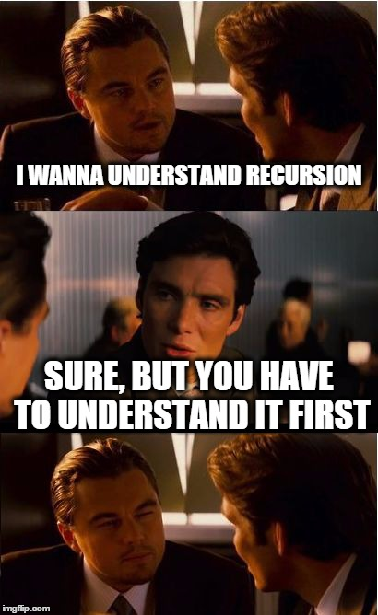
Recursion in Assembly what recursion really is in hardware

Slide 7
factorial(3)
p = 3 * factorial(2)
return p
int factorial(int n) {
if (n==0)
return 1;
else
return n*factorial(n-1);
}
factorial(2)
p = 2 * factorial(1)
return p
factorial(1)
p = 1*factorial(0)
return p
factorial (0)
p = 1 # Base!
return p

Slide 8
Before writing assembly, we need to know explicitly where to store values
int factorial (int n) {
if (n == 0)
return 1;
else
return n * factorial(n-1);
}
Need to store …
the value of n
the value of n – 1
the value factorial(n-1)
the return value: 1 or n*factorial(n-1)

Slide 9
Design decision #1: store values in registers
int factorial(int n) {
if (n==0)
return 1;
else
return n*fact(n-1);
}
Does it work?
store n in $t0
store n-1 in $t1
store factorial(n-1) in $t2
store return value in $t3

Slide 10
No, it doesn’t work.
factorial(3)
p = 3 * factorial(2)
return p
Store n=3 in $t0
factorial(2)
p = 2 * factorial(1)
return p
Store n=2 in $t0, the stored 3 is overwritten, lost!
factorial(1)
p = 1*factorial(0)
return p
factorial (0)
p = 1 # Base!
return p
Same problem for $t1, t2, t3
store n in $t0
store n-1 in $t1
store factorial(n-1) in $t2
store return value in $t3

Slide 11
A register is like a laundry basket -- you put your stuff there, but when you call another function (person), that person will use the same basket and take / mess up your stuff.
And yes, the other person will guarantee to use the same basket because …
the other person is YOU!
(because recursion)

Slide 12
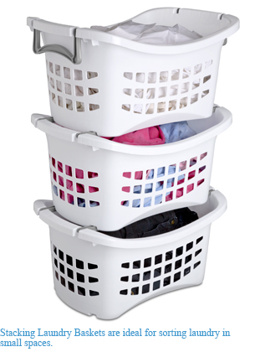
So the correct design decision is to use ________ .
Stack
Each recursive call has its own space for storing the values
Stores n=2 for factorial (2)
Stores n=3 for factorial (3)

Slide 13
Two useful things about stack
It has a lot of space
Its LIFO order (last in first out) is suitable for implementing recursions (function calls).

Slide 14
LIFO order & recursive calls
Note: Everybody is getting the correct basket because of LIFO!
factorial(2)
p = 2 * factorial(1)
return p
factorial(1)
p = 1*factorial(0)
return p
factorial (0)
p = 1 # Base!
return p
n = 0
n = 1
n = 2

Slide 15
Design decisions made,
now let’s actually write the assembly code

Slide 16
LIFO order & recursive calls
int x = 2;
int y = factorial(x)
print(y) # RA0
factorial(n=2)
r = factorial(1)
p = n * r; # RA1
return p # P2
factorial(n=1)
r = factorial(0)
p = n * r; # RA2
return p #P1
n = 0
P0 = 1
P1 = 1
RA2
RA1
RA0
factorial(n=0)
p = 1 # Base!
return p #P0
RA2
n = 1
n = 2
n = 0
P0 = 1
RA1
RA1
n = 1
n = 1
P1 = 1
RA0
RA0
RA0
n = 2
n = 2
n = 2
P2 = 2

Slide 17
Actions in factorial (n)
Before making the recursive call
pop argument n
push argument n-1 (arg for recursive call)
push return address (remember where to return)
make the recursive call
After finishing the recursive call
pop return value from recursive call
pop return address
compute return value
push return value (so the upper call can get it)
jump to return address

Slide 18
factorial(int n)
n → $t0
n-1 → $t1
fact(n-1) → $t2
Pop n off the stack
Store in $t0
If $t0 == 0,
Push return value 1 onto stack
Return to calling program
If $t0 != 0,
Push $t0 and $ra onto stack
Calculate n-1
Push n-1 onto stack
Call factorial
…time passes…
Pop the result of factorial (n-1) from stack, store in $t2
Restore $ra and $t0 from stack
Multiply factorial (n-1) and n
Push result onto stack
Return to calling program

Slide 19
factorial(int n)
n → $t0
n-1 → $t1
fact(n-1) → $t2
fact: lw $t0, 0($sp)
addi $sp, $sp, 4
bne $t0, $zero, not_base
addi $t0, $zero, 1
addi $sp, $sp, -4
sw $t0, 0($sp)
jr $ra
not_base: addi $sp, $sp, -4
sw $t0, 0($sp)
addi $sp, $sp, -4
sw $ra, 0($sp)
addi $t1, $t0, -1
addi $sp, $sp, -4
sw $t1, 0($sp)
jal fact
Pop n off the stack
Store in $t0
If $t0 == 0,
Push return value 1 onto stack
Return to calling program
If $t0 != 0,
Push $t0 and $ra onto stack
Calculate n-1
Push n-1 onto stack
Call factorial
Pop the result of factorial (n-1) from stack, store in $t2
Restore $ra and $t0 from stack
Multiply factorial (n-1) and n
Push result onto stack
Return to calling program
Note: codes on the slides are not guaranteed to be correct. You need to be able to find the errors and fix them.

Slide 20
factorial(int n)
n → $t0
n-1 → $t1
fact(n-1) → $t2
lw $t2, 0($sp)
addi $sp, $sp, 4
lw $ra, 0($sp)
addi $sp, $sp, 4
lw $t0, 0($sp)
addi $sp, $sp, 4
mult $t0, $t2
mflo $t3
addi $sp, $sp, -4
sw $t3, 0($sp)
jr $ra
Pop n off the stack
Store in $t0
If $t0 == 0,
Push return value 1 onto stack
Return to calling program
If $t0 != 0,
Push $t0 and $ra onto stack
Calculate n-1
Push n-1 onto stack
Call factorial
Pop the result of factorial (n-1) from stack, store in $t2
Restore $ra and $t0 from stack
Multiply factorial (n-1) and n
Push result onto stack
Return to calling program
Note: codes on the slides are not guaranteed to be correct. You need to be able to find the errors and fix them.

Slide 21
Recursive programs
Use of stack
Before recursive call, store the register values that you use onto the stack, and restore them when you come back to that point.
Store $ra as one of those values, to remember where each recursive call should return.
int factorial (int x) {
if (x==0)
return 1;
else
return x*factorial(x-1);
}

Slide 22
Translated recursive program (part 1)
main: addi $t0, $zero, 10 # call fact(10)
addi $sp, $sp, -4 # by putting 10
sw $t0, 0($sp) # onto stack
jal factorial # result will be
... # on the stack
factorial: lw $a0, 4($sp) # get x from stack
bne $a0, $zero, rec # base case?
base: addi $t0, $zero, 1 # put return value
sw $t0, 4($sp) # onto stack
jr $ra # return to caller
rec: addi $sp, $sp, -4 # store return
sw $ra, 0($sp) # addr on stack
addi $a0, $a0, -1 # x--
addi $sp, $sp, -4 # push x on stack
sw $a0, 4($sp) # for rec call
jal factorial # recursive call
Note: codes on the slides are not guaranteed to be correct. You need to be able to find the errors and fix them.

Slide 23
Translated recursive program (part 2)
(continued from part 1)
lw $v0, 0($sp) # get return value
addi $sp, $sp, 4 # from stack
lw $ra, 0($sp) # restore return
addi $sp, $sp, 4 # address value
lw $a0, 0($sp) # restore x value
addi $sp, $sp, 4 # for this call
mult $a0, $v0 # x*fact(x-1)
mflo $t0 # fetch product
addi $sp, $sp, -4 # push product
sw $t0, 0($sp) # onto stack
jr $ra # return to caller
Note: codes on the slides are not guaranteed to be correct. You need to be able to find the errors and fix them.
Note: jal always stores the next address location into $ra, and jr returns to that address.

Slide 24
Assembly doesn’t support recursion
Assembly programs are just a linear sequence of assembly instructions, where you jump to the beginning of the program over and over again…
Recursion comes from the stack
…while sensibly storing and retrieving remembered values from the stack

Slide 25
Factorial stack view
Recursion reaches base case call
Base case returns 1 on the stack
x:0
ret:1
After 3rd call to factorial
$ra #10
$ra #10
.
.
.
.
.
.
x:7
$ra #3
$ra #3
$ra #3
x:8
x:8
x:8
$ra #2
$ra #2
$ra #2
Recursion returns to top level
Initial call to factorial
x:9
x:9
x:9
$ra #1
$ra #1
$ra #1
x:10
x:10
x:10
x:10
ret:10!

Slide 26
You can recurse too much
The stack is NOT of infinite size, so there is always a limit on the number of recursive calls that you can make.
When exceeds that limit, you get a stack overflow, all content of the stack will be dumped.

Slide 27
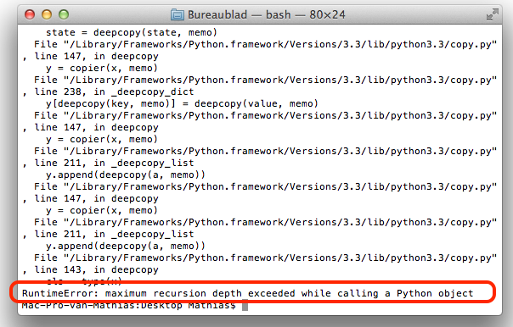

Slide 28
Supporting Recursion in General
The process we’ve defined is ad hoc
We stored an argument on the stack. We saved the RA register.
But how do you support recursion generally?
You must know the signature of the function you’re calling. The number of arguments is key so that you how many things to pop from the stack.
This is why C has function prototypes.
You need to store the values of all of the registers that you use.

Slide 29
Optimization: Caller and Callee Saves
To reduce the number of registers that need to be saved, MIPS uses caller save and callee save registers.
The t registers are caller save: if you are using them and want to keep the value, save it before calling the function.
The s registers are callee save: if you want to use them, you should save the values before using them.
What advantage does this scheme have?

Slide 30
Interrupts and Exception

Slide 31
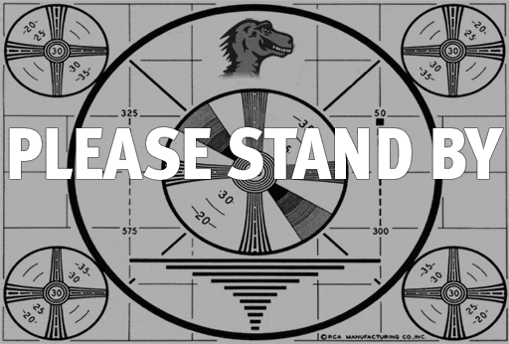
A note on interrupts
Interrupts take place when an external event requires a change in execution.
Example: arithmetic overflow, system calls (syscall), Ctrl-C, undefined instructions.
Usually signaled by an external input wire, which is checked at the end of each instruction.
High priority, override other actions

Slide 32
A note on interrupts
Interrupts can be handled in two general ways:
Polled handling: The processor branches to the address of interrupt handling code (interruption handler), which begins a sequence of instructions that check the cause of the exception, i.e., need to ask around to figure out what type of exception.
→ This is what MIPS uses (syscall → CPU checks v0, etc)
Vectored handling: The processor can branch to a different address for each type of exception. Each exception address is separated by only one word. A jump instruction is placed at each of these addresses for the handler code for that exception. So no need to ask around.

Slide 33
Interrupt Handling
In the case of polled interrupt handling, the processor jumps to exception handler code, based on the value in the cause register (see table).
If the original program can resume afterwards, this interrupt handler returns to program by calling rfe instruction.
Otherwise, the stack contents are dumped and execution will continue elsewhere.
The above happens in kernel mode.
0 (INT) | external interrupt.
4 (ADDRL) | address error exception (load or fetch)
5 (ADDRS) | address error exception (store).
6 (IBUS) | bus error on instruction fetch.
7 (DBUS) | bus error on data fetch
8 (Syscall) | Syscall exception
9 (BKPT) | Breakpoint exception
10 (RI) | Reserved Instruction exception
12 (OVF) | Arithmetic overflow exception

Slide 34
Interrupt Handling
The exception handler is just assembly code.
just like any other function
… but it must NOT cause an error! (There is no one to handle it)
One particularly useful error handler
In the old days, error handling code useful take up 80% of the OS code.
Many error handlings were later unified into one way
General solution: ”kernel panic” -- dump information and ask human to reboot the computer.

Slide 35
Parallelism

Slide 36
Parallelism
Parallelism is the idea that you can derive benefit from completing multiple tasks simultaneously.

Slide 37
Performance
When we discuss performance, we often consider the following two metrics:
Latency: the length of time required to perform an operation.
How long it takes to travel from A to B on Highway 401
More about a single task. We learned about the timing analysis.
Throughput: the number of operations that can be completed within a unit of time.
How many cars arrive at B from A via Highway 401 per hour
More about multiple tasks.
Think about how your computer’s graphics card work. It tries to process many pixels simultaneously.

Slide 38
Types of Parallelism in Hardware
Spatial: Completing the same task multiple times at the same time.
Temporal (pipelined): Breaking a task into pieces, so that multiple different instructions can be in process at the same time.
Don’t confuse this with locality!

Slide 39
Spatial Parallelism

Slide 40
Temporal Parallelism

Slide 41
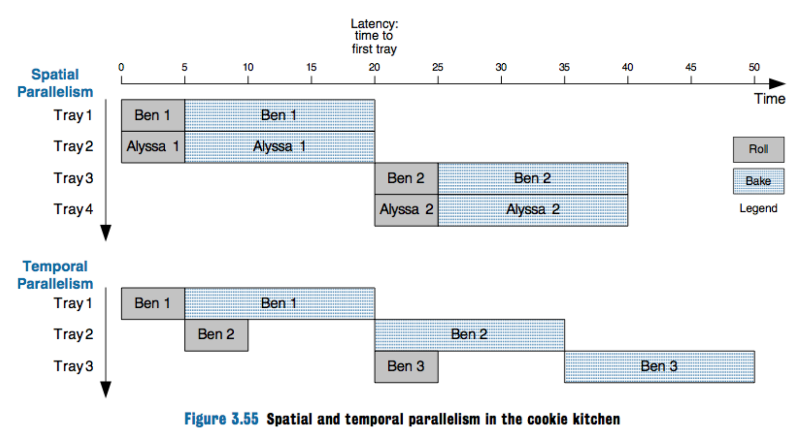
Spatial vs Temporal Parallelism (pic from DDCA)

Slide 42
Pipelined Microarchitectures

Slide 43
Review: Executing a Program
First, load the program into memory.
Set the program counter (PC) to the first instruction in memory and set the SP to the first empty space on the stack
Let instruction fetch/decode do the work! The processor can control what instruction is executed next.
When the process needs support from the operating system (OS), it will “trap” (“throw an exception”)

Slide 44
Execution Stages
Fetch: Updating the PC and locating the instruction to execute.
Decode: Translating the instruction and reading inputs from the register file.
Execute / Address Computation: Using the ALU to compute an operation or calculate an address.
Memory Read or Write: Memory operations must access memory. Non-memory operations skip this.
Register Writeback: The result is written to the register file.

Slide 45
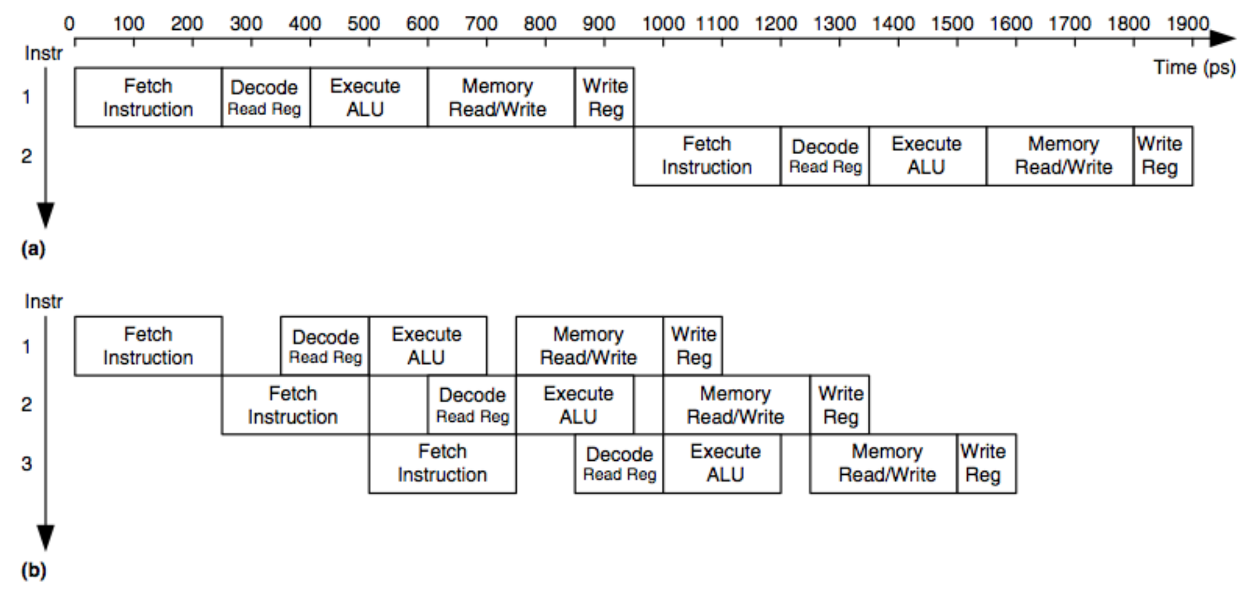
Pipelining the Execution Stages
without pipelining
latency: 950 ps
throughput: 1 instr. per 950 ps = ~1 billion / sec
Fixed-length stages
latency: 5 x 250 = 1250 ps
throughput: 1 instr. per 250 ps = ~4 billion / sec
with pipelining

Slide 46
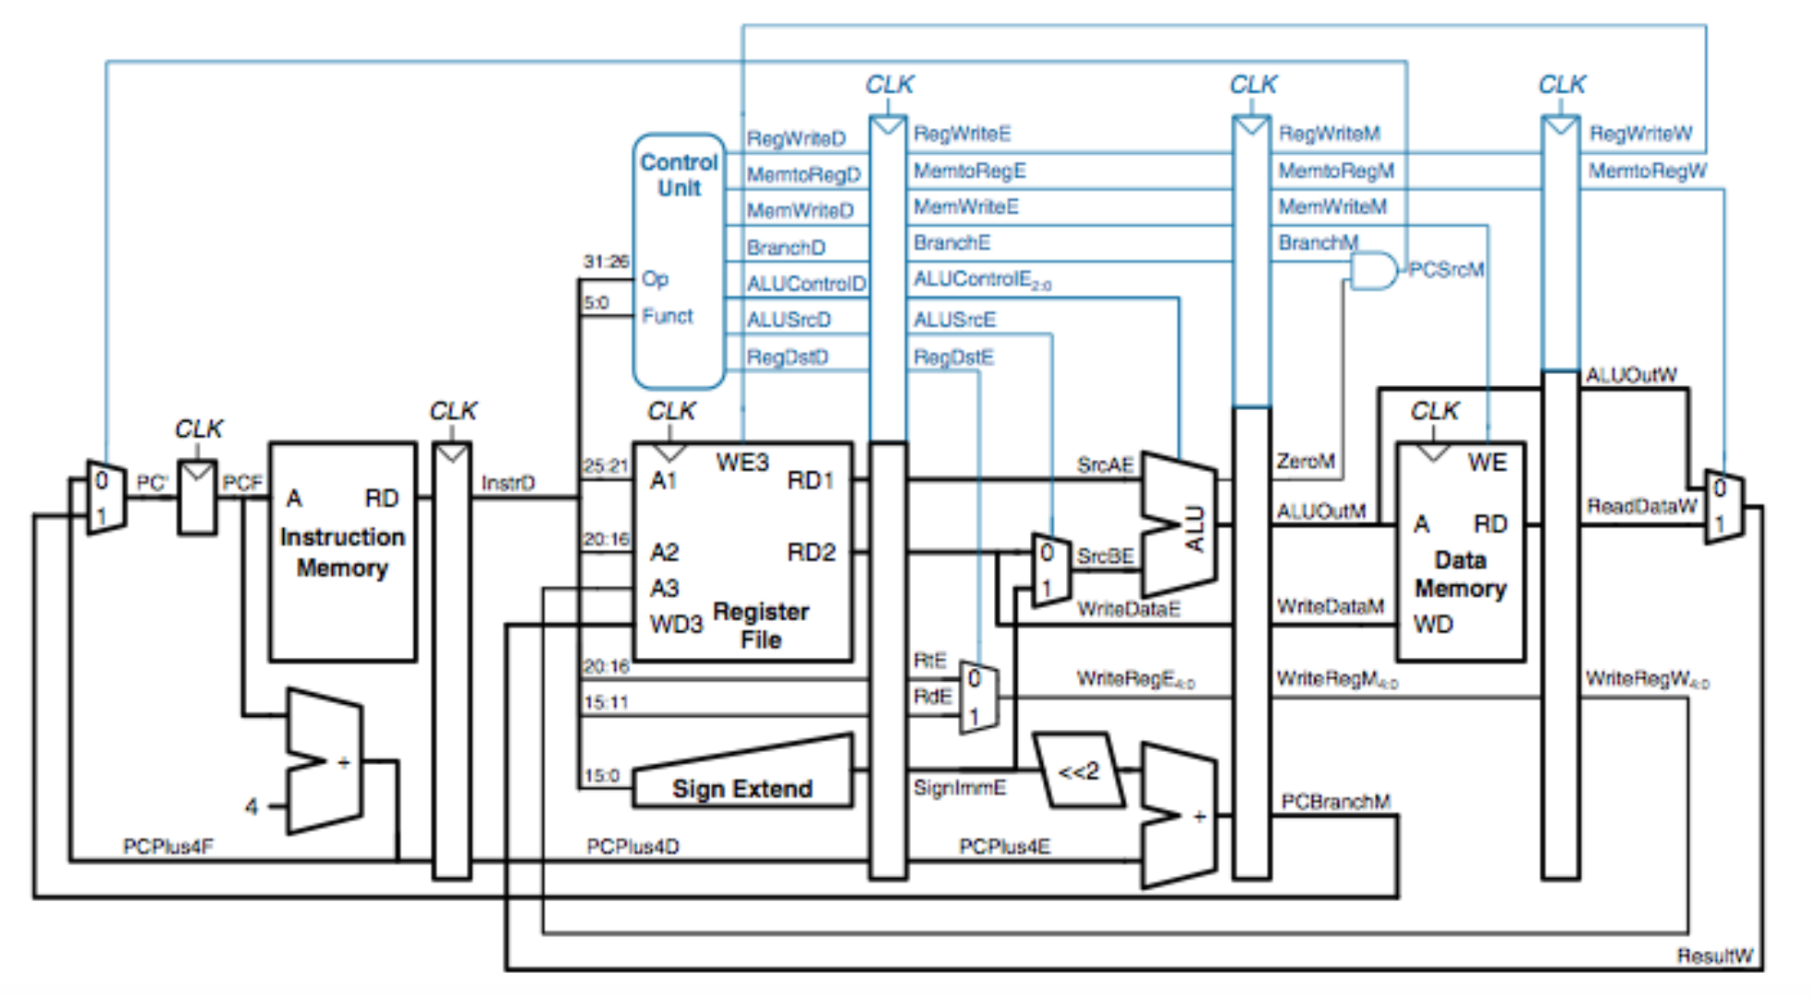
Pipelined Datapath
stages separated by pipeline registers

Slide 47
Hazard
What happens if an instruction needs a value that has not been computed?
This is a data hazard.
Example: $t0 += 2 followed by $t0 += 3
What if an instruction is changing the PC? Shouldn’t it complete before we fetch another instruction?
This is a control hazard
can happen when branching or jumping.

Slide 48
Mitigating Hazards
Data forwarding: a. k. a bypassing, values are available before they are written back, i.e., after the execute stage, results are available, and they can be forwarded to the stage that needs them.
Don’t wait until MEM READ/WRITE or WRITE REG to finish!
Requires some additional wiring in the CPU
Stalls: Sometimes, you just have to wait.
A stall (or no-op) keeps a pipeline stage from doing anything.

Slide 49
Stalls and Performance
Stalls throttle performance.
Sometimes, we can predict a result.
e.g., branch prediction
If we’re correct, then we get a performance win.
If we’re wrong, we “drop” the instruction that is using predicted values, and we’re almost no worse off.
Prediction is big business. It consumes a huge amount of the chip.

Slide 50
Summary: Pipelining
The pipelined design traded space for time: it added additional hardware to increase throughput.

Slide 51
CSCB58: Computer Organization
Prof. Gennady Pekhimenko
University of Toronto
Fall 2020
The content of this lecture is adapted from the lectures of
Larry Zheng and Steve Engels

