Slide 1
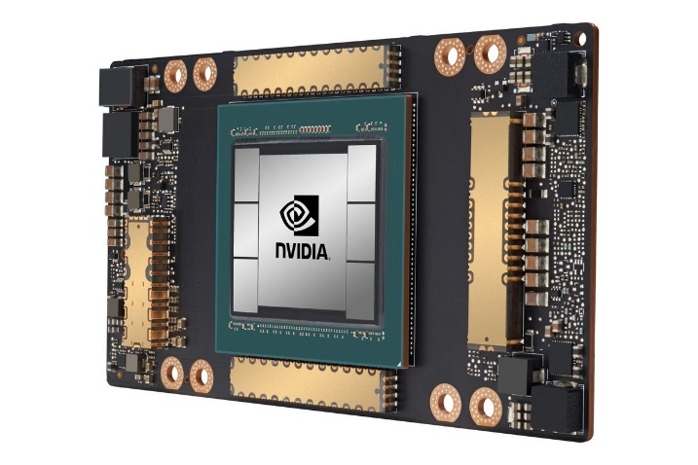
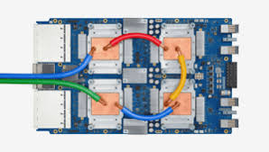
CSCB58: Computer Organization
Prof. Gennady Pekhimenko
University of Toronto
Fall 2020
The content of this lecture is adapted from the lectures of
Larry Zheng and Steve Engels

Slide 2
CSCB58 Week 10

Slide 3
Recap
We started learning about assembly, instruction by instruction
Arithmetic operations
Logical operations
Branching
Jump
Comparison
How to implement if-else and loops

Slide 4
Only a few more instructions left!

Slide 5
Memory access
System calls

Slide 6
Interacting with memory
All of the previous instructions perform operations on registers and immediate values.
What about memory?
All programs must fetch values from memory into registers, operate on them, and then store the values back into memory.
Memory operations are I-type, with the form:
lw $t0, 12($s0)
Register storing base address of data value in memory
Load or store
Local data register
Offset from memory address

Slide 7
Quick reminder
Word: 4-byte
Half-word: 2-byte
Byte: 1-byte

Slide 8
Load & store instructions
Instruction | Opcode/Function | Syntax | Operation
lb | 100000 | $t, i ($s) | $t = SE (MEM [$s + i]:1)
lbu | 100100 | $t, i ($s) | $t = ZE (MEM [$s + i]:1)
lh | 100001 | $t, i ($s) | $t = SE (MEM [$s + i]:2)
lhu | 100101 | $t, i ($s) | $t = ZE (MEM [$s + i]:2)
lw | 100011 | $t, i ($s) | $t = MEM [$s + i]:4
sb | 101000 | $t, i ($s) | MEM [$s + i]:1 = LB ($t)
sh | 101001 | $t, i ($s) | MEM [$s + i]:2 = LH ($t)
sw | 101011 | $t, i ($s) | MEM [$s + i]:4 = $t
“b”, “h” and “w” correspond to “byte”, “half word” and “word”, indicating the length of the data.
LB: lowest byte; LH: lowest half word

Slide 9
Examples
lh $t0, 12($s0)
Load a half-word (2 bytes) starting from MEM($s0 + 12),
sign-extend it to 4 bytes, and store in $t0
sb $t0, 12($s0)
Take the lowest byte of the word stored in $t0,
store it to memory starting from address $s0 + 12

Slide 10
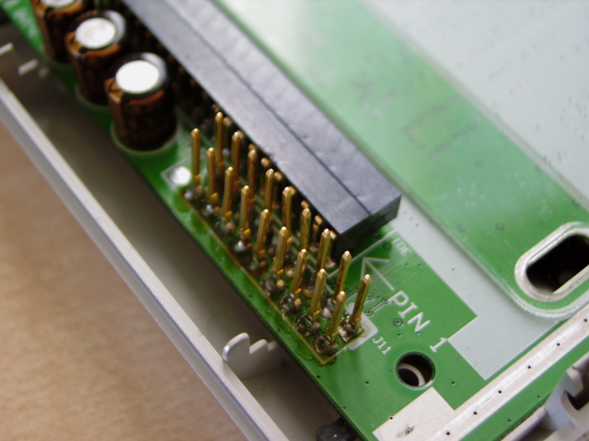
A bit more about memory
The base + offset style is useful for arrays or stack parameters, when multiple values are needed from a given memory location.
Memory is also used to communicate with outside devices, such as keyboards and monitors.
Known as memory- mapped IO.
Can be used with polling or with traps (interrupts)

Slide 11
Traps
A trap is a mechanism to pass control from your program to the kernel.
In case of exceptions (arithmetic overflow) or interrupts (from I/O) special kernel handlers are called.
A syscall is a type of trap that is voluntarily called.
More on interrupts / exceptions next week…

Slide 12
System calls
$4 is $a0, $2 is $v0
Service | Syscall code ($v0) | Input/Output
print_int | 1 | $4 is int to print
print_float | 2 | $f12 is float to print
print_double | 3 | $f12 (with $f13) is double to print
print_string | 4 | $4 is address of ASCIIZ string to print
read_int | 5 | $2 is int read
read_float | 6 | $f12 is float read
read_double | 7 | $f12 (with $f13) is doubleread
read_string | 8 | $4 is address of buffer, $5 is buffer size in bytes
sbrk | 9 | $4 is number of bytes required, $2 is address of allocated memory
exit | 10
The syscall command traps and gives control to the operating system to perform some actions
e.g. interacting with the user, and exiting the program.
Use registers $a0 and $v0 to pass arguments
... And more services for different environments

Slide 13
syscall example
li $v0, 4 # $v0 stores syscall number, 4 is print_string
la $a0, promptA # $a0 stores the address of the string to print
syscall # check $v0 and $a0 and act accordingly

Slide 14
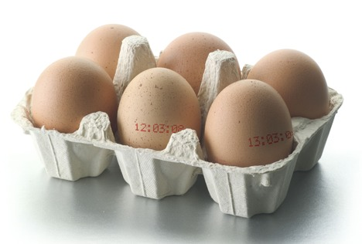
Arrays and Structs

Slide 15
Data storage
At the beginning of the program, create labels for memory locations that are used to store values.
Always in form: label type value
.data
# create a single integer variable with initial value 3
var1: .word 3
# create a 4-element integer array
array0: .word 3, 7, 5, 42
# create a 2-element character array with elements
# initialized to a and b
array1: .byte 'a’, 'b'
# allocate 40 consecutive bytes, with uninitialized
# storage. Could be used as a 40-element character array, # or a 10-element integer array.
array2: .space 40

Slide 16
Integer type (int): 4 byte
Character type (char): 1 byte

Slide 17
Arrays!
int A[100], B[100];
for (i=0; i<100; i++) {
A[i] = B[i] + 1;
}
Arrays in assembly language:
The address of the first element of the array is used to store and access the elements of the array.
To access an element of the array, get the address of that element by adding an offset distance to the address of the first element.
offset = array index * the size of a single element
Arrays are stored in memory. For operations on them, fetch the array values and store them in registers. Operate on them, then store them back into memory.

Slide 18
int A[100];
A[0] | A[1] | A[2] | A[3] | A[4] | …
Offset = 4 x 4 bytes = 16 bytes
Address of A[4] = Address of A[0] + 16 (bytes)

Slide 19
Translate this to assembly
int A[100], B[100];
for (i=0; i<100; i++) {
A[i] = B[i] + 1;
}

Slide 20
Making sense of assembly code
The key to reading and designing assembly code is recognizing portions of code that represent higher-level operations that you’re familiar with.

Slide 21
int A[100], B[100];
for (i=0; i<100; i++) {
A[i] = B[i] + 1;
}
Initialization:
Allocate space
Initial value i=0 (offset), put into a register
Put value size (400) in register
Put addresses of A, B into register
The loop:
Put addrs of A[i] and B[i] into registers ( addr(A)+offset ).
Load B[i] from mem, then +1, keep result in a register
Store result into mem A[i]
Update i++
Check loop condition and jump
.data
A: .space 400
B: .space 400
.text
main: add $t0, $zero, $zero
addi $t1, $zero, 400
la $t8, A
la $t9, B
loop: add $t4, $t8, $t0
add $t3, $t9, $t0
lw $s4, 0($t3)
addi $t6, $s4, 1
sw $t6, 0($t4)
addi $t0, $t0, 4
bne $t0, $t1, loop
end:

Slide 22
Code with comments
int A[100], B[100];
for (i=0; i<100; i++) {
A[i] = B[i] + 1;
}
.data
A: .space 400 # array of 400 bytes (100 ints)
B: .space 400 # array of 400 bytes (100 ints)
.text
main: add $t0, $zero, $zero # load “0” into $t0
addi $t1, $zero, 400 # load “400" into $t1
la $t9, B # store address of B
la $t8, A # store address of A
loop: add $t4, $t8, $t0 # $t4 = addr(A) + i
add $t3, $t9, $t0 # $t3 = addr(B) + i
lw $s4, 0($t3) # $s4 = B[i]
addi $t6, $s4, 1 # $t6 = B[i] + 1
sw $t6, 0($t4) # A[i] = $t6
addi $t0, $t0, 4 # $t0 = $t0++
bne $t0, $t1, loop # branch back if $t0<400
end:

Slide 23
Structs

Slide 24
Example: A struct program
How can we figure out the main purpose of this code?
The sw lines indicate that values in $t1 are being stored at $t0, $t0+4 and $t0+8.
Each previous line sets the value of $t1 to store.
Therefore, this code stores the values 5, 42 and 12 into the struct at location a1.
.data
a1: .space 12
.text
main: la $t0, a1
addi $t1, $zero, 5
sw $t1, 0($t0)
addi $t1, $zero, 42
sw $t1, 4($t0)
addi $t1, $zero, 12
sw $t1, 8($t0)

Slide 25
Example: A struct program
.data
a1: .space 12
.text
main: la $t0, a1
addi $t1, $zero, 5
sw $t1, 0($t0)
addi $t1, $zero, 42
sw $t1, 4($t0)
addi $t1, $zero, 12
sw $t1, 8($t0)
struct foo {
int a;
int b;
int c;
};
struct foo x;
x.a= 5;
x.b = 42;
x.c = 12;

Slide 26
Struct program with comments
struct foo {
int a;
int b;
int c;
};
struct foo x;
x.a= 5;
x.b = 42;
x.c = 12;
.data
a1: .space 12 # declare 12 bytes
# of storage to hold
# struct of 3 ints
.text
main: la $t0, a1 # load base address
# of struct into
# register $t0
addi $t1, $zero, 5 # $t1 = 5
sw $t1, 0($t0) # first struct
# element set to 5;
# indirect addressing
addi $t1, $zero, 42 # $t1 = 42
sw $t1, 4($t0) # second struct
# element set to 42
addi $t1, $zero, 12 # $t1 = 12
sw $t1, 8($t0) # third struct
# element set to 12

Slide 27
Caveat: alignment
struct foo {
int a;
char b;
int c;
};
struct foo x;
x.a= 5;
x.b = ‘B’;
x.c = 12;
Suppose b is a char (one byte), then it looks like that the address of c would be $t0 + 5.
But this may not work because MIPS by default requires store addresses to be aligned based on data size, i.e., address must be a multiple of 4 for a word, 2 for a half word, etc.
.data
a1: .space 12
.text
main: la $t0, a1
addi $t1, $zero, 5
sw $t1, 0($t0)
addi $t1, $zero, ‘B’
sb $t1, 4($t0)
addi $t1, $zero, 12
sw $t1, 5($t0)
ERROR

Slide 28
Function calls

Slide 29
Another example:
Function arguments!
A function!
int sign (int i) {
if (i > 0)
return 1;
else if (i < 0)
return -1;
else
return 0;
}
int x, r;
x = 42;
r = sign(x);
r = r + 1;
…
Return!

Slide 30
Function arguments
int sign (int i) {
if (i > 0)
return 1;
else if (i < 0)
return -1;
else
return 0;
}
int x, r;
x = 42;
r = sign(x);
r = res + 1;
…
Where are the function arguments stored?
They are stored at a certain location in the memory,
which is call the stack.
Other conventions are also possible, i.e., store first 4 arguments in $a0~$a3, the rest in the stack

Slide 31
Note
Because assembly programmers have so much control over how things are done at the low level, there are always multiple ways of implementing a feature.
We need to define a convention of how function arguments and return values are passed between functions, etc, so all programmers working on the same project are on the same page.
There can be many different version of the conventions.

Slide 32
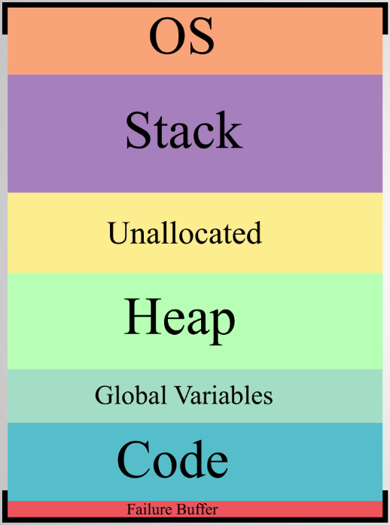
Note: stack grows backwards, i.e., when stack pointer (top) decreases, stack becomes bigger; when stack pointer increase, stack becomes smaller.
Memory model: a quick look
High address
Stack grows this way (going low)
If they collide
Heap grows this way (going high)
Low address

Slide 33
Function arguments
Why keep the arguments in memory instead of registers?
Because there aren’t enough registers for this
One function may have many arguments
If function calls subroutines, all subroutines’ arguments need to be remembered. (can’t forget until function returns)
int sign (int i) {
if (i > 0)
return 1;
else if (i < 0)
return -1;
else
return 0;
}
int x, r;
x = 42;
r = sign(x);
res = r + 1;
…

Slide 34
Note
You can use the registers to store function arguments if you know you have enough registers to do so (e.g., one single-argument function with no subroutines).
An assembly programmer makes this type of design decisions and can do whatever they want.
For high-level language programmers, the complier makes this type of decisions for them.

Slide 35
How to access stack?
The address of the “top” of the stack is stored in this register -- $sp
PUSH value in $t0 into stack
addi $sp, $sp, -4 # move stack pointer to make space
sw $t0, 0($sp) # push a word onto the stack
POP a value from stack and store in $t0
lw $t0, 0($sp) # pop a word from the stack
addi $sp, $sp, 4 # update stack pointer, stack size smaller

Slide 36
The Stack
Low address
Address 0
Address 1
Stack Pointer
Stack grows this way
Stack
Address N
High address
Byte
Notes:
The stack pointer is a register that points to the next free spot at the top of the stack.
The stack grows towards smaller addresses
LIFO behaviour -> last in, first out.

Slide 37
Pushing Values to the stack
Byte
Low address
addi $sp, $sp, -4
sw $t0, 0($sp)
Stack
Stack grows this way
4 bytes Pushed
sp
Stack
High address
Notes:
Correct implementation in assembly:
addi $sp, $sp, -4
sw $t0, 1(sp)
Or alternatively
sw $t0, -3(sp)
addi $sp, $sp, -4

Slide 38
Popping Values off the stack
Byte
lw $t0, 0($sp)
addi $sp, $sp, 4
Low address
Stack grows this way
sp
Stack
4 bytes Popped
High address
Notes:
Correct implementation in assembly
lw $t0, 1($sp)
addi sp, sp, 4
Or alternatively
addi $sp, $sp, 4
lw $t0, -3($sp)

Slide 39
Return value/address
How do we pass the return value to the caller?
Answer: let’s use the stack.
Where do we keep the return address?
Answer: let’s use $ra register.
To return: jr $ra
int sign (int i) {
if (i > 0)
return 1;
else if (i < 0)
return -1;
else
return 0;
}
int x, r;
x = 42;
r = sign(x);
res = r + 1;
…
This is a design choice, NOT the only way to do it

Slide 40
The whole story: “when Caller calls Callee”
Caller pushes arguments to the stack
Caller stores return address to $ra
Callee invoked, pop arguments from stack
Callee computes the return value
Callee pushes the return value into the stack
Jump to return addressed stored in $ra
Caller pops return value from the stack.
Move on to next line…
int sign (int i) {
if (i > 0)
return 1;
else if (i < 0)
return -1;
else
return 0;
}
int x, r;
x = 42;
r = sign(x);
res = r + 1;
…

Slide 41
Now, ready to translate the code
.text
sign: lw $t0, 0($sp)
addi $sp, $sp, 4
bgtz $t0, gt
beq $t0, $zero, eq
addi $t1, $zero, -1
j end
gt: addi $t1, $zero, 1
j end
eq: add $t1, $zero, $zero
end: addi $sp, $sp, -4
sw $t1, 0($sp)
jr $ra
int sign (int i) {
if (i > 0)
return 1;
else if (i < 0)
return -1;
else
return 0;
}
Callee invoked, pop arguments from stack
Callee computes the return value
Callee pushes the return value into the stack
Jump to return addressed stored in $ra
Caller get return value from the stack.

Slide 42
Code with comments
.text
sign: lw $t0, 0($sp) # pop arg i from
addi $sp, $sp, 4 # the stack
bgtz $t0, gt # if ( i > 0)
beq $t0, $zero, eq # if ( i == 0)
addi $t1, $zero, -1 # i < 0, return value = -1
j end # jump to return
gt: addi $t1, $zero, 1 # i > 0, return value = 1
j end # jump to return
eq: add $t1, $zero, $zero # i == 0, return value = 0
end: addi $sp, $sp, -4 # push return value to
sw $t1, 0($sp) # the stack
jr $ra # return

Slide 43
Insights
When we make multiple levels of function calls, the return address also need to be stored on stack, since the deeper level function call will overwrite the $ra registers. You will experience this in Lab 10.
Before calling a function all temporary register values need to be pushed to the stack, too. After returning from the called function, you restored the register values from the stack and continue using them. This also cost time.
int foo() {
int i, j;
i=5
j=6+i;
# save temps to stack
bar();
# restore from stack
i++;
printf(“%d %d”, i, j);
}

Slide 44
Insights
What we did is based on one function call convention that we defined, there could be other conventions.
Function calls don’t happen for free, it involves manipulating the values of several registers, and accessing memory.
All of these have performance implications.
Why “inline functions” are faster? Because the the callee assembly code is inline with the the caller code (callee code is copied to everywhere its called, rather than at a different location), so no need to jump, i.e., no stack and $ra manipulations needed.
Now you really understand when to use inline, and when not to.

Slide 45
Insights
# NAIVE
L = [……]
counter = 0
for x in L:
if x % 2 == 1:
counter +=1
return counter
# BETTER
L = [……]
counter = 0
for x in L:
counter += (x % 2)
return counter

Slide 46
Insights
Branching or jumping is in general less efficient than linear execution.
Modern processors do prefetching, i.e., while you are executing a line of instruction, the next line is already loaded from memory before you’re sure that’s the next line to execute.
This is made possible by using a pipelined architecture which enables parallelism
It’s a speed boost, but it’d be wasted if you branch to a line different from the next line.
More advance modern processors have branch predictors, which try to guess which way the branch goes before it’s known for sure.
Most modern branch predictors have > 90% accuracy.
Pro performance tip: know how your branch predictor works, and write your code in such a way that the branch prediction is more likely to be correct.

Slide 47
i = 0
while i < 1000:
print(i)
i += 1
print(i)
i += 1
print(i)
i += 1
print(i)
i += 1
print(i)
i += 1
print(i)
i += 1
print(i)
i += 1
print(i)
i += 1
print(i)
i += 1
print(i)
i += 1
Which performs better?
i = 0
while i < 10000:
print(i)
i += 1

Slide 48
People who are really serious about software should make their own hardware.
-- Steve Jobs quoting Alan Kay

Slide 49
Practice for home: String function
int strcpy (char x[], char y[]) {
int i;
i=0;
while ((x[i] = y[i]) != `\0’)
i += 1;
return i;
}

Slide 50
Translated string program
strcpy: lw $a0, 0($sp) # pop x address
addi $sp, $sp, 4 # off the stack
lw $a1, 0($sp) # pop y address
addi $sp, $sp, 4 # off the stack
add $s0, $zero, $zero # $s0 = offset i
L1: add $t1, $s0, $a0 # $t1 = x + i
lb $t2, 0($t1) # $t2 = x[i]
add $t3, $s0, $a1 # $t3 = y + i
sb $t2, 0($t3) # y[i] = $t2
beq $t2, $zero, L2 # y[i] = ‘/0’?
addi $s0, $s0, 1 # i++
j L1 # loop
L2: addi $sp, $sp, -4 # push i onto
sw $s0, 0($sp) # top of stack
jr $ra # return
initialization
main algorithm
end

