Slide 1
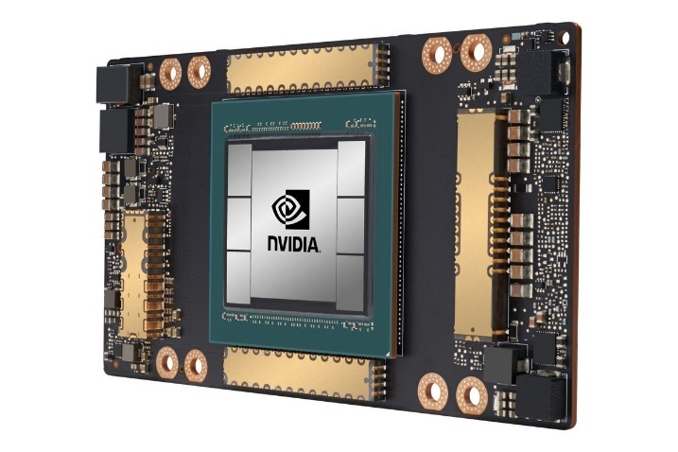
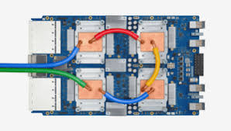
CSCB58: Computer Organization
Prof. Gennady Pekhimenko
University of Toronto
Fall 2020
The content of this lecture is adapted from the lectures of
Larry Zheng and Steve Engels

Slide 2
CSCB58 Week 10

Slide 3
Logistics
The Assembly Programming Project will be posted next week, due end of the term.
Project logistics:
Done individually
Results are reported in two stages (50% each)
Submission on Quercus by the start of the lab
No separate prelab report, just your code

Slide 4
We are here
Assembly Language
Processors
Arithmetic Logic Units
Finite State Machines
Devices
Flip-flops
Circuits
Gates
Transistors

Slide 5
Programming the processor
Things to learn:
Control unit signals to the datapath
Machine code instructions
Assembly language instructions
Programming in assembly language

Slide 6
How things fit together
Assembly Language
converted to
Machine Code
extract first 6 bits
Opcode
input to
Control Unit
produces
Datapath Signals

Slide 7
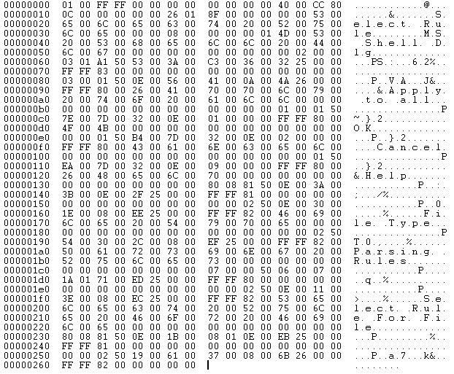
Machine Code Instructions

Slide 8
Intro to Machine Code
Machine code are the 32-bit binary instructions which the processor can understand (you can now understand, too)
All programs (C, Java, Python) are eventually translated into machine code (by a compiler or interpreter).
While executing, the instructions of the program are loaded into the instruction register one by one
For each instruction loaded, the Control Unit reads the opcode and sets the signals to control the datapath, so that the processor works as instructed.
Notes:
Before moving on to the next slide, it’s good to pick somebody and ask them how they would create a new, low-level language that takes care of some basic register operations. For example, what would be a good name for an addition operation? After somebody says “add” and that’s written to the board, ask about the order in which you’d list the registers being operated on. After months of Verilog, the suggestion is usually destination, then sources. Which leads to the next slide ☺

Slide 9
Assembly language
Each line of assembly code corresponds to one line of 32-bit long machine code.
Basically, assembly is a user-friendly way to write machine code.
Example: C = A + B
Store A in $t1, B in $t2, C in $t3
Assembly language instruction:
Machine code instruction:
Note: There is a 1-to-1 mapping for all assembly code and machine code instructions!
add $t3, $t1, $t2
000000 01001 01010 01011 XXXXX 100000
Notes:
This provides one of the final links between the processor and the programmer, even though there’s not much to it. It’s important to emphasize that the assembly instruction is something that we can recognize and understand, and the machine code instructions is what the computer understands, and translating between the two is a simple 1-to-1 mapping.

Slide 10
Why learn assembly?
You’ll understand how your program really works.
You’ll understand your program’s performance better by knowing its real “runtime”.
You’ll understand how control flows (if / else / for / while) are implemented.
You’ll understand why eliminating if statements makes your code faster.
You’ll understand why pointer is such a natural concept for programming.
You’ll understand the cost of making function calls.
You’ll understand why stack can overflow
You’ll understand there is no “recursion” in the hardware, and how it’s actually done.
You’ll understand why memory need to be managed.
You’ll understand why people spend so much time creating operating systems.
You’ll appreciate more the constructs in high-level programming languages.
And much more…

Slide 11
And, you’ll be able to read this book.
Donald Knuth “The Art of Computer Programming”
“All algorithms in this book are written in assembly for clarity.”

Slide 12
About register names
In machine code with have register 0 to register 31, specified by 5 bits of the instruction.
In assembly we have names like $t1, $t2, $s1, $v0, etc.
What’s the relation between these two?

Slide 13
Machine code + registers
MIPS is register-to-register.
Every operation operates on data in registers.
MIPS provides 32 registers.
Several have special values (conventions):
Register 0 ($zero): value 0 -- always.
Register 1 ($at): reserved for the assembler.
Registers 2-3 ($v0, $v1): return values
Registers 4-7 ($a0-$a3): function arguments
Registers 8-15, 24-25 ($t0-$t9): temporaries
Registers 16-23 ($s0-$s7): saved temporaries
Registers 28-31 ($gp, $sp, $fp, $ra): memory and function support
Registers 26-27: reserved for OS kernel
Also three special registers (PC, HI, LO) that are not directly accessible.
HI and LO are used in multiplication and division, and have special instructions for accessing them.
$v0, $t2, $a3, etc are the registers’ nicknames in assembly
Technically you can use any register for anything, but this is the convention
Notes:
Good to talk about how 32 registers are far more than what’s needed for the most complicated operation, so it’s okay for the processor to reserve a bunch of them for specialized functions. Make sure to draw attention to the equivalence between using $0 and $zero, $8 and $t0, because that will come in handy later when doing the assembly->machine code translation. Also take a moment to talk about the stack pointer and the return address, because they are needed later.

Slide 14
Translate assembly to machine code
When writing machine code instructions (or interpreting them), we need to know which register values to encode (or decode).
e.g.
add $t3, $t1, $t2
000000
100000
01001
01010
01011
000000 01001 01010 01011 XXXXX 100000

Slide 15
Machine code details
Things to note about machine code:
R-type instructions have an opcode of 000000, with a 6-bit function listed at the end.
Although we specify “don’t care” bits as X values, the assembly language interpreter always assigns them to some value (like 0)
In exams, we want you to write X instead of 0, to show that you know we don’t care those bits

Slide 16
Try this at home
Below is the content of an executable file “mystery.exe”,
what does this program do?
1000 1110 0000 1000 0101 1010 1111 0001
1000 1110 0010 1001 1101 0010 0011 0010
0000 0001 0000 1001 0101 0000 0010 0000
1000 1110 0100 1011 1111 0011 0011 0111
0000 0000 0000 1100 0011 0001 0000 0000
0000 0010 0110 1010 1010 0000 0010 0010
1010 1101 1101 0100 0000 1111 0101 1010

Slide 17
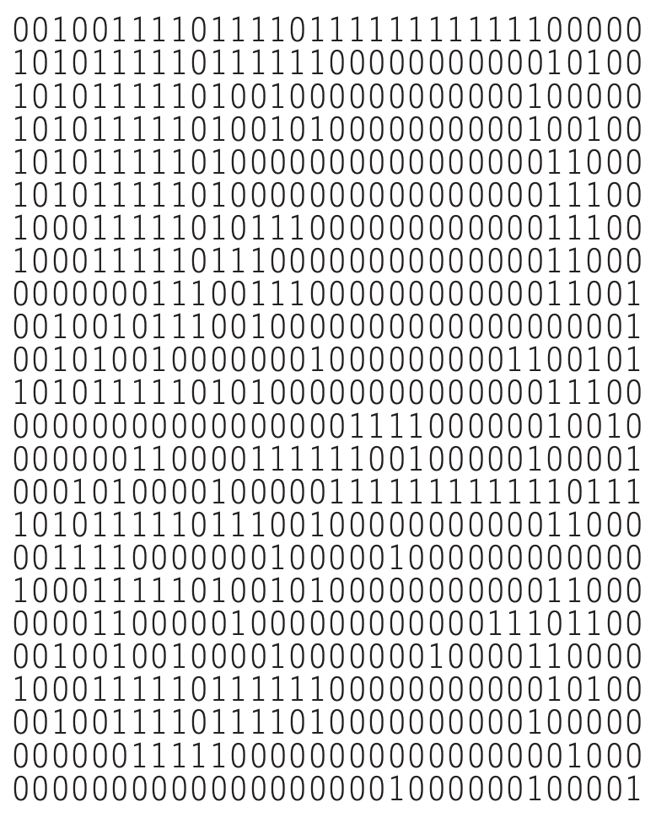
Then try this one

Slide 18
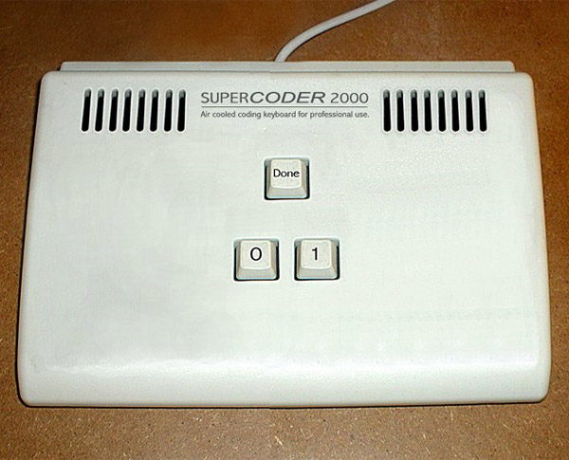
Now you can totally program an executable like this (don’t even need a compiler).

Slide 19
Assembly Language Instructions

Slide 20
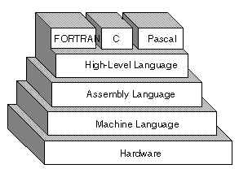
Assembly language
Assembly language is the lowest-level language that you’ll ever program in.
Many compilers translate their high-level program commands into assembly commands, which are then converted into machine code and used by the processor.
Note: There are multiple types of assembly language, especially for different architectures!

Slide 21
Trivia
The thing that converts assembly code to executable is NOT called a compiler.
It’s called an assembler, because there is no fancy complication needed, it just assembles the lines!

Slide 22
A little about MIPS
MIPS
Short for Microprocessor without Interlocked Pipeline Stages
A type of RISC (Reduced Instruction Set Computer) architecture.
Provides a set of simple and fast instructions
Compiler translates instructions into 32-bit instructions for instruction memory.
Complex instructions are built out of simple ones by the compiler and assembler.

Slide 23
The layout of assembly code

Slide 24
Code sectioning syntax: example
.data
A: .space 400 # array of 100 integers
B: .space 400 # array of 100 integers
.text
main: add $t0, $zero, $zero # load “0” into $t0
addi $t1, $zero, 400 # load “400" into $t1
addi $t9, $zero, B # store address of B
addi $t8, $zero, A # store address of A
loop: add $t4, $t8, $t0 # $t4 = addr(A) + i
add $t3, $t9, $t0 # $t3 = addr(B) + i
lw $s4, 0($t3) # $s4 = B[i]
addi $t6, $s4, 1 # $t6 = B[i] + 1
sw $t6, 0($t4) # A[i] = $t6
addi $t0, $t0, 4 # $t0 = $t0++
bne $t0, $t1, loop # branch back if $t0<400
end:

Slide 25
Code sectioning syntax
.data
Indicates the start of the data declarations.
.text
Indicates the start of the program instructions.
main:
The initial line to run when executing the program.
You can create other labels as needed.

Slide 26
MIPS Instructions
Things to note about MIPS instructions:
Instruction are written as: <instr> <parameters>
Each instruction is written on its own line
All instructions are 32 bits (4 bytes) long
Instruction addresses are measured in bytes, starting from the instruction at address 0.
The following tables show the most common MIPS instructions, the syntax for their parameters, and what operation they perform.
Notes:
If it hasn’t come up already, mention that the smallest addressable portion of memory is a single byte, so all of the registers in a 32-bit architecture are 4 bytes long.

Slide 27
Frequency of instructions
Instruction Type | Examples | Usage | Integer Frequency | Floating point Frequency
Arithmetic | add, sub, addi | Operations in assignment statement s | 16% | 48%
Data transfer | lw, sw, lb, lbu, lh, lhu, sb, lui | References to data structures, such as arrays | 35% | 36%
Logical | and, or, nor, andi, ori, sll, srl | 0perations in assignment statement s | 12% | 4%
Conditional branch | beq, bne, slt, slti, sltiu | If statements and loops | 34% | 8%
Jump | j, jr, jal | Procedure calls, returns, and case/switch statements | 2% | 0%
Original source: Computer Organization And Design: The Hardware/Software Interface, 5th Edition, Patterson & Hennessy, 2014, p163

Slide 28
Arithmetic instructions
Instruction | Opcode/Function | Syntax | Operation
add | 100000 | $d, $s, $t | $d = $s + $t
addu | 100001 | $d, $s, $t | $d = $s + $t
addi | 001000 | $t, $s, i | $t = $s + SE(i)
addiu | 001001 | $t, $s, i | $t = $s + SE(i)
div | 011010 | $s, $t | lo = $s / $t; hi = $s % $t
divu | 011011 | $s, $t | lo = $s / $t; hi = $s % $t
mult | 011000 | $s, $t | hi:lo = $s * $t
multu | 011001 | $s, $t | hi:lo = $s * $t
sub | 100010 | $d, $s, $t | $d = $s - $t
subu | 100011 | $d, $s, $t | $d = $s - $t
Note: “hi” and “lo” refer to the high and low bits referred to in the register slide.
“SE” = “sign extend”.

Slide 29
ALU instructions
Note that for ALU instruction, most are R-type instructions.
The six-digit codes in the tables are therefore the function codes (opcodes are 000000).
Exceptions are the I-type instructions (addi, andi, ori, etc.)
Not all R-type instructions have an I-type equivalent.
RISC architectures dictate that an operation doesn’t need an instruction if it can be performed through multiple existing operations.
Example: divi $t0, 42 can be done by
addi $t1, $zero, 42
div $t0 $t1

Slide 30
Logical instructions
Instruction | Opcode/Function | Syntax | Operation
and | 100100 | $d, $s, $t | $d = $s & $t
andi | 001100 | $t, $s, i | $t = $s & ZE(i)
nor | 100111 | $d, $s, $t | $d = ~($s | $t)
or | 100101 | $d, $s, $t | $d = $s | $t
ori | 001101 | $t, $s, i | $t = $s | ZE(i)
xor | 100110 | $d, $s, $t | $d = $s ^ $t
xori | 001110 | $t, $s, i | $t = $s ^ ZE(i)
Note: ZE = zero extend (pad upper bits with 0 value).

Slide 31
Shift instructions
Instruction | Opcode/Function | Syntax | Operation
sll | 000000 | $d, $t, a | $d = $t << a
sllv | 000100 | $d, $t, $s | $d = $t << $s
sra | 000011 | $d, $t, a | $d = $t >> a
srav | 000111 | $d, $t, $s | $d = $t >> $s
srl | 000010 | $d, $t, a | $d = $t >>> a
srlv | 000110 | $d, $t, $s | $d = $t >>> $s
Note: srl = “shift right logical”, and sra = “shift right arithmetic”.
The “v” denotes a variable number of bits, specified by $s.

Slide 32
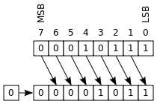
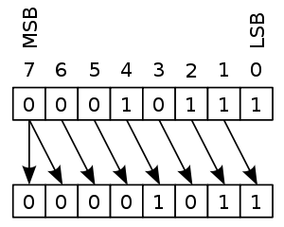
Logic shift vs Arithmetic shift
Left shift: same, fill empty spot (lower bits) with zeros
(that’s why we have sll but no sla)
Right shift: different
Logic shift fills empty spot(higher bits) with zeros
Arithmetic shift fills empty spot (higher bits) with the MSB of the original number.
Logic
Arithmetic

Slide 33
Data movement instructions
Instruction | Opcode/Function | Syntax | Operation
mfhi | 010000 | $d | $d = hi
mflo | 010010 | $d | $d = lo
mthi | 010001 | $s | hi = $s
mtlo | 010011 | $s | lo = $s
These are instructions for operating on the HI and LO registers described earlier.

Slide 34
Time for more instructions!

Slide 35
Flow control:
Branch and loop

Slide 36
Control flow in assembly
Not all programs follow a linear set of instructions.
Some operations require the code to branch to one section of code or another (if/else).
Some require the code to jump back and repeat a section of code again (for/while).
For this, we have labels on the left-hand side that indicate the points that the program flow might need to jump to.
References to these points in the assembly code are resolved at compile time to offset values for the program counter.

Slide 37
Code sectioning syntax: example
.data
A: .space 400 # array of 100 integers
B: .space 400 # array of 100 integers
.text
main: add $t0, $zero, $zero # load “0” into $t0
addi $t1, $zero, 400 # load “400" into $t1
addi $t9, $zero, B # store address of B
addi $t8, $zero, A # store address of A
loop: add $t4, $t8, $t0 # $t4 = addr(A) + i
add $t3, $t9, $t0 # $t3 = addr(B) + i
lw $s4, 0($t3) # $s4 = B[i]
addi $t6, $s4, 1 # $t6 = B[i] + 1
sw $t6, 0($t4) # A[i] = $t6
addi $t0, $t0, 4 # $t0 = $t0++
bne $t0, $t1, loop # branch back if $t0<400
end:

Slide 38
Branch instructions
Instruction | Opcode/Function | Syntax | Operation
beq | 000100 | $s, $t, label | if ($s == $t) pc += i << 2
bgtz | 000111 | $s, label | if ($s > 0) pc += i << 2
blez | 000110 | $s, label | if ($s <= 0) pc += i << 2
bne | 000101 | $s, $t, label | if ($s != $t) pc += i << 2
Branch operations are key when implementing if statements and while loops.
The labels are memory locations, assigned to each label at compile time.
Note: i is calculated as (label - (current PC + 4)) >> 2

Slide 39
Comparison instructions
Instruction | Opcode/Function | Syntax | Operation
slt | 101010 | $d, $s, $t | $d = ($s < $t)
sltu | 101001 | $d, $s, $t | $d = ($s < $t)
slti | 001010 | $t, $s, i | $t = ($s < SE(i))
sltiu | 001001 | $t, $s, i | $t = ($s < SE(i))
Note: Comparison operation stores a one in the destination register if the less-than comparison is true, and stores a zero in that location otherwise.

Slide 40
Note: Real vs Pseudo instructions
What we list in the slides are all real instructions, i.e., each one has an opcode corresponding to it.
There are some pseudo-instructions, which don’t have their own opcode, but is implemented using real instructions; they are provided for coding convenience.
For example:
bge $t0,$t1,Label is actually
slt $t2,$t0,$t1; beq $t2,$zero,Label

Slide 41
Jump instructions
Instruction | Opcode/Function | Syntax | Operation
j | 000010 | label | pc += i << 2
jal | 000011 | label | $31 = pc; pc += i << 2
jalr | 001001 | $s | $31 = pc; pc = $s
jr | 001000 | $s | pc = $s
jal = “jump and link”.
Register $31 (aka $ra) stores the address that’s used when returning from a subroutine.
Note: jr and jalr are not j-type instructions.

Slide 42
If/Else statements in MIPS
if ( i == j )
i++;
else
j--;
j += i;
Strategy for if/else statements:
Test condition, and jump to if logic block whenever condition is true.
Otherwise, perform else logic block, and jump to first line after if logic block.
A flowchart can be helpful here
Notes:
At this point, I get somebody in the class to help translate this into assembly. If you pick registers for i and j and show the different branch keywords on the board, they can derive one of the two translations that show up on the next slide.

Slide 43
If statement
Only problem: branch instructions jump on TRUE instead of FALSE, so negate the checked condition to i != j
if ( i == j )
i++;
else
j--;
j += i;
i=j
false
true
if block
jump
else block
end

Slide 44
If statement flowcharts
if ( i == j )
i++;
else
j--;
j += i;
i!=j
true
false
if block
jump
# $t1 = i, $t2 = j
main: bne $t1, $t2, ELSE
addi $t1, $t1, 1
j END
ELSE: addi $t2, $t2, -1
END: add $t2, $t2, $t1
else block
end

Slide 45
Translated if/else statements
# $t1 = i, $t2 = j
main: bne $t1, $t2, ELSE # branch if ! ( i == j )
addi $t1, $t1, 1 # i++
j END # jump over ELSE
ELSE: addi $t2, $t2, -1 # j--
END: add $t2, $t2, $t1 # j += i
If we change BNE to BEQ, then we also need to swap the IF and ELSE blocks
# $t1 = i, $t2 = j
main: beq $t1, $t2, IF # branch if ( i == j )
addi $t2, $t2, -1 # j--
j END # jump over IF
IF: addi $t1, $t1, 1 # i++
END: add $t2, $t2, $t1 # j += i

Slide 46
Multiple if conditions
if ( i == j || i == k )
i++ ; // if-body
else
j-- ; // else-body
j = i + k ;
i=j
false
true
i=k
false
true
Branch on FALSE!
if block
else block
end

Slide 47
Multiple if conditions
if ( i == j || i == k )
i++ ; // if-body
else
j-- ; // else-body
j = i + k ;
i=j
false
true
i!=k
true
false
if block
# $t1 = i, $t2 = j, $t3 = k
main: beq $t1, $t2, IF
bne $t1, $t3, ELSE
IF: addi $t1, $t1, 1
j END
ELSE: addi $t2, $t2, -1
END: add $t2, $t1, $t3
else block
end

Slide 48
Loops

Slide 49
Loops in MIPS (while loop)
Example of a simple loop, in assembly:
…which is the same as saying (in C):
# $t0 = i, $t1 = n
main: add $t0, $zero, $zero # i = 0
addi $t1, $zero, 100 # n = 100
START: beq $t0, $t1, END # if i == n, END
addi $t0, $t0, 1 # i++
j START
END:
while (i != 100) {
i++;
}

Slide 50
For loop
for ( <init> ; <cond> ; <update> ) {
<for body>
}
For loops (such as above) are usually implemented with the following structure:
main: <init>
START: if (!<cond>) branch to END
<for-body>
UPDATE: <update>
jump to START
END:

Slide 51
Exercise:
j = 0
for ( _____ ; _____ ; _____ ) {
j = j + i;
}
# $t0 = i, $t1 = j
main: add $t1, $zero, $zero # set j = 0
add $t0, $zero, $zero # set i = 0
addi $t9, $zero, 100 # set $t9 to 100
START: beq $t0, $t9, EXIT # branch if i==100
add $t1, $t1, $t0 # j = j + i
UPDATE: addi $t0, $t0, 1 # i++
j START
EXIT:

Slide 52
Answer
j = 0
for ( i=0 ; i!=100 ; i++ ) {
j = j + i;
}
This translates to:
while loops are the same, without the initialization and update sections.
# $t0 = i, $t1 = j
main: add $t1, $zero, $zero # set j = 0
add $t0, $zero, $zero # set i = 0
addi $t9, $zero, 100 # set $t9 to 100
START: beq $t0, $t9, EXIT # branch if i==100
add $t1, $t1, $t0 # j = j + i
UPDATE: addi $t0, $t0, 1 # i++
j START
EXIT:

Slide 53
Another exercise
Fibonacci sequence:
How would you convert this into assembly?
int fib(void) {
int n = 10;
int f1 = 1, f2 = -1;
while (n != 0) {
f1 = f1 + f2;
f2 = f1 – f2;
n = n – 1;
}
return f1;
}
Notes:
At this point, I go back and forth between this slide and the next, showing that the initialization section and the calculation section both translate pretty intuitively from one slide to the next. It’s also a good opportunity for people to ask about the assembly keywords on the next slide that they haven’t seen yet, which provides a good segue into the next section.

Slide 54
Assembly code example
int fib(void) {
int n = 10;
int f1 = 1, f2 = -1;
while (n != 0) {
f1 = f1 + f2;
f2 = f1 – f2;
n = n – 1;
}
return f1;
}
Fibonacci sequence in assembly code:
# fib.asm
# register usage: $t3=n, $t4=f1, $t5=f2
# RES refers to memory address of result
FIB: addi $t3, $zero, 10 # initialize n=10
addi $t4, $zero, 1 # initialize f1=1 addi $t5, $zero, -1 # initialize f2=-1
LOOP: beq $t3, $zero, END # done loop if n==0
add $t4, $t4, $t5 # f1 = f1 + f2 sub $t5, $t4, $t5 # f2 = f1 - f2
addi $t3, $t3, -1 # n = n – 1
j LOOP # repeat until done
END: sb $t4, RES # store result

Slide 55
Making an assembly program
Assembly language programs typically have structure similar to simple Python or C programs:
They set aside registers to store data.
They have sections of instructions that manipulate this data.
It is always good to decide at the beginning which registers will be used for what purpose!
More on this later ☺

Slide 56
CSCB58: Computer Organization
Prof. Gennady Pekhimenko
University of Toronto
Fall 2020
The content of this lecture is adapted from the lectures of
Larry Zheng and Steve Engels

