Slide 1
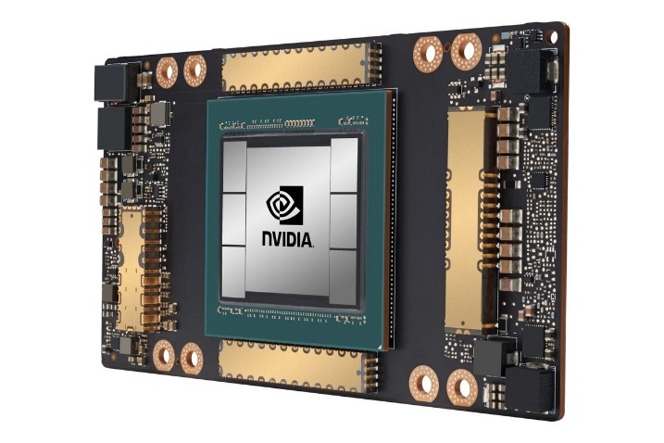
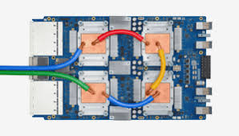
CSCB58: Computer Organization
Prof. Gennady Pekhimenko
University of Toronto
Fall 2020
The content of this lecture is adapted from the lectures of
Larry Zheng and Steve Engels

Slide 2
CSCB58 Week 8

Slide 3
Recap: We are here
Assembly Language
Processors
Arithmetic Logic Units
Finite State Machines
Devices
Flip-flops
Circuits
Gates
Transistors

Slide 4
Controller Thing
Next
Storage
Thing
Arithmetic Thing

Slide 5
The Blueprint of
a microprocessor
The Controller Thing
PCWriteCond
Control
Unit
PCSource
PCWrite
ALUOp
IorD
ALUSrcB
MemRead
ALUSrcA
MemWrite
RegWrite
MemtoReg
RegDst
IRWrite
Opcode
0
1
Shift left 2
2
Instruction [31-26]
Registers
PC
0
Address
Instruction [25-21]
Read reg 1
0
A
Zero
1
Memory data
Instruction [20-16]
Read reg 2
Read data 1
A
1
Write data
Instruction [15-0]
0
ALU result
ALU Out
1
Write reg
Read data 2
B
4
0
Instruction Register
1
B
ALU
Memory
Write data
2
0
3
Memory data register
1
Sign extend
Shift left 2
The Storage Thing
The Arithmetic Thing

Slide 6
We’ve learned the arithmetic thing
ALU
A
B
With ALU, we can do addition, subtraction, logic operations, etc.
C_{in},S
VCNZ
G

Slide 7
So this is the ALU
A
B
C_{in},S
VCNZ
G
So where do A and B come from?

Slide 8
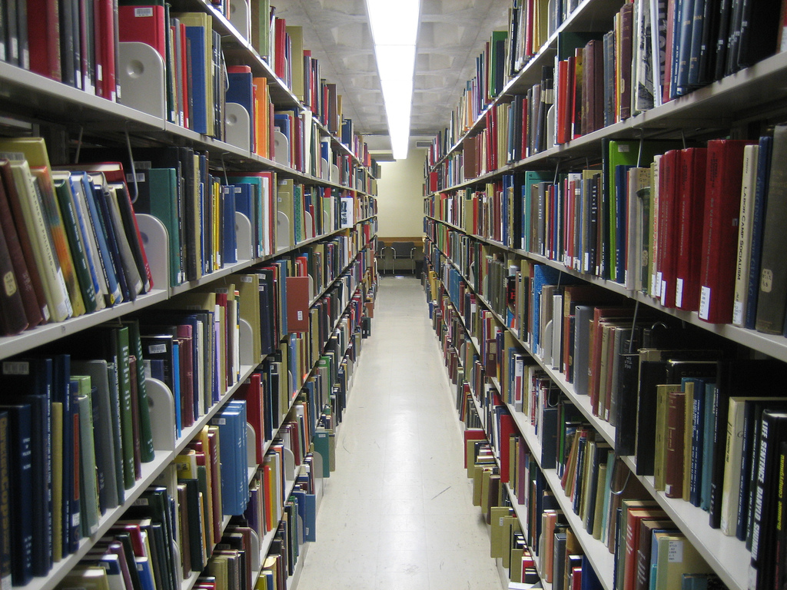
The “Storage Thing”
aka: the register file and main memory

Slide 9
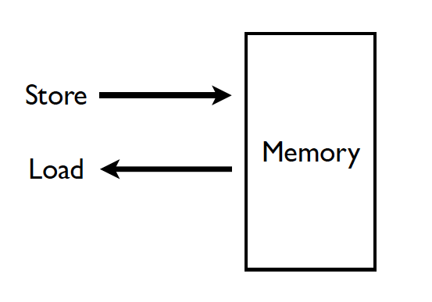
Memory (Programmer’s View)

Slide 10
Computer memory hierarchy
Sorted by data access speed
Registers: in the processor
Cache: several levels, the closest is next to the processor
Memory: off-chip
Hard disk: for virtualization; requires OS support to access
Network: not for process execution …

Slide 11
Computer memory hierarchy
Sorted by data (food) access speed
Registers: that plate in front of you
Cache: the fridge in the kitchen
Memory: the grocery store downstairs
Hard disk: the farm in the suburb
Network: the farm in a different country

Slide 12
Memory and registers
There are units in the CPU that store multiple data values for use by the CPU:
Registers: Small number of fast memory units that allow multiple values to be read and written simultaneously.
Main memory: Larger grid of memory cells that are used to store the main information to be processed by the CPU.

Slide 13
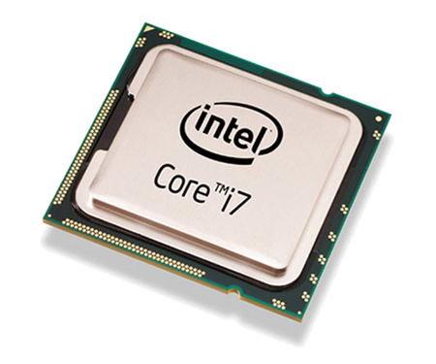
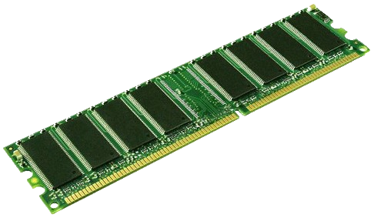
Registers are in here
Memory is in here

Slide 14
Registers are in here in the CPU
Memory chips are plugged in here

Slide 17
Register file
An array of registers in the CPU

Slide 18
Register File Functionality
Typical setup (MIPS):
Each register is 32-bit
There are 32 registers.
5-bit address
Register
File
Read/Write
Register 0
Destination Reg.
(n-bit address)
Register 1
Register 2
Data to write
…
…
Value from
Reg. A
Register A
(n-bit address)
Register 2^{n}
Register B
(n-bit address)
Value from
Reg. B
Register File

Slide 19
Register File – Write Operation
Load Enable
A select
Data
Load
R₀
0
1
A
Load
R₁
2
3
Load
R₂
0
1
B
Load
R₃
2
3
0
1
2
3
Decoder
B select
D address

Slide 20
Register File – Read Operation
Load Enable
A select
Data
Load
R₀
0
1
A
Load
R₁
2
3
Load
R₂
0
1
B
Load
R₃
2
3
0
1
2
3
Decoder
B select
D address

Slide 21
The main memory
An array of memory units

Slide 22
Electronic Memory
Like register files, main memory is made up of a decoder and rows of memory units.
Row 0
Address
Lines
m
Row 1
Decoder
Row 2
Row 3
...
Row 2^{m}-1
...
These lines are used for both input and output (called a bus)
D₀
D₁
D₂
D_{n-1}
Data
Lines

Slide 23
One-hot decoder
The decoder takes in the m-bit binary address and activates a single row in the memory array.
A₂ | A₁ | A₀ | O₇ | O₆ | O₅ | O₄ | O₃ | O₂ | O₁ | O₀
0 | 0 | 0 | 0 | 0 | 0 | 0 | 0 | 0 | 0 | 1
0 | 0 | 1 | 0 | 0 | 0 | 0 | 0 | 0 | 1 | 0
0 | 1 | 0 | 0 | 0 | 0 | 0 | 0 | 1 | 0 | 0
… |  |  | …
1 | 1 | 0 | 0 | 1 | 0 | 0 | 0 | 0 | 0 | 0
1 | 1 | 1 | 1 | 0 | 0 | 0 | 0 | 0 | 0 | 0

Slide 24
Controlling the flow
Since some lines (buses) will now be used for both input and output, we use a tri-state buffer (remember them from the mux example?)
When WE (write enable) signal is low, buffer output is a high impedance signal (connected to neither high voltage or ground).
WE
A
Y
WE | A | Y
0 | X | Z
1 | 0 | 0
1 | 1 | 1

Slide 25
WE
WE | A | Y
0 | X | Z
1 | 0 | 0
1 | 1 | 1
A
Y
WE = 1
A
Y
WE = 0
A
Y

Slide 26
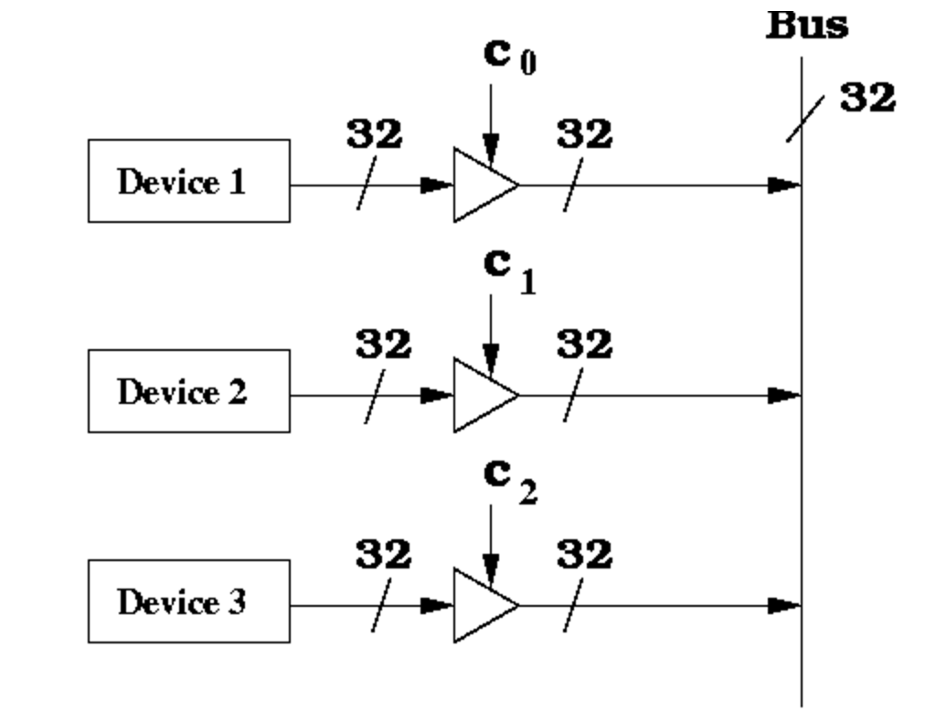
Control the flow using tri-state buffer
Control c0, c1 and c2 so that only one of the devices output is written to the bus.
In general, the bus can be read by multiple devices at the same but can only be written by one device at a time.

Slide 27
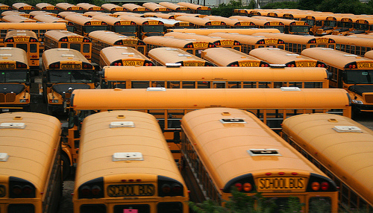
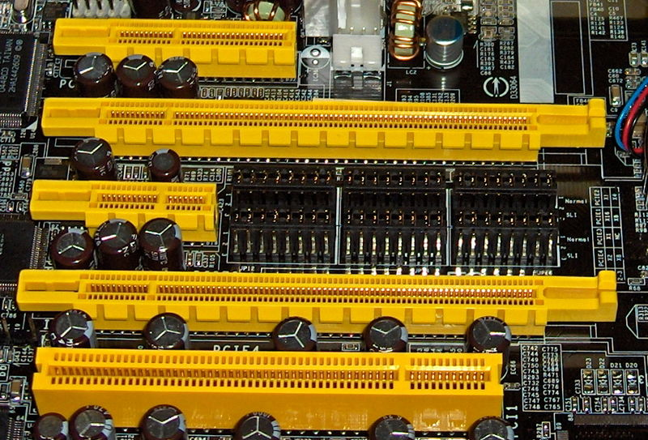
Data Bus
Communication between components takes place through groups of wires called a bus (or data bus).
Multiple components can read from a bus, but only one can write to a bus at a time.
Each component has a tri-state buffer that feeds into the bus. When not reading or writing, the tri-state buffer drives high impedance onto the bus.

Slide 28
RAM Storage Cell
what stores each bit of the memory

Slide 29
Storage cells
For storing a single bit
Each row is made of an array of storage cells.
Multiple ways of representing these cells.
e.g. RAM cell (basically a gated latch)
Select
B
S
Q
C
C
B
R
Q
RAM cell

Slide 30
RAM slice model
W
ord
W
ord
Select
select
select
0
RAM cell
0
Word select signals determine which row to send out on the C lines.
B
X
C
W
ord
S
Q
select
1
RAM cell
R
Q
X
C
B
RAM cell
W
ord
select
2
n
2
1
RAM cell
W
ord
Select
Read/Write
select
logic
2
n
-
1
S
Q
X
Data in
Data out
Read/
Bit
X
Write
select
R
Q
RAM cell
(b) Symbol
S
Q
Data in
R
Q
Write logic
Read logic
Data out
Read/
Bit
Write
select

Slide 31
SRAM Static Random Access Memory
Example:
There are other types of RAMs such as DRAM, SDRAM, DDR SDRAM, RDRAM, VRAM, etc.

Slide 32
Asynchronous SRAM Interface – An example
Address
(n-bit)
SRAM
Data
(m-bit)
CE’
Read/Write’
OE’
Chip Enable’ (CE’) | Read/Write’ | Output Enable’ (OE’) | Access Type
0 | 0 | X | SRAM Write
0 | 1 | 0 | SRAM Read
1 | X | X | SRAM not enabled

Slide 33
Read/Write SRAM - Timing waveforms
Clock
SRAM Read
SRAM Write
Address
__
CE
Read/
Write
__
OE
hi-Z
hi-Z
hi-Z
Data
Data from SRAM
Data to SRAM
Reading and writing of signals takes time. To make sure things are read/written correctly, we must control the timing carefully.

Slide 34
Memory vs registers
Memory houses most of the data values being used by a program.
Registers are more local data stores, meant to be used to execute an instruction.
Registers are not meant to host memory between instructions (like scrap paper for a calculation).
Exception is the stack pointer register, which is sometimes in the same register file as the others.

Slide 35
Memory Technology: DRAM
Dynamic random access memory
Capacitor charge state indicates stored value
Whether the capacitor is charged or discharged indicates storage of 1 or 0
1 capacitor
1 access transistor
Capacitor leaks through the RC path
DRAM cell loses charge over time
DRAM cell needs to be refreshed
row enable
_bitline

Slide 36
DRAM – Dynamic Random Access Memory
Array of Values
READ address
3455434
43543
WRITE address, value
98734
Accessing any location takes the same amount of time
0
847
42
Data needs to be constantly refreshed
873909
1729
Notes:
DRAM stands for Dynamic Random Access Memory.
Memory, as many of may know, is a device that can store information and allow the information to be retrieved at a later point in time. The simplest abstraction for memory is an array of fixed-size values. We can read from a location by specifying its address or write to a location by providing its address and the value to be written.
A random access memory is one in which accessing any location takes the same amount of time.
The dynamic part of DRAM refers to the fact that DRAM loses data when left alone.

Slide 37
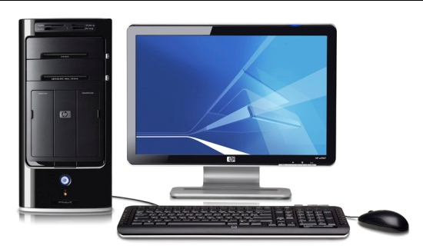
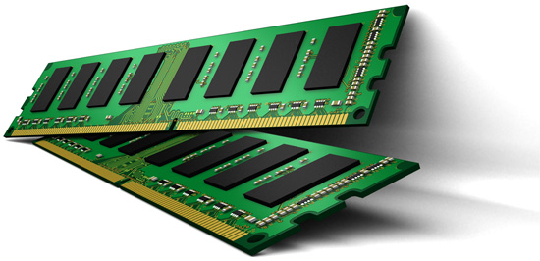
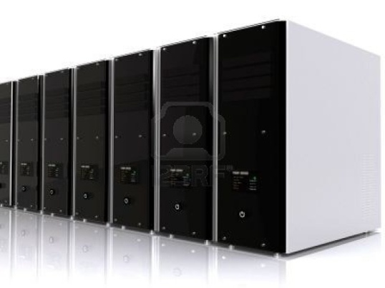
DRAM in Today’s Systems
Why DRAM? Why not some other memory?
Notes:
DRAM memory is an integral part of most computing systems today. Desktops, laptops, mobile phones, large servers; all of them have DRAM based memory.
In fact, if you ever wondered why your laptops have a separate sleep mode and hibernate mode, the dynamic part of DRAM is one of the primary reasons. In the sleep mode, the DRAM in your laptop is still powered on and kept in a state where it does not lose its data. In the hibernate mode, the data in DRAM is written to the hard disk and the system is completely shutdown.
Why DRAM? Why not some other memory?

Slide 38
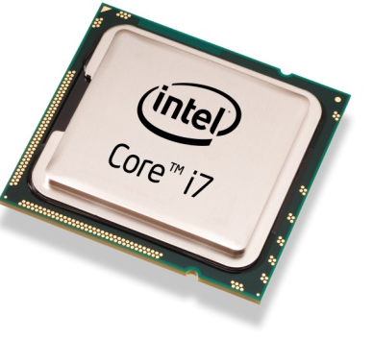
Von Neumann Model
Processor
Memory
Program
Data
T1 = Read Data[1]
4 instruction accesses +
3 data accesses
T1 = Read Data[1]
3
T2 = Read Data[2]
4
4
T3 = T1 + T2
8
Write Data[3], T3
2
Memory performance is important

Slide 39
Factors that Affect Choice of Memory
Speed
Should be reasonably fast compared to processor
Capacity
Should be large enough to fit programs and data
Cost
Should be cheap
Notes:
There are three factors that affect the choice of memory in a system.
Speed, Capacity and Cost. Blah..
In fact, as we will see in this talk, cost is one of the primary factors that drives decisions taken by the industry.

Slide 40
Why DRAM?
Flip-flops
Higher Cost
Favorable point in the trade-off spectrum
SRAM
Cost
DRAM
Higher access latency
Disk
Flash
Access Latency
Notes:
In contrast, DRAM is at a favorable point in this trade-off spectrum between cost and latency. And it is going to remain so for the foreseeable future.

Slide 41
Is DRAM Fast Enough?
Processor
Commodity DRAM
Core
Core
Core
Core
Latency
3 GHz, 2 Instructions / cycle
50ns
300 Instructions
Parallelism
Request
300 Instructions
Request
300 Instructions
Request
300 Instructions
Request
Independent programs
Served in parallel?
Notes:
Is DRAM fast enough? Let us try to understand this using today’s processor and DRAM technology. The DRAM we can buy today, which I will refer to as commodity DRAM, takes 50ns to serve a request. A modern processor running at 3Ghz and executing 2 instructions every cycle can run up to 300 instructions in the same duration. To make matters worse, modern processors have multiple cores which can independently execute different programs. If each of these programs independently generate memory requests, the question is whether DRAM can serve the requests in parallel? If the independent requests are served serially, then the cores will have to wait for much longer before doing any useful work. So, there are two problems related to DRAM that we need to address: Latency and Parallelism.

Slide 42
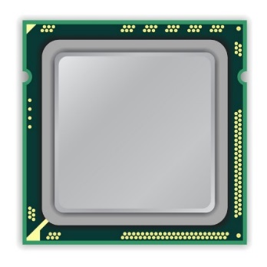
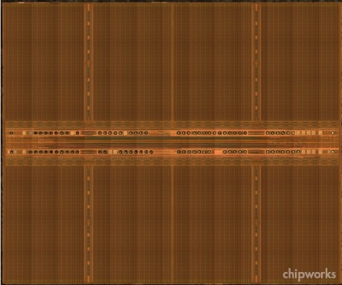
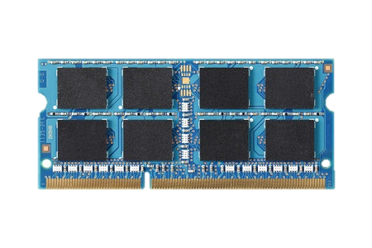
DRAM Organization
mat
processor
peripheral logic
bank
main memory
high latency
Notes:
Right figure shows the picture of real DRAM chip,
which consists of multiple banks and peripheral logic for accessing cells in banks.
Each bank is subdivided into multiple mats.

Slide 43
DRAM Cell Array: Mat
mat
bitline
mat
cell
peripheral logic
cell
wordline
wordline
driver
sense amplifier
Notes:
A mat consists of 2d cell array.
The cells are horizontally connected to wordline driver by wordline,
and vertically connected to a sense amplifier by bitline.

Slide 44
Memory Element (Cell)
Component that can be in at least two states
0
1
Can be electrical, magnetic, mechanical, etc.
DRAM → Capacitor

Slide 45
Capacitor – Bucket of Electric Charge
“Charged”
“Discharged”
V_{max}
Voltage level indicator. Not part of the actual circuit
0
0
0
Charge

Slide 46
DRAM Chip
DRAM Chip
Contains billions of capacitors (also called cells)
?
0

Slide 47
Divide and Conquer
DRAM Bank
?
Challenges
Weak
Reading destroys state

Slide 48
Sense-Amplifier
V_{max}
V_{x}+δ
V_{x}
V_{x}+δ
V_{x}
Amplify the difference
V_{x} > V_{y}
Stable state
V_{y}
V_{y}-δ
V_{y}
0

Slide 49
But … memory is far away
Most processor spend most of their time waiting.
... often for memory. This delay is referred to as the “memory wall”.
No matter how fast we make a processor, if memory is too far away, we’ll just spend more time waiting.
As processors get faster, more processor cycles can be executed before a load completes.
As a result, Amdahl’s Law tells us memory access time is an aspect of performance that has become increasingly important.

Slide 50
Aside: Amdahl’s Law
Amdahl’s law is a statement in computer architecture about system performance.
The performance gain in task achievable by optimizing a subproblem is limited by the proportion of time spent in that subproblem in the unoptimized task.
Ex: If you only spend 1/100 of your time doing task A, then even if you reduce the time required for A to zero, you’ll only save 1%.

Slide 51
Aside: Amdahl’s Law
Amdahl’s law is a statement in computer architecture about system performance.
The performance gain in task achievable by optimizing a subproblem is limited by the proportion of time spent in that subproblem in the unoptimized task.
Conclusion: Focus your optimization efforts on the tasks that consume the most time.

Slide 52
Amdahl’s Law
f: Parallelizable fraction of a program
P: Number of processors
Maximum speedup limited by serial portion:
Serial bottleneck
1
Speedup =
1 - f
+
f
P

Slide 53
But … memory is far away
Most processor spend most of their time waiting.
... often for memory. This delay is referred to as the “memory wall”.
No matter how fast we make a processor, if memory is too far away, we’ll just spend more time waiting.
As processors get faster, more processor cycles can be executed before a load completes.
As a result, Amdahl’s Law tells us memory access time is an aspect of performance that has become increasingly important.

Slide 54
Scaling the Memory Wall
Caches are a structure that makes it appear that memory is closer than it is.
Every load to memory fetches more than just the value that is loaded.
In fact, a lot of values -- a block (or line) -- is brought from the memory to a location close to the processor.
Why? The cost of a bus is its length. Making it wider is inexpensive.
The closer location is called a cache. It stores the value that was loaded and the values near it, in case they are needed soon.

Slide 55
Big Idea: Locality
Caches rely on spatial and temporal locality.
This is a Big Idea in computing. Basically: if we used something recently, we’re likely to use it again (or something near it) soon.
“It or something near it” is spatial locality.
“… soon” is temporal locality.

Slide 56
Examples of Locality
“Iterating over an array” exhibits both temporal and spatial locality.
“Executing code” often exhibits temporal and spatial locality.
“Accessing items from a dictionary” does not: the items in the dictionary may not be close to each other in memory.
Linked lists and other dynamically allocated structures can also cause locality problems.

Slide 57
First, some key terms …
Address
Tag
Block
Set
Associativity
Hit rate (and miss rate)
Average Memory Access Time (AMAT)
(Read Textbook Chapter 8.3 for detailed definitions!)

Slide 58
First, some key terms …
The cache has a few sets of blocks
In a direct mapped cache, each set has one block
In a N-way set associative cache, each set has N blocks.
A fully associative cache has one set with all the blocks.
A memory address gets “hashed” to a set.
Different memory addresses may be hashed to the same set.

Slide 59
Addresses and Caches
Each load fetches an entire cache block -- not just a single value.
The size of a cache “block” is dependent on the cache.
A “block” is a set of words with closely related addresses.
Why fetch a whole block when you just need part of it?
spatial locality
The easiest way to define a block is to look at its mask.

Slide 60
Bit Masking
A bit vector is an integer that should be interpreted as a sequence of bits.
We can think of an address as a bit vector.
A mask is a value that can be used to turn specific bits in a bit vector on or off.
For example, let’s set a mod-16 mask. value = .... mod_16 = 15 # 0x000000F print (value & mod_16) # Only the bottom 4 bits # “&” is “bitwise and”

Slide 61
A small example
Consider a 8-bit memory address (byte-addressable)
10101010, 256 different addresses
What if we divide 256 addresses into 8-byte blocks?
How many blocks are there?
The address is now “hierarchical”:
block number
offset within the block
10101010
block number, block offset

Slide 62
Exercise: Cache Masking
Given a 32-bit address space, identify the tag, set, and block offset for a (direct mapped) cache that stores 16 32-byte blocks.
00000000 00000000 00000000 00000000 <- 32 bits

Slide 63
Exercise: Cache Masking
Given a 32-bit address space, identify the tag, set, and block offset for a (direct mapped) cache that stores 16 32-byte blocks.
In a direct-mapped cache, we use part of the address as an index into the cache. Since there are 16 storage locations in this cache, we need 4 (2^4 = 16) bits from the address as the index.

Slide 64
Exercise: Cache Masking
Given a 32-bit address space, identify the tag, set, and block offset for a (direct mapped) cache that stores 16 32-byte blocks.
00000000 00000000 00000000 00000000 <- 32 bits ^^^^^ <- offset into a block
^ ^^^ <- set
Everything else is the tag.
We match the tag to make sure the memory address matches.

Slide 65
Associativity
Most caches use some form of hashing.
The caches are smaller than the memory they are caching from, so they can’t store everything!
If two blocks hash to the same value, they can’t both be stored. To avoid that, caches are often associative.
A 2-way set associative cache can store two blocks that hash to the same value.
A fully associative cache doesn’t have to worry about hash collisions at all.

Slide 66
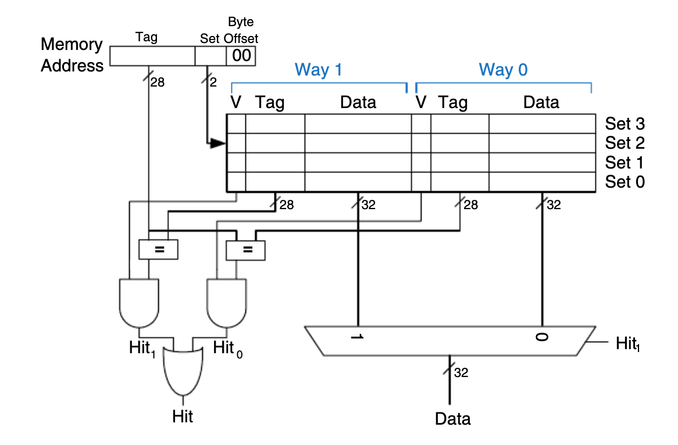
2-way set associative cache: how it’s done in hardware

Slide 67
Cache Loading and Evicting
Each cache has a finite size.
It can store some maximum number of blocks.
Based on its associativity, it can store a set number of blocks with a specific hash.
Every time a load is performed from memory, the block must be stored.
This means that another block might need to be evicted.

Slide 68
How do we choose what to evict?
Ideally, we’d kick out data we never need again.
But we can’t see the future, so we do the next best thing. We rely on locality and kick out … something old.
The most common heuristic is “least recently used” (LRU).
The cache block that was accessed the longest time ago is dropped.
Other heuristics include “first in first out” (FIFO), “least frequently used”, and others.

Slide 69
Discussion
What is the effect of increasing:
(a) block size (b) associativity (c) cache size
Let’s vary these parameters to see what happens.

Slide 70
Exercise: Cache Example
Simulate the performance of a cache on the following (hex) address loads.
40 48 4c 40 50 58 5c 40 60 48 4c 44 40 60 58 5c
The cache is direct-mapped and stores 4 words. It uses a FIFO eviction policy.
0
60
40
50
40
60
40
1
44
16 accesses, and only one 1(!) hit
2
48
58
58
48
3
5c
4c
5c
4c
Notes:
0, 2, 3, 0, 0, 2, 3, 0, 0, 0, 2, 3, 1, 0, 0, 2, 3

Slide 71
Exercise: Cache Example
Simulate the performance of a cache on the following (hex) address loads.
40 48 4c 40 50 58 5c 40 60 48 4c 44 40 60 58 5c
The cache is direct-mapped and stores 2 blocks of two words. It uses a FIFO eviction policy.
40
64
60
44
60
40
40
44
54
64
50
44
16 accesses, and now 6 hits
58
58
5c
5c
48
4c
48
4c

Slide 72
Exercise: Cache Example
Simulate the performance of a cache on the following (hex) address loads.
40 48 4c 40 50 58 5c 40 60 48 4c 44 40 60 58 5c
The cache is 2-way set associative and stores 4 words. It uses a FIFO eviction policy.
48
58
48
40
50
40
40
60
58
60
16 accesses, and now 3 hits
44
4c
5c

Slide 73
Exercise: Cache Example
Simulate the performance of a cache on the following (hex) address loads.
40 48 4c 40 50 58 5c 40 60 48 4c 44 40 60 58 5c
The cache is 2-way set associative and stores 4 words. It uses an LRU eviction policy.
40
50
48
48
58
60
40
40
60
58
50
16 accesses, and now 2 hits
5c
44
4c
5c

Slide 74
Exercise: Cache Example
Simulate the performance of a cache on the following (hex) address loads.
40 48 4c 40 50 58 5c 40 60 48 4c 44 40 60 58 5c
The cache is fully associative and stores 4 words. It uses a LRU eviction policy.
5c
4c
60
44
58
58
40
60
4c
40
48
5c
50
48

Slide 75
Discussion
What is the effect of increasing:
(a) block size (b) associativity (c) cache size
(Read Textbook Chapter 8.3 for more discussion!)

Slide 76
Cache Consistency
Consistency is a huge problem -- and we won’t discuss it.
Imagine a multi-processor system: each processor has its own L1.
What happens when one of the processors issues a store? Is it written back to memory? To the other processor’s L1?
How quickly does that write-back happen? What will occur if the second processor accesses that memory address before the write-back?

Slide 77
Next…
The Controller Thing
PCWriteCond
Control
Unit
PCSource
PCWrite
ALUOp
IorD
ALUSrcB
MemRead
ALUSrcA
MemWrite
RegWrite
MemtoReg
RegDst
IRWrite
Opcode
0
1
Shift left 2
2
Instruction [31-26]
Registers
PC
0
Address
Instruction [25-21]
Read reg 1
0
A
Zero
1
Memory data
Instruction [20-16]
Read reg 2
Read data 1
A
1
Write data
Instruction [15-0]
0
ALU result
ALU Out
1
Write reg
Read data 2
B
4
0
Instruction Register
1
B
ALU
Memory
Write data
2
0
3
Memory data register
1
Sign extend
Shift left 2

Slide 78
CSCB58: Computer Organization
Prof. Gennady Pekhimenko
University of Toronto
Fall 2020
The content of this lecture is adapted from the lectures of
Larry Zheng and Steve Engels

