Slide 1
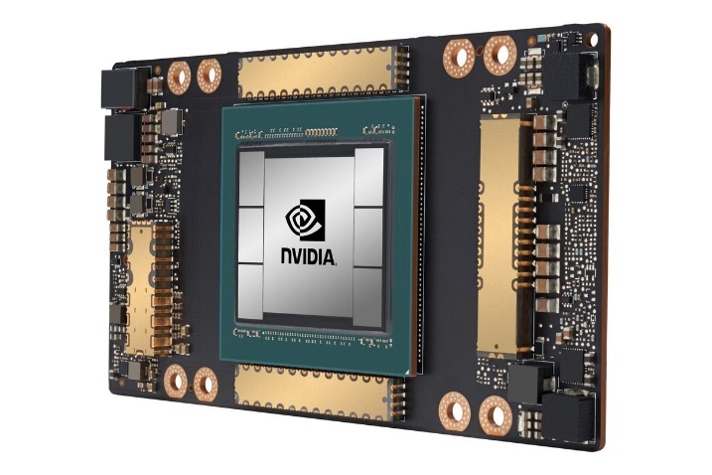
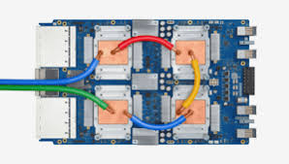
CSCB58: Computer Organization
Prof. Gennady Pekhimenko
University of Toronto
Fall 2020
The content of this lecture is adapted from the lectures of
Larry Zheng and Steve Engels

Slide 2
CSCB58 Week 7

Slide 3
Circuit Timing

Slide 4
Timing
So far we have been worrying whether a circuit is correct.
Now let’s think about how to make a circuit fast.
Key concept: latency
propagation delay
contamination delay

Slide 5
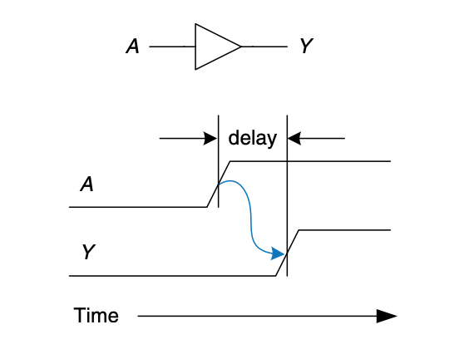
Delay Example
We measure the interval between the two “50% points” of the changing signals

Slide 6
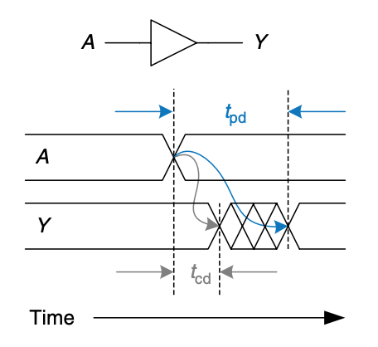
Propagation & Contamination Delay
Propagation delay: the maximum time from when an input changes until the output or outputs reach their final value.
Contamination delay: the minimum time from when an input changes until any output starts to change its value.

Slide 7
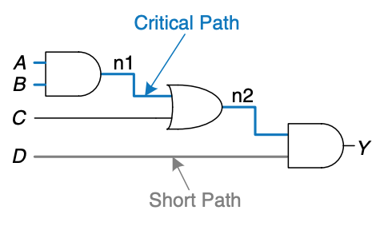
Given a circuit diagram, calculate its propagation delay and contamination delay

Slide 8
Need to know
The propagation and contamination delay of each logic gate used
Gate | t_pd (propagation) | t_cd (contamination)
2-input AND | 100 picoseconds | 60 picoseconds
2-input OR | 120 picoseconds | 40 picoseconds

Slide 9
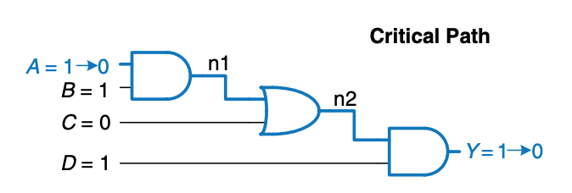
Calculate Propagation Delay
Find the critical path (path with the largest number of gates)
then sum up the propagation delay of all the gates on the critical path
100 + 120 + 100 = 320 picoseconds
Gate | t_pd | t_cd
2-input AND | 100 ps | 60 ps
2-input OR | 120 ps | 40 ps

Slide 10
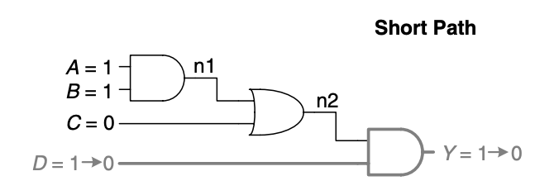
Calculate Contamination Delay
Find the short path (path with the smallest number of gates)
then sum up the contamination delay of all the gates on the short path
60 picoseconds
Gate | t_pd | t_cd
2-input AND | 100 ps | 60 ps
2-input OR | 120 ps | 40 ps

Slide 11
Knowing how to calculate delays allows us to design circuits that are fast.

Slide 12
Quick intro:
Tri-state buffer
WE | A | Y
0 | X | Z
1 | 0 | 0
1 | 1 | 1
WE
A
Y
WE = 1
A
Y
WE = 0
A
Y

Slide 13
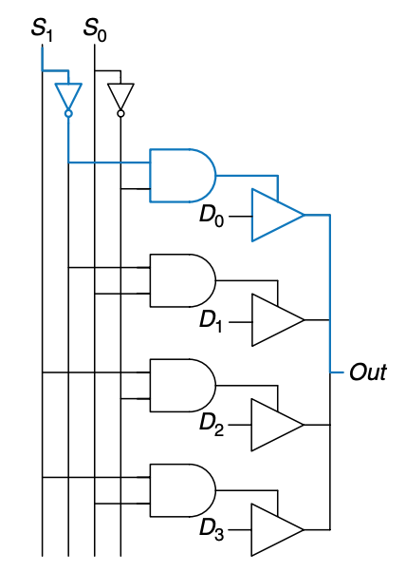
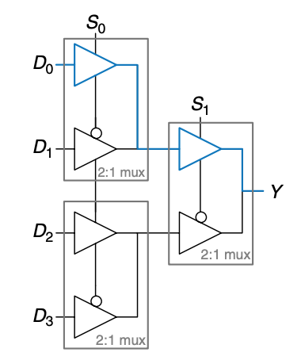
Example: design fast circuit
two different
4-1 muxes

Slide 14
Example: design fast circuit
We care about the propagation delays of the two circuits.
it tells us “how soon I can get the answer”
More specifically, we care about the D-to-Y delay and S-to-Y delay because D and S may arrive at different time.

Slide 15
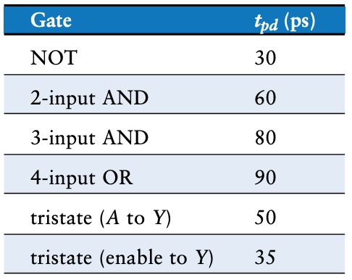
D-to-Y propagation delay:
2 x TRISTATE_AY = 100
S-to-Y propagation delay
TRISTATE_ENY + TRISTATE_AY
= 35 + 50 = 85

Slide 16
D-to-Y propagation delay:
TRISTATE_AY = 50
S-to-Y propagation delay
NOT + AND2 + TRISTATE_ENY
= 30 + 60 + 35 = 125

Slide 17
Analysis result
Circuit 1 propagation:
D-to-Y: 100 ps
S-to-Y: 85 ps
Circuit 2 propagation
D-to-Y: 50 ps
S-to-Y: 125 ps
Which circuit is faster?
What if D and S arrive at the same time?
What if D arrives earlier than S?
What if S arrives earlier than D?

Slide 18
Delays: the lower/higher, the better?
Propagation delay, typically, should be upper-bounded.
shorter propagation means getting answer faster
How to make it lower?
shorten the critical path
Contamination delay, typically, should be lower-bounded
want to reliably sample the value before change.
How to make it longer?
add buffers to the short path

Slide 20
New Topic:
Processor
Components

Slide 21
Using what we have learned so far (combinational logic, devices, sequential circuits, FSMs), how do we build a processor?

Slide 22
The Final Destination
PCWriteCond
Control
Unit
PCSource
PCWrite
ALUOp
IorD
ALUSrcB
MemRead
ALUSrcA
MemWrite
RegWrite
MemtoReg
RegDst
IRWrite
Opcode
0
1
Shift left 2
2
Instruction [31-26]
Registers
PC
0
Address
Instruction [25-21]
Read reg 1
0
A
1
Instruction [20-16]
Read data 1
A
1
Zero
Memory data
Read reg 2
ALU result
Write data
Instruction [15-0]
0
ALU Out
1
Write reg
Read data 2
B
0
Instruction Register
4
1
B
Memory
Write data
2
ALU
3
0
Memory data register
1
Sign extend
Shift left 2

Slide 23
Deconstructing processors
Simpler at a high level:
Controller Unit
“Datapath”
Storage
Unit
Arithmetic Unit

Slide 24
Datapath vs. Control
Datapath: where all data computations take place.
Often a diagram version of real wired connections.
Control unit: orchestrates the actions that take place in the datapath.
The control unit is a big finite-state machine that instructs the datapath to perform all appropriate actions.

Slide 25
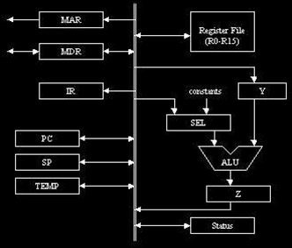
Datapath example

Slide 26
Example: Calculate x² + 2x
Assume that you have access to a value from an external source. How would you calculate x² + 2x with components you’ve seen so far?
Components needed:
ALU (to add, subtract and multiply values)
Multiplexers (to determine what the inputs should be to the ALU)
Registers (to hold values used in the calculation)

Slide 27
Example schematic
X
LdRA
LdRB
RA
RB
SelxA
0 1
0 1
SelAB
ALU
ALUop
Notes:
Let’s look at this and figure out which are the datapath components that we have here:

Slide 28
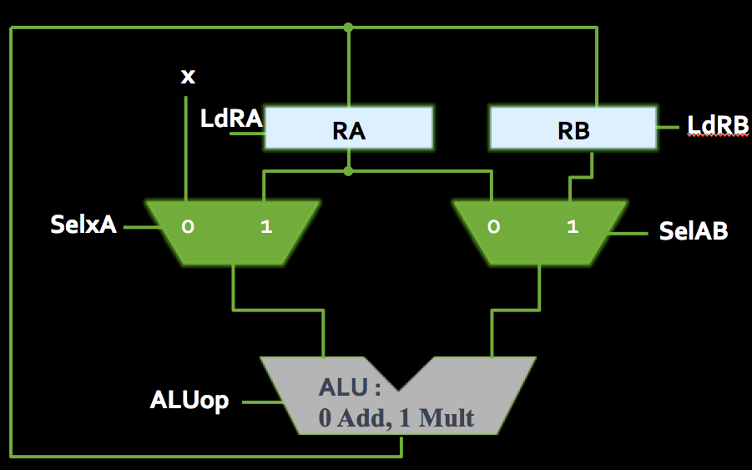
Making the calculation
Steps for x² + 2x:
Load X into RA & RB
Multiply RA & RB
Store result in RA
Add X to RA
Store result in RA
Add X to RA again
ALU output is x² + 2x.
How do we make this happen?
Notes:
Who produces those datapath control signals? An FSM

Slide 29
Making the calculation
High-level Steps
Control Signals
Load X into RA & RB
Multiply RA & RB
Store result in RA
Add X to RA
Store result in RA
Add X to RA again
ALU output is x² + 2x.
Who sends these signals?
SelxA = 0, ALUop = A, LdRA = 1, LdRB = 1
SelxA = 1, SelAB = 1, ALUop = Multiply, LdRA = 1
SelxA = 0, SelAB = 0, ALUop = Add, LdRA = 1
SelxA = 0, SelAB = 0, ALUop = Add
Notes:
Who produces those datapath control signals? An FSM

Slide 30
Control Unit
Basically, a giant Finite State Machine
Synchronized to system-wide signals (clock, resetn)
Outputs the datapath control signals
SelxA, SelAB => control mux outputs (ALU inputs)
ALUop => controls ALU operation
LdRA, LdRB => controls loading for registers RA, RB
Some architectures also output a done signal, when the computation is complete
Yet another output; not shown in our datapaths

Slide 31
Datapath + Control
8 bits
x
Datapath
(ALU, registers, muxes)
clk
FSM
resetn
selxA
8 bits
selAB
F (ALU
result)
These signals are optional, for whenever the operation starts or stops
LdRA
LdRB
ALUop
go
done

Slide 32
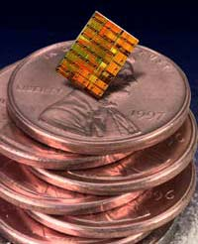
Microprocessors
So far, we’ve been talking about making devices, such as adders, counters and registers.
The ultimate goal is to make a microprocessor, which is a digital device that processes input, can store values and produces output, according to a set of on-board instructions.

Slide 33
The Final Destination
PCWriteCond
Control
Unit
PCSource
PCWrite
ALUOp
IorD
ALUSrcB
MemRead
ALUSrcA
MemWrite
RegWrite
MemtoReg
RegDst
IRWrite
Opcode
0
1
Shift left 2
2
Instruction [31-26]
Registers
PC
0
Address
Instruction [25-21]
Read reg 1
0
A
1
Instruction [20-16]
Read data 1
A
1
Zero
Memory data
Read reg 2
ALU result
Write data
Instruction [15-0]
0
ALU Out
1
Write reg
Read data 2
B
0
Instruction Register
4
1
B
Memory
Write data
2
ALU
3
0
Memory data register
1
Sign extend
Shift left 2

Slide 34
Deconstructing processors
Processors aren’t so bad when you consider them piece by piece:
Controller Thing
Storage
Thing
Arithmetic Thing

Slide 35
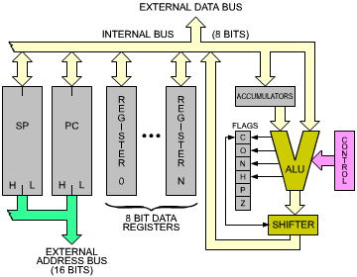
Microprocessors
These devices are a combination of the units that we’ve discussed so far:
Registers to store values.
Adders and shifters to process data.
Finite state machines to control the process.
Microprocessors are the basis of all computing since the 1970’s, and can be found in nearly every sort of electronics.

Slide 36
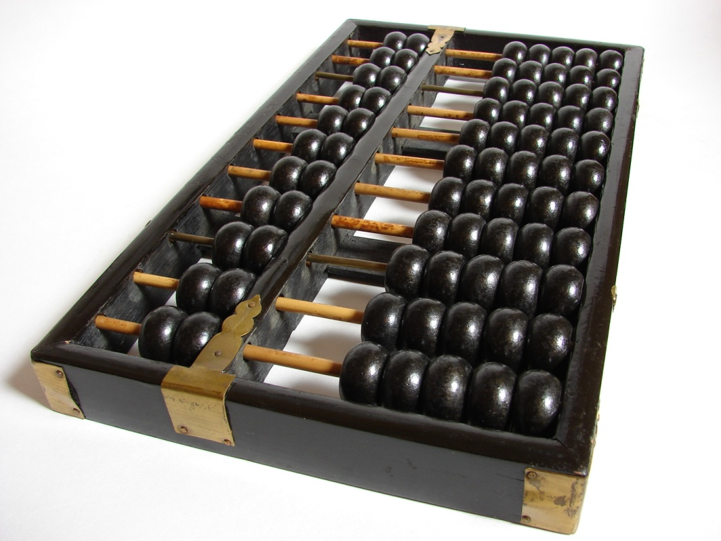
The “Arithmetic Thing”
aka: the Arithmetic Logic Unit (ALU)

Slide 37
We are here
Assembly Language
Processors
Arithmetic Logic Units
Finite State Machines
Devices
Flip-flops
Circuits
Gates
Transistors

Slide 38
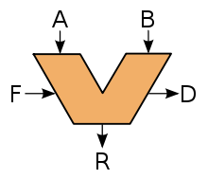
Arithmetic Logic Unit
The first microprocessor applications were calculators.
Recall the unit on adders and subtractors.
These are part of a larger structure called the arithmetic logic unit (ALU).
This larger structure is responsible for the processing of all data values in a basic CPU.

Slide 39
ALU inputs
The ALU performs all of the arithmetic operations covered in this course so far, and logical operations as well (AND, OR, NOT, etc.)
A and B are the operands
The select bits (S) indicate which operation is being performed (S2 is a mode select bit, indicating whether the ALU is in arithmetic or logic mode).
The carry bit C_{in} is used in operations such as incrementing an input value or the overall result.
B
A
C_{in},S
VCNZ
G

Slide 40
ALU outputs
A
B
In addition to the input signals, there are output signals V, C, N & Z which indicate special conditions in the arithmetic result:
V: overflow condition
The result of the operation could not be stored in the n bits of G, meaning that the result is incorrect.
C: carry-out bit
N: Negative indicator
Z: Zero-condition indicator
C_{in},S
VCNZ
G

Slide 41
The “A” of ALU
To understand how the ALU does all of these operations, let’s start with the arithmetic side.
Fundamentally, this side is made of an adder / subtractor unit, which we’ve seen already:
Y₃
Y₂
Y₁
Y₀
Sub
X₃
X₂
X₁
X₀
C_{out}
FA
C₃
FA
C₂
FA
C₁
C_{in}
FA
S₃
S₂
S₁
S₀

Slide 42
ALU block diagram
In addition to data inputs and outputs, this circuit also has:
outputs indicating the different conditions,
inputs specifying the operation to perform (similar to Sub).
n-bit
ALU
A₀
Data input A
A₁
...
…
G₀
A_{n}
G₁
Data output G
…
...
B₀
G_{n}
Data input B
B₁
...
…
B_{n}
C_{out}
Carry output
Carry input
C_{in}
V
Overflow indicator
S₀
N
Negative indicator
Operation &
Mode select
S₁
Zero indicator
Z
S₂

Slide 43
Arithmetic components
C_{in}
n
n-bit
parallel
adder
A
X
n
G
G = X + Y + C_{in}
n
B input
logic
n
B
Y
S₀
S₁
C_{out}
In addition to addition and subtraction, many more operations can be performed by manipulating what is added to input B, as shown in the diagram above.

Slide 44
Arithmetic operations
If the input logic circuit on the left sends B straight through to the adder, result is G = A+B
What if B was replaced by all ones instead?
Result of addition operation: G = A-1
What if B was replaced by B?
Result of addition operation: G = A-B-1
And what if B was replaced by all zeroes?
Result is: G = A. (Not interesting, but useful!)
→ Instead of a Sub signal, the operation you want is signaled using the select bits S₀ & S₁.

Slide 45
Operation selection
Select bits |  | Y input | Result | Operation
S₁ | S₀
0 | 0 | All 0s | G = A | Transfer
0 | 1 | B | G = A+B | Addition
1 | 0 | B | G = A+B | Subtraction - 1
1 | 1 | All 1s | G = A-1 | Decrement
This is a good start! But something is missing…
What about the carry bit?

Slide 46
Full operation selection
Select |  | Input | Operation
S₁ | S₀ | Y | C_{in}=0 | C_{in}=1
0 | 0 | All 0s | G = A (transfer) | G = A+1 (increment)
0 | 1 | B | G = A+B (add) | G = A+B+1
1 | 0 | B | G = A+B | G = A+B+1 (subtract)
1 | 1 | All 1s | G = A-1 (decrement) | G = A (transfer)
Based on the values on the select bits and the carry bit, we can perform any number of basic arithmetic operations by manipulating what value is added to A.

Slide 47
The “L” of ALU
We also want a circuit that can perform logical operations, in addition to arithmetic ones.
How do we tell which operation to perform?
Another select bit!
If S₂ = 1, then logic circuit block is activated.
Multiplexer is used to determine which block (logical or arithmetic) goes to the output.
S₀
4-to-1
mux
S₁
G
A
0
B
1
2
3

Slide 48
Single ALU Stage
C_{i}
Arithmetic
circuit
C_{i+1}
C_{i}
V
A_{i}
A_{i}
N
B_{i}
B_{i}
Z
G_{i}
S₀
S₀
S₁
S₁
0
G_{i}
1
Logic
circuit
A_{i}
B_{i}
G_{i}
S₀
S₁
S₂

Slide 49
Multiplication

Slide 50
What about multiplication?
Multiplication (and division) operations are always more complicated than other arithmetic (addition, subtraction) or logical (AND, OR) operations.
Three major ways that multiplication can be implemented in circuitry:
Layered rows of adder units.
An adder/shifter circuit
Booth’s Algorithm

Slide 51
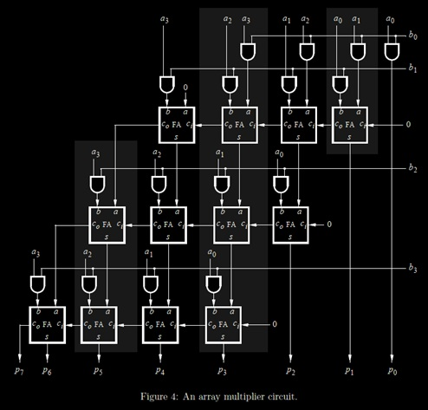
Multiplication
Multiplier circuits can be constructed as an array of adder circuits.
This can get a little expensive as the size of the operands grows.
Is there an alternative to this circuit?

Slide 52
Multiplication
Revisiting grade 3 math…
12 3
x 456
1368
123
x 456
123
x 456
1368
912
456
56088
1 2 3
x 456
1368
912
1 23
x 456
1368
912
456

Slide 53
Multiplication
And now, in binary…
10 1
x 110
110
101
x 110
101
x 110
110
000
110
11110
1 0 1
x 110
110
000
1 01
x 110
110
000
110

Slide 54
Observations
101
x 110
110
000
110
11110
Calculation flow
Multiply by 1 bit of multiplier
Add to sum and shift sum
Shift multiplier by 1 bit
Repeat the above
What is “multiply by 1 bit of binary”?
10101 x 1 ?
10101 x 0 ?
It’s an AND!

Slide 55
Accumulator circuits
What if you could perform each stage of the multiplication operation, one after the other?
This circuit would only need a single row of adders and a couple of shift registers.
Register Y
Register X
Shift Left 1
101
x 110
110
000
110
11110
1xn AND
Shift Left 1
Adder
Register R

Slide 56
Make it more efficient
Think about 258 x 9999
Multiply by 9, add to sum, shift, multiply by 9, add to sum, shift, multiple by 9, add to sum, shift, multiply by 9, add to sum.
258 x 9999 = 258 x (10000 - 1) = 258 x 10000 – 258
Just shift 258, becomes 2580000, then do 2580000 – 258
More efficient!

Slide 57
Efficient Multiplication: Booth’s Algorithm
Take advantage of circuits where shifting is cheaper than adding, or where space is at a premium.
when multiplying by certain values (e.g. 99), it can be easier to think of this operation as a difference between two products.
Consider the shortcut method when multiplying a given decimal value X by 9999:
X*9999 = X*10000 – X*1
Now consider the equivalent problem in binary:
X*001111 = X*010000 – X*1
More details: https://en.wikipedia.org/wiki/Booth%27s_multiplication_algorithm

Slide 58
Reflections on multiplication
Multiplication isn’t as common an operation as addition or subtraction, but occurs enough that its implementation is handled in the hardware.
Most common multiplication and division operations are powers of 2. For this, we do shifting instead of using the multiplier circuit.
e.g., in your code, do x << 3, instead of x * 8

Slide 59
A Barrel Shifter unit
D
3
D
2
D
1
D
0
S
0
S
1
3
2
1
0
S
1
S
0
3
2
1
0
S
1
S
0
3
2
1
0
S
1
S
0
3
2
1
0
S
1
S
0
4-to-1 MUX
4-to-1 MUX
4-to-1 MUX
4-to-1 MUX
Y
3
Y
2
Y
1
Y
0
This barrel shifter shifts and rotates D to the left by S bits.
If S₁S₀ is 01 => Y = D₂D₁D₀D₃
If S₁S₀ is 11 => Y = D₀D₃D₂D₁
This is a purely combinational circuit, unlike the shift registers in the lab.

Slide 60
Expanding our view
A
B
Constant in
1
0
MuxB select
Address out
n
Data out
G select
A
B
B
Shifter
S_{2:0},C_{in}
H select
V,C,N,Z
ALU
I_{R}
I_{L}
G
H
n
n
1
0
MuxF select
F
So where do A and B come from?

Slide 61
Controller Thing
Next
Storage
Thing
Arithmetic Thing

Slide 62
CSCB58: Computer Organization
Prof. Gennady Pekhimenko
University of Toronto
Fall 2020
The content of this lecture is adapted from the lectures of
Larry Zheng and Steve Engels

Slide 63
Booth’s Algorithm
This idea is triggered on cases where two neighboring digits in an operand are different.
If digits at i and i-1 are 0 and 1, the multiplicand is added to the result at position i.
If digits at i and i-1 are 1 and 0, the multiplicand is subtracted from the result at position i.
The result is always a value whose size is the sum of the sizes of the two multiplicands.

Slide 64
Booth’s Algorithm
Example:
01010010
x 00011110
01010010
+ 111110101110
0100110011100
B
A
Add B here
Subtract B from here
Sign extend this before adding

Slide 65
Booth’s Algorithm
We need to make this work in hardware.
Option #1: Have hardware set up to compare neighbouring bits at every position in A, with adders in place for when the bits don’t match.
Problem: This is a lot of hardware, which Booth’s Algorithm is trying to avoid.
Option #2: Have hardware set up to compare tw0 neighbouring bits, and have them move down through A, looking for mismatched pairs.
Problem: Hardware doesn’t move like that. Oops.

Slide 66
Booth’s Algorithm
Still need to make this work in hardware…
Option #3: Have hardware set up to compare tw0 neighbouring bits in the lowest position of A, and looking for mismatched pairs in A by shifting A to the right one bit at a time.
Solution! This could work, but the accumulated solution P would have to shift one bit at a time as well, so that when B is added or subtracted, it’s from the correct position.

Slide 67
Booth’s Algorithm
Note: unlike the accumulator, the bits here are being shifted to the right!
Steps in Booth’s Algorithm:
Designate the two multiplicands as A & B, and the result as some product P.
Add an extra zero bit to the right-most side of A.
Repeat the following for each original bit in A:
If the last two bits of A are the same, do nothing.
If the last two bits of A are 01, then add B to the highest bits of P.
If the last two bits of A are 10, then subtract B from the highest bits of P.
Perform one-digit arithmetic right-shift on both P and A.
The result in P is the product of A and B.

Slide 68
Booth’s Algorithm Example
Example: (-5) * 2
Steps #1 & #2:
A = -5 → 11011
Add extra zero to the right → A = 11011 0
B = 2 → 00010
-B = -2 → 11110
P = 0 → 00000 00000

Slide 69
Booth’s Algorithm Example
Step #3 (repeat 5 times):
Check last two digits of A:
1101 10
Since digits are 10, subtract B from the most significant digits of P:
P 00000 00000
-B +11110
P’ 11110 00000
Arithmetic shift P and A one bit to the right:
A = 111011 P = 11111 00000

Slide 70
Booth’s Algorithm Example
Step #3 (repeat 4 more times):
Check last two digits of A:
1110 11
Since digits are 11, do nothing to P.
Arithmetic shift P and A one bit to the right:
A = 111101 P = 11111 10000

Slide 71
Booth’s Algorithm Example
Step #3 (repeat 3 more times):
Check last two digits of A:
1111 01
Since digits are 01, add B to the most significant digits of P:
P 11111 10000
+B +00010
P’ 00001 10000
Arithmetic shift P and A one bit to the right:
A = 111110 P = 00000 11000

Slide 72
Booth’s Algorithm Example
Step #3 (repeat 2 more times):
Check last two digits of A:
1111 10
Since digits are 10, subtract B from the most significant digits of P:
P 00000 11000
-B +11110
P’ 11110 11000
Arithmetic shift P and A one bit to the right:
A = 111111 P = 11111 01100

Slide 73
Booth’s Algorithm Example
Step #3 (final time):
Check last two digits of A:
1111 11
Since digits are 11, do nothing to P:
Arithmetic shift P and A one bit to the right:
A = 111111 P = 11111 10110
Final product: P = 111110110
= -10

