Slide 1
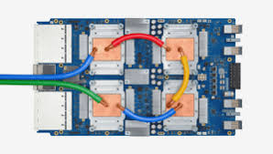
CSCB58: Computer Organization
Prof. Gennady Pekhimenko
University of Toronto
Fall 2020
The content of this lecture is adapted from the lectures of
Larry Zheng and Steve Engels

Slide 2
CSCB58 Week 5

Slide 3
We are here
Assembly Language
Processors
Arithmetic Logic Units
Finite State Machines
Devices
Flip-flops
Circuits
Gates
Transistors

Slide 4
Circuits using flip-flops
Now that we know about flip-flops and what they do, how do we use them in circuit design?
What’s the benefit in using flip-flops in a circuit at all?
Inputs
Combinational Circuit
Outputs
Storage Units
We can design much cooler circuits using flip-flops.

Slide 5
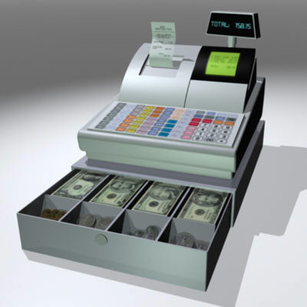
Example #1: Registers
For storing values

Slide 6
Shift registers
A series of D flip-flops can store a multi-bit value (such as a 16-bit integer, for example).
Data can be shifted into this register one bit at a time, over 16 clock cycles.
Known as a shift register.
SI
D₀
Q
D₁
Q
D₂
Q
D₁₅
Q
Q
Q
Q
Q
Clk

Slide 7
Load registers
One can also load a register’s values all at once, by feeding signals into each flip-flop:
In this example: a 4-bit load register.
D₀
D₁
D₂
D₃
D
Q
D
Q
D
Q
D
Q
Q
Q
Q
Q
Clk
One clock pulse, 4 bits stored.

Slide 8
Load registers
To control when this register is allowed to load its values, we introduce the D flip-flop with enable:
EN
D2
Q
D
Q
D
EN
Clk
Q
Q
When EN = 1, D2 is whatever D is, load D
When EN = 0, D2 is whatever Q is, maintain Q

Slide 9
Load registers
D₀
D₁
D₂
D₃
D
Q
D
Q
D
Q
D
Q
EN
EN
EN
EN
Q
Q
Q
Q
Write
Clk
Implementing the register with these special D flip-flops will now maintain values in the register until overwritten by setting EN high.

Slide 10
In computer architecture, registers are the CPU’s most local storages (30+ of them on-chip), i.e., they are the lowest level of the memory hierarchy. They are the memory units that the CPU directly interact with.
Higher level of memory include cache, RAM, hard disc, etc.

Slide 11
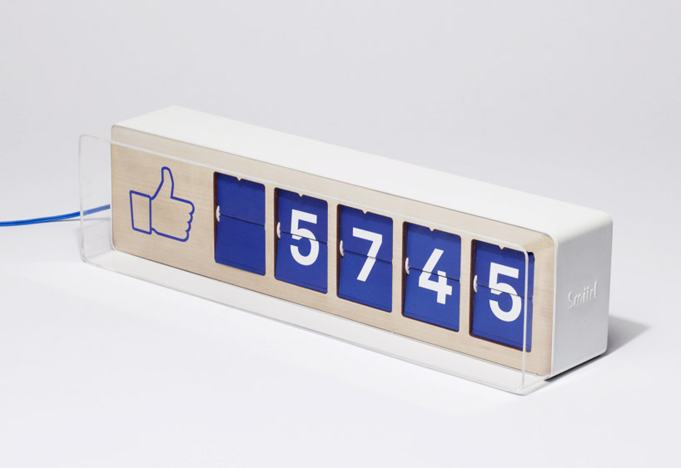
Example #2: Counters

Slide 12
Counters
T
Q
Consider the T flip-flop:
Output is inverted when input T is high.
What happens when a series of T flip-flops are connected together in sequence?
More interesting:
Connect the output of one flip-flop to the clock input of the next!
Q
T
D
Q
Clk
Q

Slide 13
Counters
Asynchronous means the four outputs do not change upon the same clock signal.
1
Q₀
Q₁
Q₂
Q₃
T
Q
T
Q
T
Q
T
Q
Q
Q
Q
Q
This is a 4-bit ripple counter, which is an example of an asynchronous circuit.
Timing isn’t quite synchronized with the rising clock pulse.
Cheap to implement, but unreliable for timing.

Slide 14
Demo: asynchronous human counter
1
Q₀
Q₁
Q₂
Q₃
T
Q
T
Q
T
Q
T
Q
Q
Q
Q
Q
Need 4 volunteers, Q0, Q1, Q2, Q3
Q0 toggles when receives clock signal (tap on shoulder)
Q1 toggles when Q0 goes from 1 to 0
Q2 toggles when Q1 goes from 1 to o
Q3 toggles when Q2 goes from 1 to 0
6. Audience read the number Q3Q2Q1Q0

Slide 15
Counters
1
Q₀
Q₁
Q₂
Q₃
Timing diagram
T
Q
T
Q
T
Q
T
Q
C
Q
Q
Q
Q
C
Q₀
0
0
0
0
1
0
0
0
0
1
0
0
1
1
0
0
0
0
1
0
1
0
1
0
0
1
1
0
1
1
1
0
0
0
0
1
Q₁
Q₂
Q₃

Slide 16
Synchronous Counter
Toggle only when the lower bit is 1 and is toggling to 0 (carry bit generated)
Write
T
Q
T
Q
T
Q
T
Q
Q₂
Q₃
Q₀
Q₁
Q
Q
Q
Q
Clk
This is a synchronous counter, because all output Q’s change upon the same clock edge.

Slide 17
Counter with parallel load
When load is high, set states to R0 and R1
Load
Write
R₀
R₁
0
1
0
1
D
Q
D
Q
Q
Q
Clk
Clear
Counters are often implemented with a parallel load and clear inputs.
Can set the counter to whatever value needed.

Slide 18
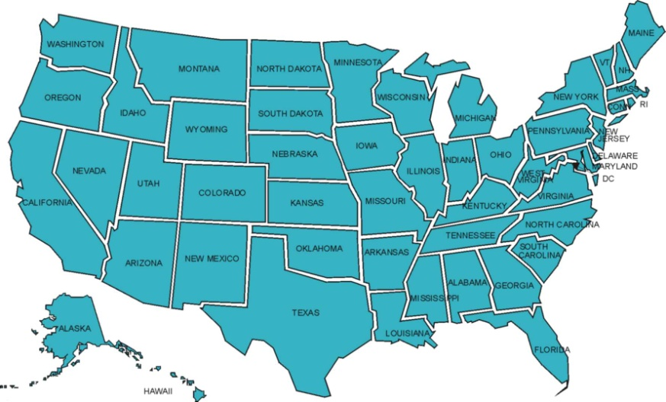
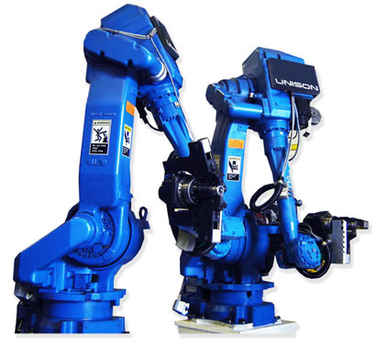
State Machines

Slide 19
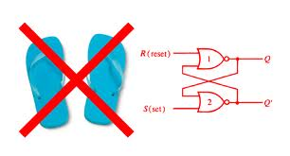
Designing with flip-flops
Counters and registers are examples of how flip-flops can implement useful circuits that store values.
How do you design these circuits?
What would you design with these circuits?

Slide 20
Designing with flip-flops
Sequential circuits are the basis for memory, instruction processing, and any other operation that requires the circuit to remember past data values.
These past data values are also called the states of the circuit.
Need to describe the relation between the current state and the next state: use combinational circuits

Slide 21
State example: Counters
With counters, each state is the current number that is stored in the counter.
On each clock tick, the circuit transitions from one state to the next, based on the inputs.
0
1
0
1
0
Each state does not need to correspond to a binary number, they are just different states
1
1
one
two
three
0
001
010
011
0
zero
four
000
100
seven
six
five
111
110
101
1
1
0
1
0
1
0

Slide 22
State Tables
State | Write | State
zero | 0 | zero
zero | 1 | one
one | 0 | one
one | 1 | two
two | 0 | two
two | 1 | three
three | 0 | three
three | 1 | four
four | 0 | four
four | 1 | five
five | 0 | five
five | 1 | six
six | 0 | six
six | 1 | seven
seven | 0 | seven
seven | 1 | zero
State tables help to illustrate how the states of the circuit change with various input values.
Transitions are understood to take place on the clock ticks.

Slide 23
State Tables
F₁ | F₂ | F₃ | Write | F₁ | F₂ | F₃
0 | 0 | 0 | 0 | 0 | 0 | 0
0 | 0 | 0 | 1 | 0 | 0 | 1
0 | 0 | 1 | 0 | 0 | 0 | 1
0 | 0 | 1 | 1 | 0 | 1 | 0
0 | 1 | 0 | 0 | 0 | 1 | 0
0 | 1 | 0 | 1 | 0 | 1 | 1
0 | 1 | 1 | 0 | 0 | 1 | 1
0 | 1 | 1 | 1 | 1 | 0 | 0
1 | 0 | 0 | 0 | 1 | 0 | 0
1 | 0 | 0 | 1 | 1 | 0 | 1
1 | 0 | 1 | 0 | 1 | 0 | 1
1 | 0 | 1 | 1 | 1 | 1 | 0
1 | 1 | 0 | 0 | 1 | 1 | 0
1 | 1 | 0 | 1 | 1 | 1 | 1
1 | 1 | 1 | 0 | 1 | 1 | 1
1 | 1 | 1 | 1 | 0 | 0 | 0
Same table as on the previous slide, but with the actual flip-flop values instead of state labels.
Note: Flip-flop values are both inputs and outputs of the circuit here.

Slide 24
Finite State Machines
and this brings us to…

Slide 25
Finite State Machines (FSMs)
From theory courses…
A Finite State Machine is an abstract model that captures the operation of a sequential circuit.
A FSM is defined (in general) by:
A finite set of states,
A finite set of transitions between states, triggered by inputs to the state machine,
Output values that are associated with each state or each transition (depending on the machine),
Start and end states for the state machine.

Slide 26
Design procedures comparison (roughly)
Combinational circuits
Desired behaviour
Truth table
Logic expression
Circuit
Sequential circuits
Desired behaviour (cooler behaviour)
Finite state machine
Circuit with flip-flops

Slide 27
Example #1: Tickle Me Elmo
Remember how the Tickle Me Elmo works!

Slide 28
Example #1: Tickle Me Elmo
Toy reacts differently each time it is squeezed:
First squeeze → “Ha ha ha…that tickles.”
Second squeeze → “Ha ha ha…oh boy.”
Third squeeze → “HA HA HA HA…”, go crazy
Questions to ask:
What are the inputs?
What are the states of this machine?
How do you change from one state to the next?

Slide 29
Example #1: Tickle Me Elmo
Initial
Squeeze
Tickles
Squeeze
GoCrazy
Squeeze
OhBoy
Squeeze

Slide 30
Example #2: Traffic Light
Change=0
Red
Change=1
Change=1
Yellow
Green
Change=1
Change=0
Change=0

Slide 31
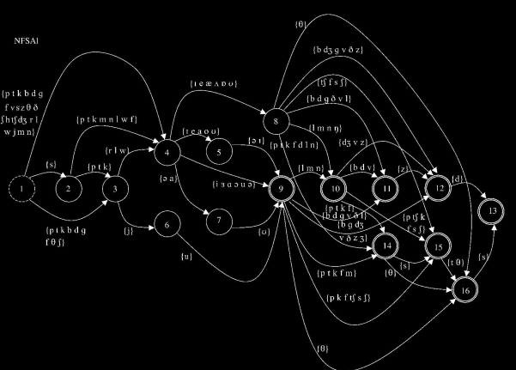
FSM design
Design steps for FSM:
Draw state diagram
Derive state table from state diagram
Assign flip-flop configuration to each state
Redraw state table with flip-flop values
Derive combinational circuit for output and for each flip-flop input.

Slide 32
Example: Sequence Recognizer
Recognize a sequence of input values, and raise a signal if that input has been seen.
Example: Three high values in a row
Detect that the input has been high for three rising clock edges.
Assumes a single input X and a single output Z.
What are the states?

Slide 33
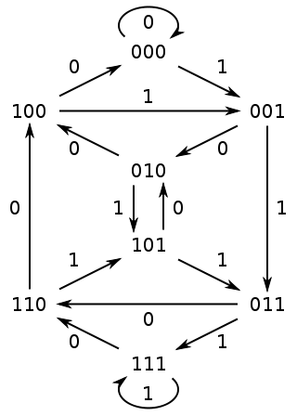
Step 1: State diagram
In this case, the states are labeled with the most recent three input values.
Transitions between states are indicated by the values on the transition arrows.

Slide 34
Step 2: State table
Make sure that the state table lists all the states in the state diagram, and all the possible inputs that can occur at that state.
Previous State | EN | Next State
000 | 0 | 000
000 | 1 | 001
001 | 0 | 010
001 | 1 | 011
010 | 0 | 100
010 | 1 | 101
011 | 0 | 110
011 | 1 | 111
100 | 0 | 000
100 | 1 | 001
101 | 0 | 010
101 | 1 | 011
110 | 0 | 100
110 | 1 | 101
111 | 0 | 110
111 | 1 | 111

Slide 35
Step 3: Assign flip-flops
Assign flip-flops for storing states.
A single flip-flop can store two values (0 and 1), and thus two states.
How many states can be stored with each additional flip-flop?
One flip-flop → 2 states
Two flip-flops → 4 states
Three flip-flops → 8 states
…
Eight flip-flops? → 2⁸ = 256 states
n states need: ceiling(log₂n) flip-flops

Slide 36
How many flip-flops for this one?
3

Slide 37
Step 3: Assign flip-flops
In this case, we need to store 8 states.
8 states = 3 flip-flops (3 = log₂ 8)
For now, assign a flip-flop to each digit of the state names in the FSM & state table.
EN
Combinational Circuit
D
Q
D
Q
D
Q
Q
Q
Q
Clk

Slide 38
Step 4: State table
F₂ | F₁ | F₀ | EN | F₂ | F₁ | F₀
0 | 0 | 0 | 0 | 0 | 0 | 0
0 | 0 | 0 | 1 | 0 | 0 | 1
0 | 0 | 1 | 0 | 0 | 1 | 0
0 | 0 | 1 | 1 | 0 | 1 | 1
0 | 1 | 0 | 0 | 1 | 0 | 0
0 | 1 | 0 | 1 | 1 | 0 | 1
0 | 1 | 1 | 0 | 1 | 1 | 0
0 | 1 | 1 | 1 | 1 | 1 | 1
1 | 0 | 0 | 0 | 0 | 0 | 0
1 | 0 | 0 | 1 | 0 | 0 | 1
1 | 0 | 1 | 0 | 0 | 1 | 0
1 | 0 | 1 | 1 | 0 | 1 | 1
1 | 1 | 0 | 0 | 1 | 0 | 0
1 | 1 | 0 | 1 | 1 | 0 | 1
1 | 1 | 1 | 0 | 1 | 1 | 0
1 | 1 | 1 | 1 | 1 | 1 | 1
Prev. State
Next State
000
000
001
001
010
010
011
011
100
100
101
101
110
110
111
111
000
001
001
010
010
011
011
100
100
101
101
110
110
111
111
000
Mapping states to flip-flop values
This is NOT the only way of mapping from state to flip flop values, in fact it is not even a good way, as we will see later.

Slide 39
Step 4: State table
F₂ | F₁ | F₀ | EN | F₂ | F₁ | F₀
0 | 0 | 0 | 0 | 0 | 0 | 0
0 | 0 | 0 | 1 | 0 | 0 | 1
0 | 0 | 1 | 0 | 0 | 1 | 0
0 | 0 | 1 | 1 | 0 | 1 | 1
0 | 1 | 0 | 0 | 1 | 0 | 0
0 | 1 | 0 | 1 | 1 | 0 | 1
0 | 1 | 1 | 0 | 1 | 1 | 0
0 | 1 | 1 | 1 | 1 | 1 | 1
1 | 0 | 0 | 0 | 0 | 0 | 0
1 | 0 | 0 | 1 | 0 | 0 | 1
1 | 0 | 1 | 0 | 0 | 1 | 0
1 | 0 | 1 | 1 | 0 | 1 | 1
1 | 1 | 0 | 0 | 1 | 0 | 0
1 | 1 | 0 | 1 | 1 | 0 | 1
1 | 1 | 1 | 0 | 1 | 1 | 0
1 | 1 | 1 | 1 | 1 | 1 | 1
Mapping states to flip-flop values
This is NOT the only way of mapping from state to flip flop values, in fact it is not even a good way, as we will see later.

Slide 40
Step 5: Circuit design
Karnaugh map for F₂:
 | F₀·EN | F₀·EN | F₀·EN | F₀·EN
F₂·F₁ | 0 | 0 | 0 | 0
F₂·F₁ | 1 | 1 | 1 | 1
F₂·F₁ | 1 | 1 | 1 | 1
F₂·F₁ | 0 | 0 | 0 | 0
F₂ = F₁
Next state
Current state

Slide 41
Step 5: Circuit design
Karnaugh map for F₁:
 | F₀·EN | F₀·EN | F₀·EN | F₀·EN
F₂·F₁ | 0 | 0 | 1 | 1
F₂·F₁ | 0 | 0 | 1 | 1
F₂·F₁ | 0 | 0 | 1 | 1
F₂·F₁ | 0 | 0 | 1 | 1
F₁ = F₀
Next state
Current state

Slide 42
Step 5: Circuit design
Karnaugh map for F₀:
 | F₀·EN | F₀·EN | F₀·EN | F₀·EN
F₂·F₁ | 0 | 1 | 1 | 0
F₂·F₁ | 0 | 1 | 1 | 0
F₂·F₁ | 0 | 1 | 1 | 0
F₂·F₁ | 0 | 1 | 1 | 0
F₀ = EN
Next state
Current state

Slide 43
Step 5: Circuit design
F₂ = F₁
F₁ = F₀
F₀ = EN
Resulting circuit looks like the diagram on the right.
This will record the states and make the state transitions happen based on the input,
What about the output value Z which should go high when we have three highs in a row.
EN
D
Q
F₀
Clk
Q
D
Q
F₁
Q
D
Q
F₂
Q

Slide 44
Step 5: Circuit design
Boolean equation for Z:
EN
D
Q
F₀
Z = F₀·F₁·F₂
Clk
Q
Z
D
Q
F₁
Q
D
Q
F₂
Q

Slide 45
Moore machine vs Mealy machine
Two ways to derive the circuitry needed for the output values of the state machine:
Moore machine:
The output for the FSM depends solely on the current state (based on entry actions).
Mealy machine:
The output for the FSM depends on the state and the input (based on input actions).
Being in state X can result in different output, depending on the input that caused that state.

Slide 46
An issue: timing and state assignments
010
Example: if recognizer circuit is in state 011 and gets a 0 as an input, it moves to state 110.
The first and last digits should change “at the same time”, but they can’t.
If the first flip-flop changes first, the state will change to 111, and the output Z would go high for an instant, which is unexpected behaviour.
If the second flip-flop changes first, it’s fine since the intermediate state 010 does NOT cause unexpected behaviour.

Slide 47
An issue: timing and state assignments
So how do you solve this?
Two possible solutions:
Whenever possible, make flip-flop assignments such that neighbouring states differ by at most one flip-flop value.
Intermediate states can be allowed if the output generated by those states is consistent with the output of the starting or destination states.
If the intermediate states are unused in the state diagram, you can set the output for these states to provide the output that you need.
Might need to add more flip-flops to create these states.

Slide 48
Previous State | EN | Next State
000 | 0 | 000
000 | 1 | 001
001 | 0 | 010
001 | 1 | 011
010 | 0 | 100
010 | 1 | 101
011 | 0 | 110
011 | 1 | 111
100 | 0 | 000
100 | 1 | 001
101 | 0 | 010
101 | 1 | 011
110 | 0 | 100
110 | 1 | 101
111 | 0 | 110
111 | 1 | 111
State 000 does not have to have flip-flop values 000, it can be anything you want to assign.
Home exercise: re-assign the states so the time issue doesn’t exist

Slide 49
After-class example: Mouse clicks
Design a circuit that takes in two signals:
A signal P, which is high if the user is pressing the mouse button,
A signal M, which is high if the mouse is being moved.
Based on the inputs, indicate whether the user is clicking, double-clicking, or dragging the mouse on the screen.

Slide 50
10
Clicked
11
00
01
00,01
10
00
10,11
Neutral
01
Dragging
Released
11
01
00
10
11
Double Clicked
10
Transitions indicate the values of P&M.
Outputs depend on the state (Moore machine)
Home exercise: build the circuit for the mouse based on this FSM.

Slide 51
Next week processor architecture

Slide 52
CSCB58: Computer Organization
Prof. Gennady Pekhimenko
University of Toronto
Fall 2020
The content of this lecture is adapted from the lectures of
Larry Zheng and Steve Engels

