Slide 1
CSCB58: Computer Organization
Prof. Gennady Pekhimenko
University of Toronto
Fall 2020
The content of this lecture is adapted from the lectures of
Larry Zheng and Steve Engels

Slide 2
CSCB58 Week 4

Slide 3
Quiz 2 Discussion

Slide 4
Question 2
X’W’ +
V’Y’ +
XVW

Slide 5
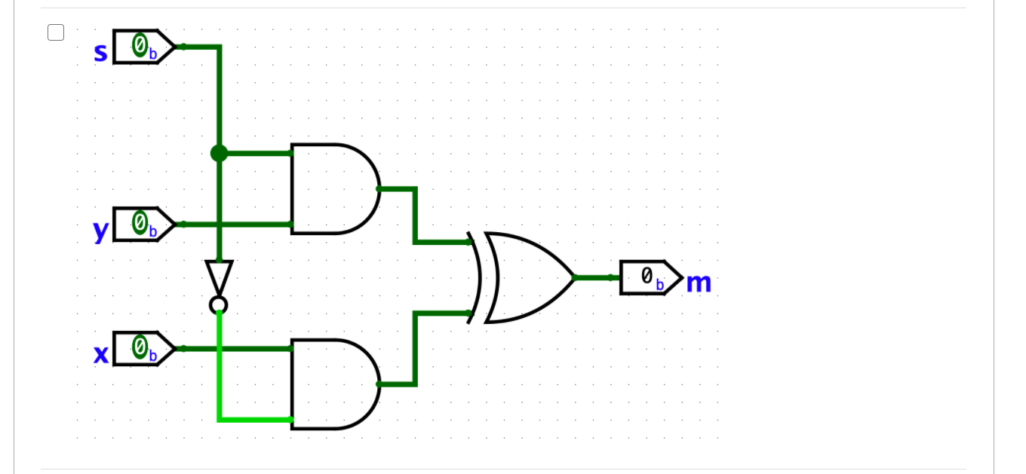
Question 5
Which of the following circuit diagrams represent a 2-to-1 multiplexer? Select all that apply

Slide 6
New Topic: Sequential Circuits
Assembly Language
Processors
Arithmetic Logic Units
Finite State Machines
Devices
Flip-flops
Circuits
Gates
Transistors

Slide 7
Memory
Why do we have memory?
Why do circuits have memory?

Slide 8
Something we can’t do yet
How does the Tickle Me Elmo work?
https://www.youtube.com/watch?v=zG62dirxRgc
Same input, different outputs.
The circuit somehow remembers how many pushes have been made.

Slide 9
Two kinds of circuits
So far, we’ve dealt with combinational circuits:
Circuits where the output values are entirely dependent and predictable from the input values.
Another class of circuits: sequential circuits
Circuits that also depend on both the inputs and the previous state of the circuit.

Slide 10
In other words…
Combination circuits does NOT have memory
Everything is based on current input value
Sequential Circuits have memory.
They remember something from the past (the previous state of the circuit), and its output depends on that
It is why computers have memory (e.g., RAM)

Slide 11
Sequential circuits
This creates circuits whose internal state can change over time, where the same input values can result in different outputs.
Why would we need circuits like this?
Memory values
To remember stuff
Reacting to changing inputs
“Output X = 1 when input A changes”

Slide 12
How can a circuit have memory?
Inputs
Outputs
Circuit
The magic: feedback!

Slide 13
Truth table of a sequential circuit
output: Q_{T+1}
A
feedback: Q_{T}
Q
In these truth tables, Q_{T} and Q_{T+1} represent the values of Q at a time T, and a point in time immediately after (T+1)
A | Q_{T} | Q_{T+1}= A∙Q_{T}
0 | 0 | 0
0 | 1 | 0
1 | 0 | 0
1 | 1 | 1
The output not only depends on the input A, but also depends on the previous state of the circuit.

Slide 14
AND with feedback
A
Q
(0, 1, 0) is a transient state since it will become (0, 0, 0) immediately
A | Q_{T} | Q_{T+1}= A∙Q_{T}
0 | 0 | 0
0 | 1 | 0
1 | 0 | 0
1 | 1 | 1
Once the output is 0, it will be stuck at 0, no matter how you change A.
It has a memory that cannot be changed.

Slide 15
NAND with feedback, more interesting
A
Q
A | Q_{T} | Q_{T+1}
0 | 0 | 1
0 | 1 | 1
1 | 0 | 1
1 | 1 | 0
Transient (-> (0, 1, 1))
Oscillates between
each other
Output Q_{T+1} can be changed by changing A

Slide 16
NAND waveform behaviour
A | Q_{T} | Q_{T+1}
0 | 0 | 1
0 | 1 | 1
1 | 0 | 1
1 | 1 | 0
A
Q
Oscillates
A
Q
Input A can control output Q, but the behavior of Q is not very stable.

Slide 17
NOR with feedback
A
Q
A | Q_{T} | Q_{T+1}
0 | 0 | 1
0 | 1 | 0
1 | 0 | 0
1 | 1 | 0
Oscillates between
each other
Transient (-> (1, 0, 0))
Output Q_{T+1} can be changed by changing A

Slide 18
Feedback behaviour
NAND behaviour
NOR behaviour
A | Q_{T} | Q_{T+1}
0 | 0 | 1
0 | 1 | 1
1 | 0 | 1
1 | 1 | 0
A | Q_{T} | Q_{T+1}
0 | 0 | 1
0 | 1 | 0
1 | 0 | 0
1 | 1 | 0
What makes NAND and NOR feedback circuits different?
Unlike the AND and OR gate circuits (which get stuck), the output Q_{T+1} can be changed, based on A.
However, gates like these that feed back on themselves could enter an unsteady state.

Slide 19
Latch
A feedback circuit with (sort-of) stable behaviour

Slide 20
Latches
If multiple gates of these types are combined, you can get more steady behaviour.
These circuits are called latches.
A
A
Q
Q
Q
Q
B
B

Slide 21
S’R’ Latch
S
Q
R
Q

Slide 22
Warm up
This ”locking” situation is typically a good starting point when analyzing the behaviour of a sequential circuit.
A
Knowing A = 0, what can you say about the output of the NAND gate?
Must be 1, regardless of the other input
i.e., a zero input “locks” the NAND gate

Slide 23
S’R’ latch: Case 1
1
0
S
Q
Let’s see what happens when the input values are changed…
Assume that S’ and R’ are set to 1 and 0 to start.
The R’ input sets the output Q’ to 1, which sets the output Q to 0.
Setting R’ to 1 keeps the output value Q’ at 1, which maintains both output values.
Q
R
1
0
1
0
S
Q
Q
R
1
1

Slide 24
S’R’ latch: Case 2
1
0
0
1
S
Q
(continuing from previous)
S’ and R’ start with values of 1, when S’ is set to 0.
This sets output Q to 1, which sets the output Q’ to 0.
Setting S’ back to 1 keeps the output value Q at 0, which maintains both output values.
Q
R
1
0
1
1
0
1
1
S
Q
Q
R
0
1

Slide 25
1
0
1
0
1
S
S
Q
Q
Q
Q
R
R
1
0
1
1
Case 1
Case 2
Same input, different outputs

Slide 26
1
1
0
0
0
1
S
S
Q
Q
Q
Output of inputs 11 :
maintain the previous output!
Q
R
R
1
1
0
1
0
1
0
1
1
0
1
S
S
Q
Q
Q
Q
R
R
1
0
1
1

Slide 27
S’R’ latch
S | R | Q_{T} | Q_{T} | Q_{T+1} | Q_{T+1}
0 | 0 | X | X | 1 | 1
0 | 1 | X | X | 1 | 0
1 | 0 | X | X | 0 | 1
1 | 1 | 0 | 1 | 0 | 1
1 | 1 | 1 | 0 | 1 | 0
S
Q
Q
R
S and R are called “set” and “reset” respectively.
When S’ = 0, R’ = 1, Q is 1
When S’ = 1, R’ = 0, Q is 0
When S’R’ = 11, same as previous state (01 or 10)
How about going from 00 to 11
Depends on whether it changes from 00 to 01 to 11, or from 00 to 10 to 11 (race condition)
unstable behaviour

Slide 28
More on instability
Unstable behaviour occurs when a S’R’ latch goes from 00 to 11, or a SR latch goes from 11 to 00.
The signals don’t change simultaneously, so the outcome depends on which signal changes first.
Because of the unstable behaviour, 00 is considered a forbidden state in NAND-based S’R’ latches, and 11 is considered a forbidden state in NOR-based SR latches.

Slide 29
More on instability
S | R | Q_{T} | Q_{T} | Q_{T+1} | Q_{T+1}
0 | 0 | X | X | 1 | 1
0 | 1 | X | X | 1 | 0
1 | 0 | X | X | 0 | 1
1 | 1 | 0 | 1 | 0 | 1
1 | 1 | 1 | 0 | 1 | 0
Forbidden state
SR-latch
“set” and “reset” cannot be both true!
S | R | Q_{T} | Q_{T} | Q_{T+1} | Q_{T+1}
0 | 0 | 0 | 1 | 0 | 1
0 | 0 | 1 | 0 | 1 | 0
0 | 1 | X | X | 0 | 1
1 | 0 | X | X | 1 | 0
1 | 1 | X | X | 0 | 0
SR-latch
Forbidden state

Slide 30
SR latch, with NOR gates
NOR
S | R | Q_{T} | Q_{T} | Q_{T+1} | Q_{T+1}
0 | 0 | 0 | 1 | 0 | 1
0 | 0 | 1 | 0 | 1 | 0
0 | 1 | X | X | 0 | 1
1 | 0 | X | X | 1 | 0
1 | 1 | X | X | 0 | 0
R
Q
Q
S
In this case, S and R are simply “set” and “reset”.
In this case, the circuit “remembers” previous output when going from 10 or 01 to 00.
As with SR latch, unstable behaviour is possible, but this time when inputs go from 11 to 00.

Slide 31
Summary of S’R’ / SR Latch behaviour
S
Q
R
Q
S: “set”; R: “reset”
S = 1, R = 0: Q = 1
S = 0, R = 1: Q = 0
S = 0, R = 0: “keep”

Slide 32
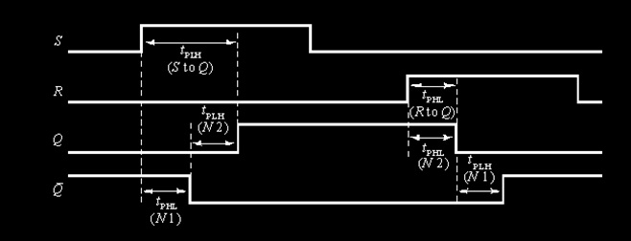
Be aware of delays
Important to note that, in reality, the output signals don’t change instantaneously, but with a certain delay.
R
Q
Q
S

Slide 33
Reading from latches
Now we have circuit units that can store high or low values.
How do we distinguish
“5 highs in a row”
“10 highs in a row”
We want to sample the signal with certain frequency.
Need to use some sort of timing signal, to let the circuit know when the output may be sampled.
→ clock signals.

Slide 34
Clock signals
“Clocks” are a regular pulse
signal, where the high value
indicates that the output of the latch may be sampled.
Usually drawn as:
But looks more like (frequency is usually high):
voltage
5V
time

Slide 35
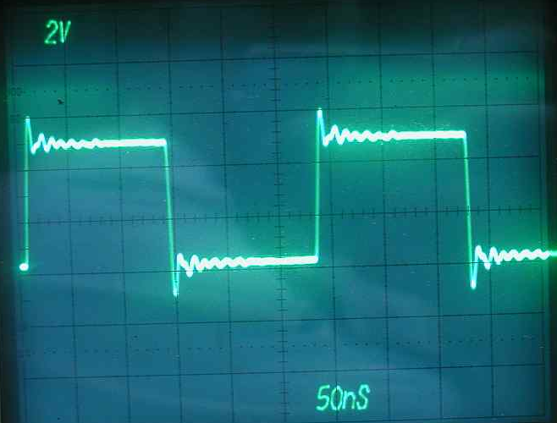
Signal restrictions
What’s the limit to how fast the latch circuit can be sampled?
Determined by:
latency time of transistors
Setup and hold time
setup time for clock signal
Jitter
Gibbs phenomenon
Frequency = how many pulses occur per second, measured in Hertz (or Hz).
What Intel and AMD try to increase every year.

Slide 36
Clocked SR Latch

Slide 37
Clocked SR latch
S
Q
C
Q
R
By adding another layer of NAND gates to the SR latch, we end up with a clocked SR latch circuit.
The clock is often connected to a pulse signal that alternates regularly between 0 and 1.

Slide 38
Clocked SR latch behaviour
Same behaviour as SR latch, but with timing:
Start off with S=0 and R=1, like earlier example.
If clock is high, the first NAND gates invert those values, which get inverted again in the output.
Setting both inputs to 0 maintains the output values.
0
1
S
0
1
Q
C
Q
R
1
1
0
0
1
S
0
1
Q
C
Q
R
1
1
1
0
0

Slide 39
Clocked SR latch behaviour
Continued from previous:
Now set the clock low.
Even if the inputs change, the low clock input prevents the change from reaching the second stage of NAND gates.
Result: the clock needs to be high in order for the inputs to have any effect.
0
1
1
0
S
0
Q
1
C
Q
R
1
1
0
1
1
0
1
1
0
S
0
Q
C
Q
R
1
1
0
1

Slide 40
S
Q
C
Q
R
When clock is high, behave like a SR latch.
When clock is low, S and R are blocked and there is no way to change the output.

Slide 41
Clocked SR latch
S
Q
S
Q
C
C
R
Q
Q
R
This is the typical symbol for a clocked SR latch.
This only allows the S and R signals to affect the circuit when the clock input (C) is high.
Note: the small NOT circle after the Q output is simply the notation to use to denote the inverted output value. It’s not an extra NOT gate.

Slide 42
Clocked SR latch behaviour
S
Q_{T} | S | R | Q_{T+1} | Result
0 | 0 | 0 | 0 | no change
0 | 0 | 1 | 0 | reset
0 | 1 | 0 | 1 | set
0 | 1 | 1 | ? | ???
1 | 0 | 0 | 1 | no change
1 | 0 | 1 | 0 | reset
1 | 1 | 0 | 1 | set
1 | 1 | 1 | ? | ???
Q
C
Q
R
Assuming the clock is 1, we still have a problem when S and R are both 1, since it is the forbidden state.
Better design: prevent S and R from both going high.

Slide 43
D latch
prevent S and R from both going high

Slide 44
D latch
Old S
D
Q_{T} | D | Q_{T+1}
0 | 0 | 0
0 | 1 | 1
1 | 0 | 0
1 | 1 | 1
Q
C
Q
Old R
By making the inputs to R and S dependent on a single signal D, you avoid the indeterminate state problem.
The value of D now sets output Q low or high.

Slide 45
D latch
D
Q
D
Q
C
C
Q
Q
This design is good, but still has problems.
i.e. timing issues.

Slide 46
Latch timing issues
Consider the circuit on the right:
When the clock signal is high, the output looks like the waveform below:
Output keeps toggling back and forth.
D
Q
C
Q
C
Q
Would be nice if Q changes only once within one clock cycle

Slide 47
Latch timing issues
Preferable behaviour:
Have output change only once when the clock pulse changes.
Solution: create disconnect between circuit output and circuit input, to prevent unwanted feedback and changes to output.
S
Q
S
Q
C
C
R
Q
R
Q
Only one latch is active at one time, so in order for a change to propagate from input to output, you need to wait at least for one turn (a clock cycle) of both being active.

Slide 48
Flip Flops

Slide 49
SR master-slave flip-flop
A flip-flop is a latched circuit whose output is triggered with the rising edge or falling edge of a clock pulse.
Example: The SR master-slave flip-flop
S
S₀
Q
S₁
Q
Q
C
C
C
R
R₀
Q
R₁
Q
Q

Slide 50
Change of Q triggered by falling clock edges
S
S₀
Q₀
S₁
Q₁
Q
C
C
C
R
R₀
Q₀
R₁
Q₁
Q
C
S
R
Q

Slide 51
Edge-triggered D flip-flop
D
C
SR flip-flops still have issues of unstable behavior (forbidden state)
Solution: D flip-flop
Connect D latch to the input of a SR latch.
Negative-edge triggered flip-flop (like the SR)
D
D
Q
S
Q
Q
C
C
C
Q
R
Q
Q

Slide 52
Flip-flop behaviour
0
0
Z
Observe the behaviour:
If the clock signal is high, the input to the first flip-flop is sent out to the second.
The second flip-flop doesn’t do anything until the clock signal goes down again.
When it clock goes from high to low, the first flip-flop stops transmitting a signal, and the second one starts.
D
D
Q
S
Q
Q
C
C
C
1
Q
R
Q
Q
Z
0
0
0
0
D
D
Q
S
Q
Q
C
C
C
0
Q
R
Q
Q
1
1
1
0

Slide 53
Flip-flop behaviour
0
0
0
1
Continued from previous:
If the input to D changes, the change isn’t transmitted to the second flip-flop until the clock goes high again.
Once the clock goes high, the first flip-flop starts transmitting at the same time as the second flip-flop stops.
D
D
Q
S
Q
Q
C
C
C
0
Q
R
Q
Q
1
1
0
1
0
1
0
D
D
Q
S
Q
Q
C
C
C
0
Q
R
Q
Q
1
1
1
1
0

Slide 54
Edge-triggered flip-flop
Alternative: positive-edge triggered flip-flops
These are the most commonly-used flip-flop circuits (and our choice for the course).
D
D
Q
S
Q
Q
D
Q
C
C
C
Q
C
Q
R
Q
Q

Slide 55
Notation
Latches
Edge-triggered flip-flops
S
S
D
D
R
R
C
C
SR
SR
D with 1 Control
D with 0 Control
D
D
C
C
Triggered D
Triggered D

Slide 56
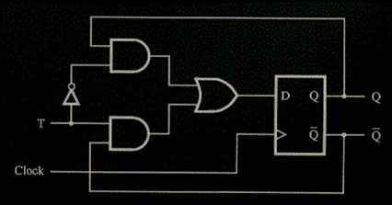
Other Flip-Flops
The T flip-flop:
Like the D flip-flop, except that it toggles its value whenever the input to T is high.

Slide 57
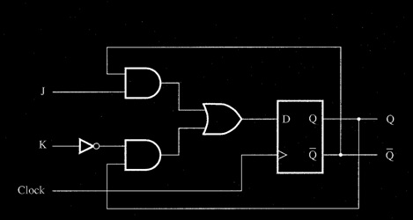
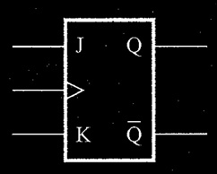
Other Flip-Flops
The JK Flip-Flop:
Takes advantage of all combinations of two inputs (J & K) to produce four different behaviours:
if J and K are 0, maintain output.
if J is 0 and K is 1, set output to 0.
if J is 1 and K is 0, set output to 1.
if J and K are 1, toggle output value.

Slide 58
Sequential circuit design
Similar to creating combinational circuits, with extra considerations:
The flip-flops now provide extra inputs to the circuit
Extra circuitry needs to be designed for the flip-flop inputs.
…which is next week’s lecture ☺
Inputs
Combinational Circuit
Outputs
Storage Units

Slide 59
Today we learned
Sequential circuits – circuits with memory
Latch
Flip-flop
Next week
Registers, Counters
Finite State Machines
Sequential circuit design

Slide 60
CSCB58: Computer Organization
Prof. Gennady Pekhimenko
University of Toronto
Fall 2020
The content of this lecture is adapted from the lectures of
Larry Zheng and Steve Engels

