Slide 1
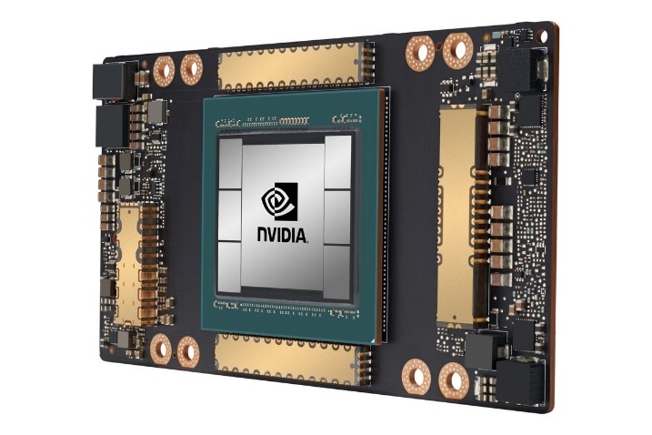
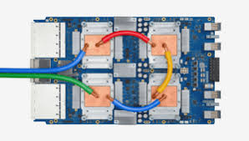
CSCB58: Computer Organization
Prof. Gennady Pekhimenko
University of Toronto
Fall 2020
The content of this lecture is adapted from the lectures of
Larry Zheng and Steve Engels

Slide 2
CSCB58 Week 3

Slide 3
Quiz 1: Question 2 Clarification

Slide 4
We are here
Assembly Language
Processors
Arithmetic Logic Units
Finite State Machines
Devices
Flip-flops
Circuits
Gates
Transistors

Slide 5
Logical Devices

Slide 6
Building up from gates…
Some common and more complex structures:
Multiplexers (MUX)
Adders (half and full)
Subtractors
Decoders
Seven-segment decoders
Comparators

Slide 7
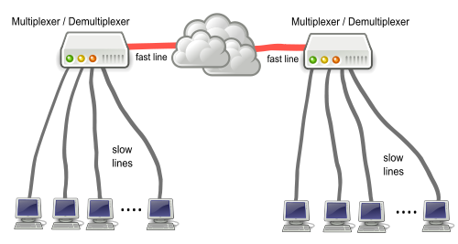
Multiplexers

Slide 8
Logical devices
Certain structures are common to many circuits, and have block elements of their own.
e.g. Multiplexers (short form: mux)
Behaviour: Output is X if S is 0, and Y if S is 1, i.e., S selects which input can go through
S
n
n
0
X
S
X
0
n
n
M
M
n
n
Y
1
Y
1

Slide 9
Multiplexer design
X | Y | S | M
0 | 0 | 0
0 | 0 | 1
0 | 1 | 0
0 | 1 | 1
1 | 0 | 0
1 | 0 | 1
1 | 1 | 0
1 | 1 | 1
 | Y·S | Y·S | Y·S | Y·S
X | 0 | 0 | 1 | 0
X | 1 | 0 | 1 | 1
0
0
0
1
1
M = Y·S + X·S
0
1
1
Y
Y
M
M
S
S
X
X

Slide 10
Multiplexer uses
Muxes are very useful whenever you need to select from multiple input values.
Example:
Surveillance video monitors,
Digital cable boxes,
routers.

Slide 11
Demultiplexers
Does multiplexer operation, in reverse.
S
S₁
S₀
n
n
0
W
X
0
n
n
n
M
M
1
X
n
n
Y
1
2
Y
n
3
Z

Slide 12
Mux + Demux

Slide 13
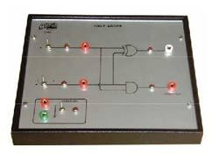
Adder circuits

Slide 14
Adders
Also known as binary adders.
Small circuit devices that add two 1-bit number.
Combined together to create iterative combinational circuits – add multiple-bit numbers
Types of adders:
Half adders (HA)
Full adders (FA)
Ripple Carry Adder
Carry-Look-Ahead Adder (CLA)

Slide 15
Review of Binary Math

Slide 16
Review of Binary Math
Each digit of a decimal number represents a power of 10:
Each digit of a binary number represents a power of 2:
258 = 2x10² + 5x10¹ + 8x10⁰
01101₂ = 0x2⁴ + 1x2³ + 1x2² + 0x2¹ + 1x2⁰
= 13₁₀

Slide 17
Unsigned binary addition
27 + 53
27 = 00011011
53 = 00110101
00011011
+00110101
01010000
95 + 181
01011111
+10110101
01011111
+10110101
100010100
Carry bit
1
1
1
1
1
1
1
1
1
1
1
1
1
carry bit
01010000
00010100

Slide 18
Half Adder
Input: two 1-bit numbers
Output: 1-bit sum and 1-bit carry

Slide 19
Half Adders
A 2-input, 1-bit width binary adder that performs the following computations:
A half adder adds two bits to produce a two-bit sum.
The sum is expressed as a sum bit S and a carry bit C.
X 0 0 1 1
+Y +0 +1 +0 +1
CS 00 01 01 10
C = X?Y
S = X?Y
X
Y
HA
C
S

Slide 20
Half Adder Implementation
Equations and circuits for half adder units are easy to define (even without Karnaugh maps)
C = X·Y S = X·Y + X·Y
= X xor Y
X
Y
Y
HA
S
C
X
S
C

Slide 21
A half adder outputs a carry-bit,
but does not take a carry-bit as input.

Slide 22
Full Adder
takes a carry bit as input
X
Y
X
Y
HA
FA
C
C
Z
S
S

Slide 23
Full Adders
X
Y
FA
C
Z
Similar to half-adders, but with another input Z, which represents a carry-in bit.
C and Z are sometimes labeled as C_{out} and C_{in}.
When Z is 0, the unit behaves exactly like…
a half adder.
When Z is 1:
S
X 0 0 1 1
+Y +0 +1 +0 +1
+Z +1 +1 +1 +1
CS 01 10 10 11

Slide 24
Full Adder Design
X | Y | Z | C | S
0 | 0 | 0 | 0 | 0
0 | 0 | 1 | 0 | 1
0 | 1 | 0 | 0 | 1
0 | 1 | 1 | 1 | 0
1 | 0 | 0 | 0 | 1
1 | 0 | 1 | 1 | 0
1 | 1 | 0 | 1 | 0
1 | 1 | 1 | 1 | 1
C | Y·Z | Y·Z | Y·Z | Y·Z
X | 0 | 0 | 1 | 0
X | 0 | 1 | 1 | 1
S | Y·Z | Y·Z | Y·Z | Y·Z
X | 0 | 1 | 0 | 1
X | 1 | 0 | 1 | 0
C = X·Y + X·Z + Y·Z
S = X xor Y xor Z
C = X·Y + (X xor Y)·Z
For gate reuse(X xor Y) considering both C and S

Slide 25
Full Adder Design
S = X xor Y xor Z
The C term can also be rewritten as:
Two terms come from this:
X·Y = carry generate (G).
Whether X and Y generate a carry bit
X xor Y = carry propagate (P).
Whether carry will be propagated to Cout
Results in this circuit →
X
Y
G
C = X·Y + (X xor Y)·Z
P
Z
C_{out}
S

Slide 26
Now we can add one bit properly, but most of the numbers we use have more than one bits.
int, unsigned int: 32 bits (architecture-dependent)
short int, unsigned short int: 16 bits
long long int, unsigned long long int: 64 bit
char, unsigned char: 8 bits
How do we add multiple-bit numbers?

Slide 27
X
Y
HA
C
S
X
Y
FA
C
Z
S

Slide 28
Each full adder takes in a carry bit and outputs a carry bit.
Each full adder can take in a carry bit which is output by another full adder.
That is, they can be chained up.

Slide 29
Ripple-Carry Binary Adder
Full adders chained up,
for multiple-bit addition

Slide 30
Ripple-Carry Binary Adder
Full adder units are chained together in order to perform operations on signal vectors.
X
Y
4
4
X₃
Y₃
X₂
Y₂
X₁
Y₁
X₀
Y₀
C_{out}
Adder
C_{in}
C_{out}
FA
C₃
FA
C₂
FA
C₁
C_{in}
FA
4
S₃
S₂
S₁
S₀
S
S₃S₂S₁S₀ is the sum of X₃X₂X₁X₀ and Y₃Y₂Y₁Y₀

Slide 31
The role of C_{in}
Why can’t we just have a half-adder for the smallest (right-most) bit?
Because if we can use it to do subtraction!
X₃
Y₃
X₂
Y₂
X₁
Y₁
X₀
Y₀
C_{out}
FA
C₃
FA
C₂
FA
C₁
FA
C_{in}
S₃
S₂
S₁
S₀

Slide 32
Let’s play a game…
Pick two numbers between 0 and 31
Convert both numbers to 5-bit binary form
Invert each digit of the smaller number
Add up the big binary number and the inverted small binary number
Add 1 to the result, keep the lowest 5 digits
Convert the result to a decimal number
What do you get?
You just did subtraction without doing subtraction!

Slide 33
Subtractors
Subtractors are an extension of adders.
Basically, perform addition on a negative number.
Before we can do subtraction, need to understand negative binary numbers.
Two types:
Unsigned = a separate bit exists for the sign; data bits store the positive version of the number.
Signed = all bits are used to store a 2’s complement negative number.

Slide 34
Two’s complement
Need to know how to get 1’s complement:
Given number X with n bits, take (2^{n}-1)-X
Negates each individual bit (bitwise NOT).
2’s complement = (1’s complement + 1)
Note: Adding a 2’s complement number to the original number produces a result of zero.
01001101 → 10110010
11111111 → 00000000
01001101 → 10110011
11111111 → 00000001
Know this!

Slide 35
(2’s complement of A) + A = 0.
The 2’s complement of A is like -A

Slide 36
Unsigned subtraction (separate sign bit)
General algorithm for A - B:
Get the 2’s complement of B (-B)
Add that value to A
If there is an end carry (C_{out} is high), the final result is positive and does not change.
If there is no end carry (C_{out} is low), get the 2’s complement of the result (B-A) and add a negative sign to it, or set the sign bit high (-(B-A) = A-B).

Slide 37
Unsigned subtraction example
53 – 27
00110101
-00011011
00110101
+11100101
100011010
27 – 53
00011011
-00110101
00011011
+11001011
011100110
carry bit
no carry bit
2’s complement
carry bit is high (positive)
00011010
carry bit is low (negative)
-00011010
26
-26

Slide 38
Signed subtraction (easier)
Store negative numbers in 2’s complement notation.
Subtraction can then be performed by using the binary adder circuit with negative numbers.
To compute A – B, just do A + (-B)
Need to get -B first (the 2’s complement of B)

Slide 39
Signed subtraction example (6-bit)
21 – 23
23 is 010111
21 is 010101
-23 is 101001 (2’s complement of 32)
21-23 is 111110 which is -2

Slide 40
Signed addition example (6-bit)
21 + 23
23 is 010111
21 is 010101
23+21: 101100
This is -20!
The supposed result 44 is exceeding the range of 6-bit signed integers. This is called an overflow.

Slide 41
Now you understand C code better
#include <stdio.h>
int main()
{
/* char is 8-bit integer */
signed char a = 100;
signed char b = 120;
signed char s = a + b;
printf("%d\n", s);
}

Slide 42
Trivia about sign numbers
The largest positive 8-bit signed integer?
01111111 = 127 (0 followed by all 1)
The smallest negative 8-bit signed integer?
10000000 = -128 (1 followed by all 0)
The binary form 8-bit signed integer -1?
11111111 (all one)
For n-bit signed number there are 2^{n} possible values
2^{n-1} are negative numbers (e.g. 8 bit, -1 to -128)
2^{n-1}-1 are positive number (e.g. 8 bit, 1 to 127)
and a zero

Slide 43
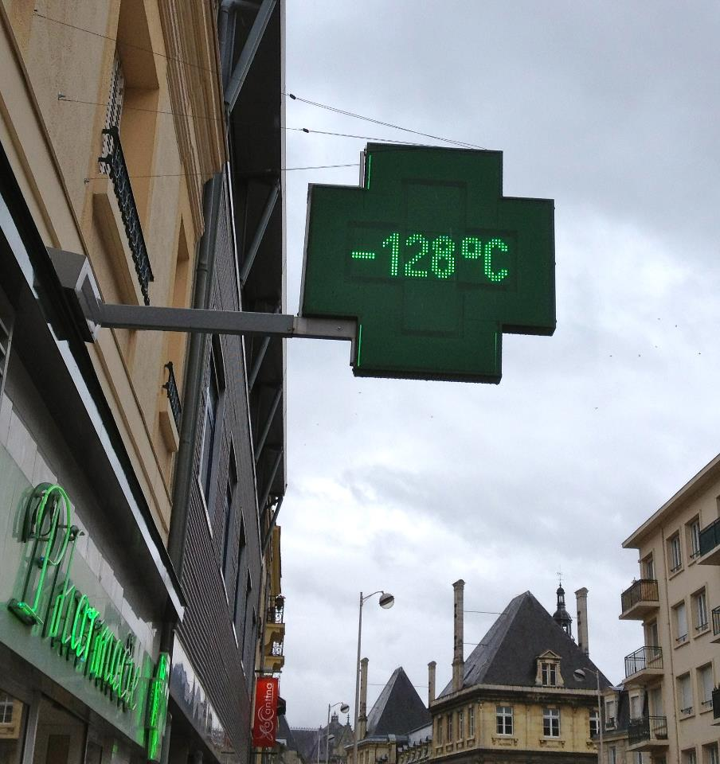
-128: 10000000 (signed)

Slide 44
Subtraction circuit
Y₃
Y₂
Y₁
Y₀
Sub
Invert all the digits (if sub = 1)
X₃
X₂
X₁
X₀
C_{out}
C₃
C₂
C₁
C_{in}
FA
FA
FA
FA
Add 1, so getting 2’s complement
S₃
S₂
S₁
S₀
If sub = 0, S = X + Y
If sub = 1, S = X – Y
One circuit, both adder or subtractor

Slide 45
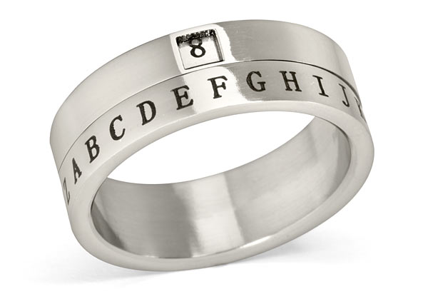
Decoders

Slide 46
What is a decoder?
“number 1”
“number 2”
“number 3”
…
…
Decoder
“number 10”
“rock!”
“good job!”
“…..”
5-bit input, encoded original information
The original information

Slide 47
Decoders
Decoders are essentially translators.
Translate from the output of one circuit to the input of another.
Example: Binary signal splitter
Activates one of four output lines, based on a two-digit binary number.
A
X₁
Decoder
B
X₀
C
D

Slide 48
Demultiplexers
Related to decoders: demultiplexers.
Does multiplexer operation, in reverse.
S
S₁
S₀
n
n
0
W
X
0
n
n
n
M
M
1
X
n
n
Y
1
2
Y
n
3
Z

Slide 49
Multiplexer:
Choose one from multiple inputs as output
Demultiplexer:
One input chooses from multiple outputs

Slide 50
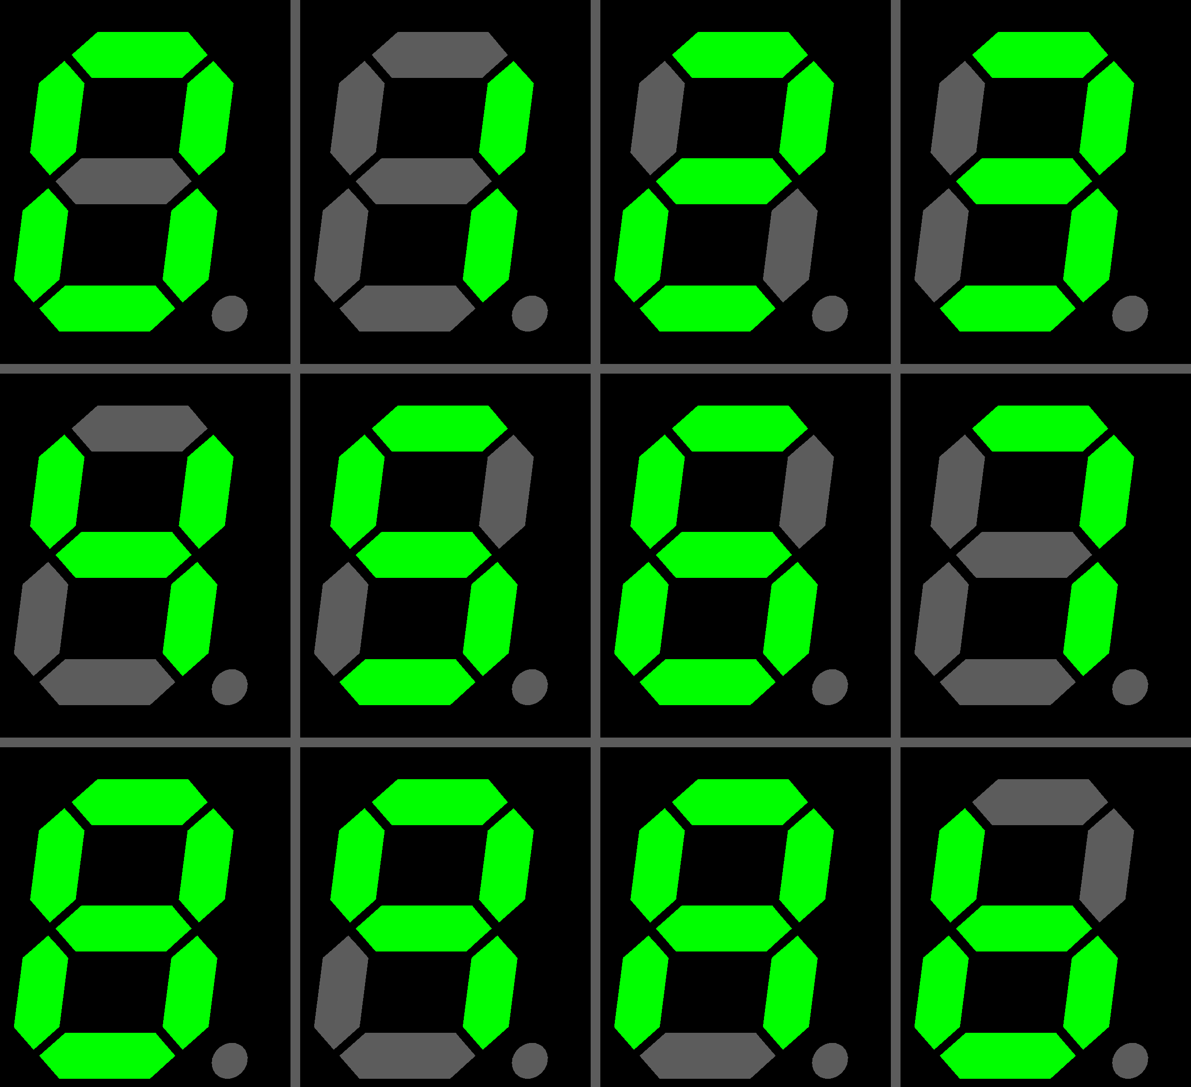
7-segment decoder
Common and useful decoder application.
Translate from a 4-digit binary number to the seven segments of a digital display.
Each output segment has a particular logic that defines it.
Example: Segment 0
Activate for values: 0, 2, 3, 5, 6, 7, 8, 9.
In binary: 0000, 0010, 0011, 0101, 0110, 0111, 1000, 1001.
First step: Build the truth table and K-map.
0
5
1
6
4
2
3

Slide 51
Note
What we talk about here is NOT the same as what we do in Lab 2
In labs we translate numbers 0, 1, 3, 4, 5, 6 to displayed letters such as (H, E, L, L, O, _, E, L, I)
This is specially defined for the lab
Here we are talking about translating 0, 1, 2, 3, 4,…, to displayed 0, 1, 2, 3, 4, ...
This is more common use

Slide 52
7-segment decoder
0
5
1
6
For 7-seg decoders, turning a segment on involves driving it low. (active low)
(In Lab 2, we treat it like active high. It’s OK because Logisim does auto-conversion to make it work).
i.e. Assuming a 4-digit binary number, segment 0 is low whenever input number is 0000, 0010, 0011, 0101, 0110, 0111, 1000 or 1001, and high whenever input number is 0001 or 0100.
This create a truth table and map like the following…
4
2
3

Slide 53
7-segment decoder
X₃ | X₂ | X₁ | X₀ | HEX₀
0 | 0 | 0 | 0 | 0
0 | 0 | 0 | 1 | 1
0 | 0 | 1 | 0 | 0
0 | 0 | 1 | 1 | 0
0 | 1 | 0 | 0 | 1
0 | 1 | 0 | 1 | 0
0 | 1 | 1 | 0 | 0
0 | 1 | 1 | 1 | 0
1 | 0 | 0 | 0 | 0
1 | 0 | 0 | 1 | 0
 | X₁·X₀ | X₁·X₀ | X₁·X₀ | X₁·X₀
X₃·X₂ | 0 | 1 | 0 | 0
X₃·X₂ | 1 | 0 | 0 | 0
X₃·X₂ | X | X | X | X
X₃·X₂ | 0 | 0 | X | X
0
HEX0 = X₃·X₂·X₁·X₀ + X₃·X₂·X₁·X₀
But what about input values from 1010 to 1111?
5
1
6
4
2
6 rows missing!
1010 ~ 1111
3

Slide 54
“Don’t care” values
Some input values will never happen, so their output values do not have to be defined.
Recorded as ‘X’ in the Karnaugh map.
These values can be assigned to whatever values you want, when constructing the final circuit.
HEX0 = X₃·X₂·X₁·X₀ + X₂·X₁·X₀
 | X₁·X₀ | X₁·X₀ | X₁·X₀ | X₁·X₀
X₃·X₂ | 0 | 1 | 0 | 0
X₃·X₂ | 1 | 0 | 0 | 0
X₃·X₂ | X | X | X | X
X₃·X₂ | 0 | 0 | X | X
Boxes can cover “x”’s, or not, whichever you like.

Slide 55
Again for segment 1
0
5
1
6
4
2
X₃ | X₂ | X₁ | X₀ | HEX₁
0 | 0 | 0 | 0 | 0
0 | 0 | 0 | 1 | 0
0 | 0 | 1 | 0 | 0
0 | 0 | 1 | 1 | 0
0 | 1 | 0 | 0 | 0
0 | 1 | 0 | 1 | 1
0 | 1 | 1 | 0 | 1
0 | 1 | 1 | 1 | 0
1 | 0 | 0 | 0 | 0
1 | 0 | 0 | 1 | 0
3
 | X₁·X₀ | X₁·X₀ | X₁·X₀ | X₁·X₀
X₃·X₂ | 0 | 0 | 0 | 0
X₃·X₂ | 0 | 1 | 0 | 1
X₃·X₂ | X | X | X | X
X₃·X₂ | 0 | 0 | X | X
HEX1 = X₂·X₁·X₀ + X₂·X₁·X₀

Slide 56
Again for segment 2
0
5
1
6
4
2
X₃ | X₂ | X₁ | X₀ | HEX₂
0 | 0 | 0 | 0 | 0
0 | 0 | 0 | 1 | 0
0 | 0 | 1 | 0 | 1
0 | 0 | 1 | 1 | 0
0 | 1 | 0 | 0 | 0
0 | 1 | 0 | 1 | 0
0 | 1 | 1 | 0 | 0
0 | 1 | 1 | 1 | 0
1 | 0 | 0 | 0 | 0
1 | 0 | 0 | 1 | 0
3
 | X₁·X₀ | X₁·X₀ | X₁·X₀ | X₁·X₀
X₃·X₂ | 0 | 0 | 0 | 1
X₃·X₂ | 0 | 0 | 0 | 0
X₃·X₂ | X | X | X | X
X₃·X₂ | 0 | 0 | X | X
HEX2 = X₂·X₁·X₀

Slide 57
The final 7-seg decoder
Decoders all look the same, except for the inputs and outputs.
Unlike other devices, the implementation differs from decoder to decoder.
HEX6
X₃
HEX5
7-seg decoder
HEX4
X₂
HEX3
X₁
HEX2
X₀
HEX1
HEX0

Slide 58
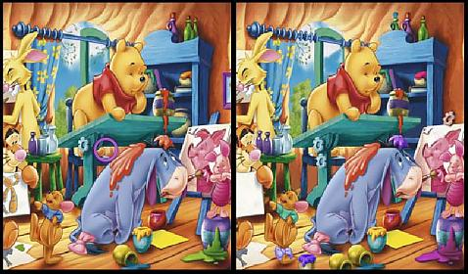
Comparators

Slide 59
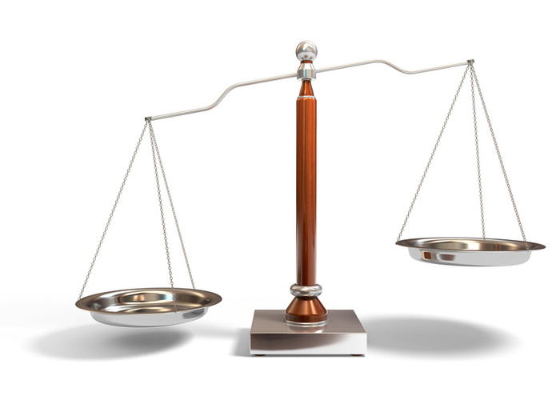
Comparators
A circuit that takes in two input vectors, and determines if the first is greater than, less than or equal to the second.
How does one make that in a circuit?

Slide 60
Basic Comparators
A
B
Comparator
A=B
A>B
Consider two binary numbers A and B, where A and B are one bit long.
The circuits for this would be:
A==B:
A>B:
A<B:
A<B
A | B
0 | 0
0 | 1
1 | 0
1 | 1
A·B + A·B
A·B
A·B

Slide 61
Basic Comparators
A₁
A₀
B₁
B₀
What if A and B are two bits long?
The terms for this circuit for have to expand to reflect the second signal.
For example:
A==B:
Comparator
A=B
A>B
A<B
(A₁·B₁+A₁·B₁)·(A₀·B₀+A₀·B₀)
Make sure that the values of bit 1 are the same
Make sure that the values of bit 0 are the same

Slide 62
Basic Comparators
A₁
A₀
B₁
B₀
Comparator
What about checking if A is greater or less than B?
A>B:
A<B:
A=B
A>B
A<B
A₁·B₁ + (A₁·B₁+A₁·B₁)·(A₀·B₀)
Check if first bit satisfies condition
If not, check that the first bits are equal…
…and then do the 1-bit comparison
A₁·B₁ + (A₁·B₁+A₁·B₁)·(A₀·B₀)
A > B if and only if A1 > B1 or (A1 = B1 and A0 > B0)

Slide 63
General Comparators
The general circuit for comparators requires you to define equations for each case.
Case #1: Equality
If inputs A and B are equal, then all bits must be the same.
Define X_{i} for any digit i:
(equality for digit i)
Equality between A and B is defined as:
X_{i} = A_{i}·B_{i} + A_{i}·B_{i}
A==B : X₀·X₁·…·X_{n}

Slide 64
Comparators
Case #2: A > B
The first non-matching bits occur at bit i, where A_{i}=1 and B_{i}=0. All higher bits match.
Using the definition for X_{i} from before:
Case #3: A < B
The first non-matching bits occur at bit i, where A_{i}=0 and B_{i}=1. Again, all higher bits match.
n
A>B = A_{n}·B_{n} + X_{n}·A_{n-1}·B_{n-1} + … + A₀·B₀·Π X_{k}
k=1
n
A<B = A_{n}·B_{n} + X_{n}·A_{n-1}·B_{n-1} + … + A₀·B₀·Π X_{k}
k=1

Slide 65
Comparator truth table
Given two input vectors of size n=2, output of circuit is shown at right.
Inputs |  |  |  | Outputs
A₁ | A₀ | B₁ | B₀ | A < B | A = B | A > B
0 | 0 | 0 | 0 | 0 | 1 | 0
0 | 0 | 0 | 1 | 1 | 0 | 0
0 | 0 | 1 | 0 | 1 | 0 | 0
0 | 0 | 1 | 1 | 1 | 0 | 0
0 | 1 | 0 | 0 | 0 | 0 | 1
0 | 1 | 0 | 1 | 0 | 1 | 0
0 | 1 | 1 | 0 | 1 | 0 | 0
0 | 1 | 1 | 1 | 1 | 0 | 0
1 | 0 | 0 | 0 | 0 | 0 | 1
1 | 0 | 0 | 1 | 0 | 0 | 1
1 | 0 | 1 | 0 | 0 | 1 | 0
1 | 0 | 1 | 1 | 1 | 0 | 0
1 | 1 | 0 | 0 | 0 | 0 | 1
1 | 1 | 0 | 1 | 0 | 0 | 1
1 | 1 | 1 | 0 | 0 | 0 | 1
1 | 1 | 1 | 1 | 0 | 1 | 0

Slide 66
Comparator example (cont’d)
A<B:
 | B₀·B₁ | B₀·B₁ | B₀·B₁ | B₀·B₁
A₀·A₁ | 0 | 1 | 1 | 1
A₀·A₁ | 0 | 0 | 1 | 1
A₀·A₁ | 0 | 0 | 0 | 0
A₀·A₁ | 0 | 0 | 1 | 0
LT = B₁·A₁ + B₀·B₁·A₀ + B₀·A₀·A₁

Slide 67
Comparator example (cont’d)
A=B:
 | B₀·B₁ | B₀·B₁ | B₀·B₁ | B₀·B₁
A₀·A₁ | 1 | 0 | 0 | 0
A₀·A₁ | 0 | 1 | 0 | 0
A₀·A₁ | 0 | 0 | 1 | 0
A₀·A₁ | 0 | 0 | 0 | 1
EQ = B₀·B₁·A₀·A₁ + B₀·B₁·A₀·A₁ + B₀·B₁·A₀·A₁ + B₀·B₁·A₀·A₁

Slide 68
Comparator example (cont’d)
A>B:
 | B₀·B₁ | B₀·B₁ | B₀·B₁ | B₀·B₁
A₀·A₁ | 0 | 0 | 0 | 0
A₀·A₁ | 1 | 0 | 0 | 0
A₀·A₁ | 1 | 1 | 0 | 1
A₀·A₁ | 1 | 1 | 0 | 0
GT = B₁·A₁ + B₀·B₁·A₀ + B₀·A₀·A₁

Slide 69
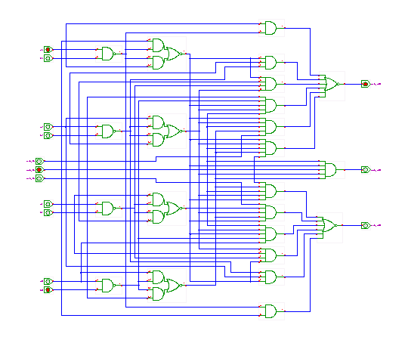
Comparing larger numbers
As numbers get larger, the comparator circuit gets more complex.
At a certain level, it can be easier sometimes to just process the result of a subtraction operation instead.
Easier, less circuitry, just not faster.

Slide 70
Today we learned
How a computer does following things
Control the flow of signal (mux and demux)
Arithmetic operations: adder, subtractor
Decoder
Comparators
Next week:
Sequential circuits: circuits that have memories.

Slide 71
CSCB58: Computer Organization
Prof. Gennady Pekhimenko
University of Toronto
Fall 2020
The content of this lecture is adapted from the lectures of
Larry Zheng and Steve Engels

