Slide 1
CSCB58: Computer Organization
Prof. Gennady Pekhimenko
University of Toronto
Fall 2020
The content of this lecture is adapted from the lectures of
Larry Zheng and Steve Engels

Slide 2
CSCB58 Week 2

Slide 3
Lab tips
Login into Zoom for the time slot instructed
Make sure your name matches your Quercus registration
Make sure to finish the work that needs to be done before the lab
Be ready to explain your work to the TA in order to get full mark

Slide 4
Lab tips
Don’t store your files in any shared folder on the lab machines, to avoid academic offence.
Back up your work (copy to USB, upload to Dropbox, etc), you may need it for future labs.
Keep an eye on your quota.
use the “quota” command
use “du –d 1” to see which folder is taking up the space.

Slide 5
Logic Gates: Recap

Slide 6
AND Gates
A
Y
B
A | B | Y
0 | 0 | 0
0 | 1 | 0
1 | 0 | 0
1 | 1 | 1
Truth table

Slide 7
OR Gates
A
Y
B
A | B | Y
0 | 0 | 0
0 | 1 | 1
1 | 0 | 1
1 | 1 | 1

Slide 8
NOT Gates
A
Y
A | Y
0 | 1
1 | 0

Slide 9
XOR Gates
A
Y
B
A | B | Y
0 | 0 | 0
0 | 1 | 1
1 | 0 | 1
1 | 1 | 0

Slide 10
Bill Gates
Never repeat jokes!

Slide 11
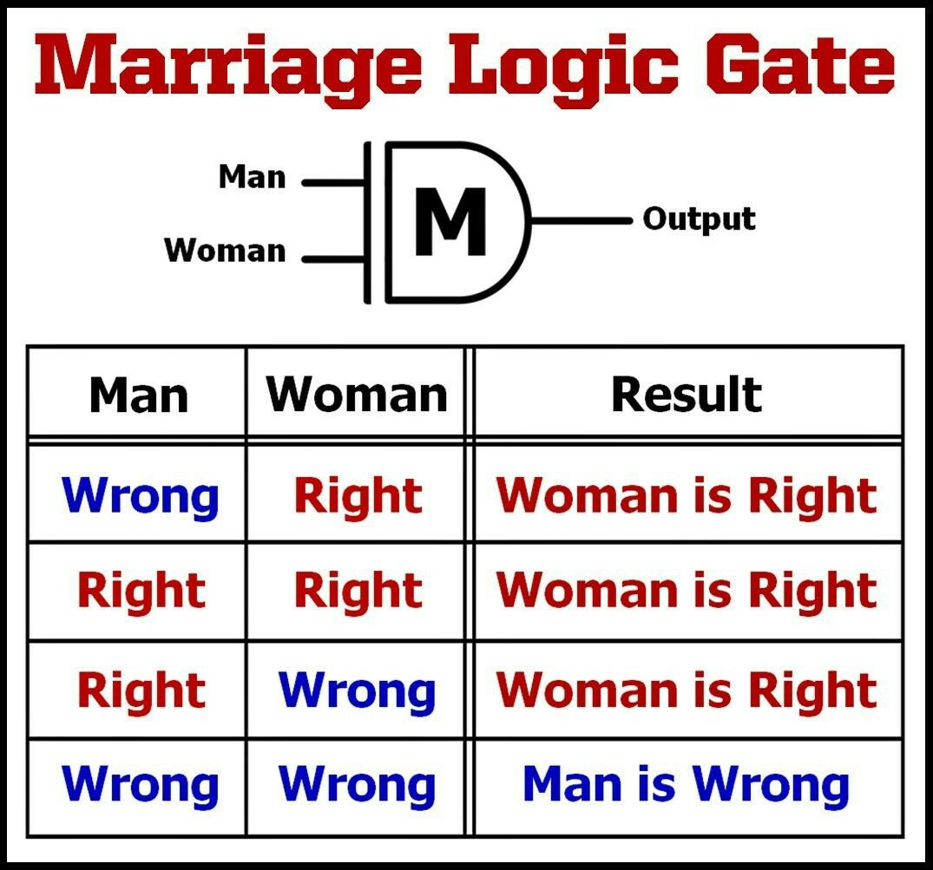
Marriage Logic Gate

Slide 12
Recap: Transistors
Transistors, made of doped semiconductors put together (PN-Junctions), is like a resistor but can change its resistance.
It has two state: connected (switched ON) or disconnected (switched OFF)
The ON/OFF state of a transistor is controlled by an electrical signal, like in the MOSFET.

Slide 13
MOSFET
Gate
Source
Drain

Slide 14
Recap: Transistors into logic gates
V_{cc}
V_{cc}
V_{cc}
V_{cc}
V_{cc}
A
A
B
A
A
B
B
B
Y
Y
B
Y
A
B
A
A
A
B
B
AND
OR
XOR

Slide 15
Next: From gates to circuits
Assembly Language
Processors
Arithmetic Logic Units
Finite State Machines
Devices
Flip-flops
Circuits
Gates
Transistors

Slide 16
The goal
Use the gates as building blocks to build large circuits that represent complex logics.
The beauty of abstraction in system design: from this point on, we will just use the symbolic logic gates (AND, OR, XOR, etc) without having to think about the lower-level details (MOSFET, pn-junctions, etc).

Slide 17
Making logic with gates
Logic gates like the following allow us to create an output value, based on one or more input values.
Each corresponds to Boolean logic that we’ve seen before in math classes:
A
Y
A
B
Y
A
Y
B
A | B | Y
0 | 0 | 0
0 | 1 | 0
1 | 0 | 0
1 | 1 | 1
A | B | Y
0 | 0 | 0
0 | 1 | 1
1 | 0 | 1
1 | 1 | 1
A | Y
0 | 1
1 | 0

Slide 18
Making boolean expressions
So how would you represent Boolean expressions using logic gates?
Like so:
Y = (A or B)
and
(not A or not B)
or C
A
B
A
B
C

Slide 19
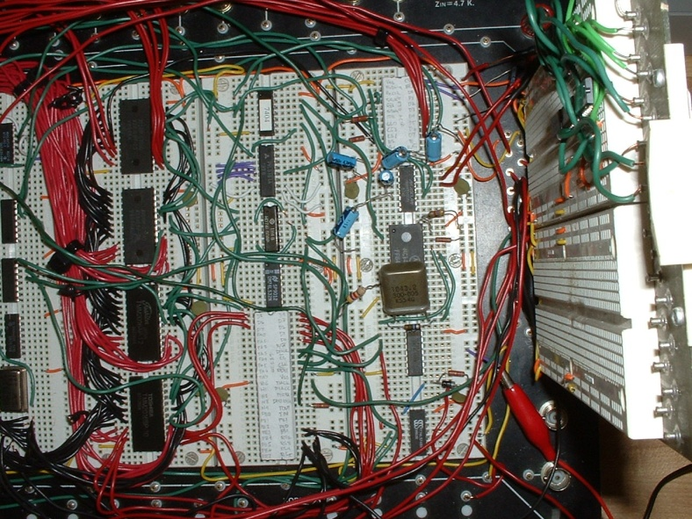
Creating complex circuits
What do we do in the case of more complex circuits, with several inputs and more than one output?
If you’re lucky, a truth table is provided to express the circuit.
Usually the behaviour of the circuit is expressed in words, and the first step involves creating a truth table that represents the described behaviour.

Slide 20
Circuit example
The circuit on the right has three inputs (A, B and C) and two outputs (X and Y).
What logic is needed to set X high when
all three inputs are high?
What logic is needed to set Y high when the number of high inputs is odd?
Logic Circuit
A
X
B
Y
C

Slide 21
Combinational circuits
Small problems can be solved easily.
X high when all three inputs are high
A
A
B
X
C
B
A
C
B
Y
Y high when number of high is odd
C

Slide 22
For more complicated circuits, we need a systematical approach

Slide 23
Creating complex logic
The general approach
Basic steps:
Create truth tables based on the desired behaviour of the circuit.
Come up with a “good” Boolean expression that has exactly that truth table.
Convert Boolean expression to gates.
The key to an efficient design?
Spending extra time on Step #2.

Slide 24
First, a better way to represent truth tables

Slide 25
Example truth table
Consider the following example:
“Y is high only when B and C are both high”
This leads to the truth table on the right.
Do we always have to draw the whole table?
Is there a better way to describe the truth table?
A | B | C | Y
0 | 0 | 0 | 0
0 | 0 | 1 | 0
0 | 1 | 0 | 0
0 | 1 | 1 | 1
1 | 0 | 0 | 0
1 | 0 | 1 | 0
1 | 1 | 0 | 0
1 | 1 | 1 | 1
This is all we needed to express!

Slide 26
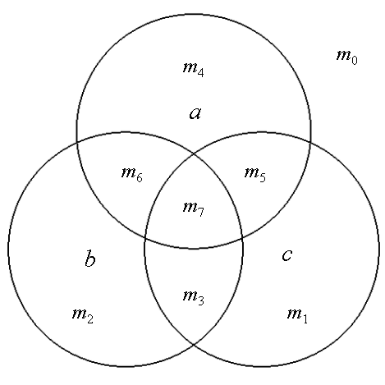
Yes, use “Minterms” and “Maxterms”

Slide 27
Quick note about notations
AND operations are denoted in these expressions by the multiplication symbol.
e.g. A·B·C or A*B*C or A˄B˄C
OR operations are denoted by the addition symbol.
e.g. A+B+C or A˅B˅C
NOT is denoted by multiple symbols.
e.g. ¬A or A’ or A
XOR occurs rarely in circuit expressions.
e.g. A ⊕ B

Slide 28
Warm-Up Exercise
For each of the following logic expressions, what are the A, B, C values that make the expression evaluate to 1 ?
A’B’C’
A=0, B=0, C=0 , and only this
ABC
111 and only this
A’BC
011 and only this
ABC’
110 and only this

Slide 29
Minterms, informally
First, sort the rows according to the value of the number “ABC” represents
Then for each row, find the AND expression that evaluates to 1 iff ABC are of the values in the row. We name the AND expression as m_{{row number}}
A | B | C | Y
0 | 0 | 0 | 0
0 | 0 | 1 | 1
0 | 1 | 0 | 1
0 | 1 | 1 | 1
1 | 0 | 0 | 1
1 | 0 | 1 | 0
1 | 1 | 0 | 1
1 | 1 | 1 | 0
A’B’C’
A’B’C
A’BC’
A’BC
AB’C’
AB’C
ABC’
ABC
m₀
m₁
m₂
m₃
m₄
m₅
m₆
m₇
Sorted

Slide 30
Minterm: formal description
Minterm: an AND true or complemented expression with every input present in form.
m₀: A·B·C
A | B | C | Y
0 | 0 | 0 | 0
0 | 0 | 1 | 1
0 | 1 | 0 | 1
0 | 1 | 1 | 1
1 | 0 | 0 | 1
1 | 0 | 1 | 0
1 | 1 | 0 | 1
1 | 1 | 1 | 0
Minterm | Y
m₀ | 0
m₁ | 1
m₂ | 1
m₃ | 1
m₄ | 1
m₅ | 0
m₆ | 1
m₇ | 0
m₁: A·B·C
m₂: A·B·C
m₃: A·B·C
m₇: A·B·C

Slide 31
Minterm (m) and Maxterm (M)
Minterm: an AND expression with every input present in true or complemented form.
Maxterm: an OR expression with every input present in true or complemented form.
M₀: A+B+C
M₁: A+B+C
M₆: A+B+C
M₇: A+B+C
Feel something fishy?

Slide 32
Naming!
Minterm is about when the output is 1
m₀ is A·B·C
A·B·C is 1 only when A, B, C are 0, 0, 0
M₀ is A+B+C
A+B+C is 0 only when A, B, C are 0, 0, 0
Maxterm is about when the output is 0

Slide 33
Exercise: Minterm or Maxterm? given four inputs: (A, B, C, D)
No! Every input needs to be there, D is missing!
A·B·C
A+B+D
Neither! Same reason
A·B+C·D
Neither! It has to be only AND or only OR, cannot mix
A+B+C+D
Maxterm, M₅
A·B·C·D
Minterm, m₁₀

Slide 34
Quick fact
Given n inputs, how many possible minterms and maxterms are there?
2^{n} minterms and 2^{n} maxterms possible (same as the number of rows in a truth table).

Slide 35
Use minterms and maxterms to go from truth table to logic expression

Slide 36
Using minterms
A | B | C | D | m₂
0 | 0 | 0 | 0 | 0
0 | 0 | 0 | 1 | 0
0 | 0 | 1 | 0 | 1
0 | 0 | 1 | 1 | 0
0 | 1 | 0 | 0 | 0
0 | 1 | 0 | 1 | 0
0 | 1 | 1 | 0 | 0
0 | 1 | 1 | 1 | 0
1 | 0 | 0 | 0 | 0
1 | 0 | 0 | 1 | 0
1 | 0 | 1 | 0 | 0
1 | 0 | 1 | 1 | 0
1 | 1 | 0 | 0 | 0
1 | 1 | 0 | 1 | 0
1 | 1 | 1 | 0 | 0
1 | 1 | 1 | 1 | 0
What are minterms used for?
A single minterm indicates a set of inputs that will make the output go high.
Example: Describe the truth table on the right using minterm:
m₂
A’B’CD’

Slide 37
Using minterms
A | B | C | D | m₂ | m₈ | m₂+m₈
0 | 0 | 0 | 0 | 0 | 0 | 0
0 | 0 | 0 | 1 | 0 | 0 | 0
0 | 0 | 1 | 0 | 1 | 0 | 1
0 | 0 | 1 | 1 | 0 | 0 | 0
0 | 1 | 0 | 0 | 0 | 0 | 0
0 | 1 | 0 | 1 | 0 | 0 | 0
0 | 1 | 1 | 0 | 0 | 0 | 0
0 | 1 | 1 | 1 | 0 | 0 | 0
1 | 0 | 0 | 0 | 0 | 1 | 1
1 | 0 | 0 | 1 | 0 | 0 | 0
1 | 0 | 1 | 0 | 0 | 0 | 0
1 | 0 | 1 | 1 | 0 | 0 | 0
1 | 1 | 0 | 0 | 0 | 0 | 0
1 | 1 | 0 | 1 | 0 | 0 | 0
1 | 1 | 1 | 0 | 0 | 0 | 0
1 | 1 | 1 | 1 | 0 | 0 | 0
What happens when you OR two minterms?
Result is output that goes high in both minterm cases.
Describe the truth table with the right-most column of outputs
m₂ + m₈
We came up with a logic expression that has the desired truth table, easily: A’B’CD’ + AB’C’D’

Slide 38
Creating boolean expressions
Two canonical forms of boolean expressions:
Sum-of-Minterms (SOM): AB + A’B + AB’
Each minterm corresponds to a single high output in the truth table.
Also known as: Sum-of-Products.
Product-of-Maxterms (POM): (A+B)(A’ + B)(A+B’)
Each maxterm corresponds to a single low output in the truth table.
Also known as Product-of-Sums.
Every logic expression can be converted to a SOM, also to a POM.

Slide 39
Y = m₂ + m₆ + m₇ + m₁₀ (SOM)
A | B | C | D | m₂ | m₆ | m₇ | m₁₀ | Y
0 | 0 | 0 | 0 | 0 | 0 | 0 | 0 | 0
0 | 0 | 0 | 1 | 0 | 0 | 0 | 0 | 0
0 | 0 | 1 | 0 | 1 | 0 | 0 | 0 | 1
0 | 0 | 1 | 1 | 0 | 0 | 0 | 0 | 0
0 | 1 | 0 | 0 | 0 | 0 | 0 | 0 | 0
0 | 1 | 0 | 1 | 0 | 0 | 0 | 0 | 0
0 | 1 | 1 | 0 | 0 | 1 | 0 | 0 | 1
0 | 1 | 1 | 1 | 0 | 0 | 1 | 0 | 1
1 | 0 | 0 | 0 | 0 | 0 | 0 | 0 | 0
1 | 0 | 0 | 1 | 0 | 0 | 0 | 0 | 0
1 | 0 | 1 | 0 | 0 | 0 | 0 | 1 | 1
1 | 0 | 1 | 1 | 0 | 0 | 0 | 0 | 0
1 | 1 | 0 | 0 | 0 | 0 | 0 | 0 | 0
1 | 1 | 0 | 1 | 0 | 0 | 0 | 0 | 0
1 | 1 | 1 | 0 | 0 | 0 | 0 | 0 | 0
1 | 1 | 1 | 1 | 0 | 0 | 0 | 0 | 0

Slide 40
Y = M₃· M₅· M₇· M₁₀· M₁₄ (POM)
A | B | C | D | M₃ | M₅ | M₇ | M₁₀ | M₁₄ | Y
0 | 0 | 0 | 0 | 1 | 1 | 1 | 1 | 1 | 1
0 | 0 | 0 | 1 | 1 | 1 | 1 | 1 | 1 | 1
0 | 0 | 1 | 0 | 1 | 1 | 1 | 1 | 1 | 1
0 | 0 | 1 | 1 | 0 | 1 | 1 | 1 | 1 | 0
0 | 1 | 0 | 0 | 1 | 1 | 1 | 1 | 1 | 1
0 | 1 | 0 | 1 | 1 | 0 | 1 | 1 | 1 | 0
0 | 1 | 1 | 0 | 1 | 1 | 1 | 1 | 1 | 1
0 | 1 | 1 | 1 | 1 | 1 | 0 | 1 | 1 | 0
1 | 0 | 0 | 0 | 1 | 1 | 1 | 1 | 1 | 1
1 | 0 | 0 | 1 | 1 | 1 | 1 | 1 | 1 | 1
1 | 0 | 1 | 0 | 1 | 1 | 1 | 0 | 1 | 0
1 | 0 | 1 | 1 | 1 | 1 | 1 | 1 | 1 | 1
1 | 1 | 0 | 0 | 1 | 1 | 1 | 1 | 1 | 1
1 | 1 | 0 | 1 | 1 | 1 | 1 | 1 | 1 | 1
1 | 1 | 1 | 0 | 1 | 1 | 1 | 1 | 0 | 0
1 | 1 | 1 | 1 | 1 | 1 | 1 | 1 | 1 | 1

Slide 41
Sum-of-Minterms vs. Product-of-Maxterm
SOM expresses which inputs cause the output to go high
POM expresses which inputs cause the output to go low
SOMs are useful in cases with very few input combinations that produce high output
POMs are useful when expressing truth tables that have very few low output cases

Slide 42
Y = m₂ + m₆ + m₇ + m₁₀ (SOM)
What if we do this using POM?
A | B | C | D | m₂ | m₆ | m₇ | m₁₀ | Y
0 | 0 | 0 | 0 | 0 | 0 | 0 | 0 | 0
0 | 0 | 0 | 1 | 0 | 0 | 0 | 0 | 0
0 | 0 | 1 | 0 | 1 | 0 | 0 | 0 | 1
0 | 0 | 1 | 1 | 0 | 0 | 0 | 0 | 0
0 | 1 | 0 | 0 | 0 | 0 | 0 | 0 | 0
0 | 1 | 0 | 1 | 0 | 0 | 0 | 0 | 0
0 | 1 | 1 | 0 | 0 | 1 | 0 | 0 | 1
0 | 1 | 1 | 1 | 0 | 0 | 1 | 0 | 1
1 | 0 | 0 | 0 | 0 | 0 | 0 | 0 | 0
1 | 0 | 0 | 1 | 0 | 0 | 0 | 0 | 0
1 | 0 | 1 | 0 | 0 | 0 | 0 | 1 | 1
1 | 0 | 1 | 1 | 0 | 0 | 0 | 0 | 0
1 | 1 | 0 | 0 | 0 | 0 | 0 | 0 | 0
1 | 1 | 0 | 1 | 0 | 0 | 0 | 0 | 0
1 | 1 | 1 | 0 | 0 | 0 | 0 | 0 | 0
1 | 1 | 1 | 1 | 0 | 0 | 0 | 0 | 0

Slide 43
Y = M₃· M₅· M₇· M₁₀· M₁₄ (POM)
What if we do this using SOM?
A | B | C | D | M₃ | M₅ | M₇ | M₁₀ | M₁₄ | Y
0 | 0 | 0 | 0 | 1 | 1 | 1 | 1 | 1 | 1
0 | 0 | 0 | 1 | 1 | 1 | 1 | 1 | 1 | 1
0 | 0 | 1 | 0 | 1 | 1 | 1 | 1 | 1 | 1
0 | 0 | 1 | 1 | 0 | 1 | 1 | 1 | 1 | 0
0 | 1 | 0 | 0 | 1 | 1 | 1 | 1 | 1 | 1
0 | 1 | 0 | 1 | 1 | 0 | 1 | 1 | 1 | 0
0 | 1 | 1 | 0 | 1 | 1 | 1 | 1 | 1 | 1
0 | 1 | 1 | 1 | 1 | 1 | 0 | 1 | 1 | 0
1 | 0 | 0 | 0 | 1 | 1 | 1 | 1 | 1 | 1
1 | 0 | 0 | 1 | 1 | 1 | 1 | 1 | 1 | 1
1 | 0 | 1 | 0 | 1 | 1 | 1 | 0 | 1 | 0
1 | 0 | 1 | 1 | 1 | 1 | 1 | 1 | 1 | 1
1 | 1 | 0 | 0 | 1 | 1 | 1 | 1 | 1 | 1
1 | 1 | 0 | 1 | 1 | 1 | 1 | 1 | 1 | 1
1 | 1 | 1 | 0 | 1 | 1 | 1 | 1 | 0 | 0
1 | 1 | 1 | 1 | 1 | 1 | 1 | 1 | 1 | 1

Slide 44
Converting SOM to gates
Once you have a Sum-of-Minterms expression, it is easy to convert this to the equivalent combination of gates:
¬A
¬B
¬C
m₀ + m₁ + m₂ + m₃ =
¬A
¬B
C
A·B·C + A·B·C +
A·B·C + A·B·C
Y
¬A
B
¬C
¬A
B
C

Slide 46
Reducing circuits

Slide 47
Reasons for reducing circuits
¬A
¬B
¬C
¬A
¬B
C
A
Y
Y
¬A
B
¬C
¬A
B
C
To minimize the number of gates, we want to reduce the Boolean expression as much as possible from a collection of minterms to something smaller.
This is where math skills come in handy ☺

Slide 48
Boolean algebra review
Axioms:
From this, we can extrapolate:
0·0 = 0 0·1 = 1·0 = 0
1·1 = 1 if x = 1, x = 0
x·0 = 0 x+1 = 1
x·1 = x x+0 = x
x·x = x x+x = x
x·x = 0 x+x = 1
x = x

Slide 49
Other boolean identities
Commutative Law:
Associative Law:
Distributive Law:
x·y = y·x x+y = y+x
x·(y·z) = (x·y)·z
x+(y+z) = (x+y)+z
x·(y+z) = x·y + x·z x+(y·z) = (x+y)·(x+z)

Slide 50
Other boolean identities
De Morgan’s Laws:
x·y = x+y
x+y = x·y

Slide 51
De Morgan and NAND gates
De Morgan’s Law is important because out of all the gates, NANDs are the cheapest to fabricate.
a Sum-of-Products circuit could be converted into an equivalent circuit of NAND gates:
This is all based on de Morgan’s Law:

Slide 52
Reducing boolean expressions
Assuming logic specs at left, we get the following:
A | B | C | Y
0 | 0 | 0 | 0
0 | 0 | 1 | 0
0 | 1 | 0 | 0
0 | 1 | 1 | 1
1 | 0 | 0 | 1
1 | 0 | 1 | 0
1 | 1 | 0 | 1
1 | 1 | 1 | 1
m₃ + m₄ + m₆ + m₇
Y = A·B·C + A·B·C + A·B·C + A·B·C

Slide 53
Warming up…
A ∙ B + A ∙ B
= A
Reduce by combing two terms that differ by a single literal.

Slide 54
Let’s reduce this
Y = A·B·C + A·B·C + A·B·C + A·B·C
Combine the last two terms…
Y = A·B·C + A·B·C + A·B
Combine the middle two and the end two …
Y = B·C + A·C
There could be different ways of combining, some are simpler than others.

Slide 55
How to get to the simplest expression?
Wait … What does “simplest” mean?

Slide 56
What is “simplest”?
In this case, “simple” denotes the lowest gate cost (G) or the lowest gate cost with NOTs (GN).
To calculate the gate cost, simply add all the gates together (as well as the cost of the NOT gates, in the case of the GN cost).
A
¬B
¬C
A
B
C
Y
A
B
¬C
¬A
5
8
B
G(Y) =
GN(Y) =
C
Don’t count ¬C twice!

Slide 57
Karnaugh maps
Find the simplest expression, systematically.

Slide 58
Reducing boolean expressions
How do we find the “simplest” expression for a circuit?
Technique called Karnaugh maps (or K-maps).
Karnaugh maps are a 2D grid of minterms, where adjacent minterm locations in the grid differ by a single literal.
Values of the grid are the output for that minterm.
 | B·C | B·C | B·C | B·C
A | 0 | 0 | 1 | 0
A | 1 | 0 | 1 | 1

Slide 59
Compare these…
A | B | C | Y
0 | 0 | 0 | 0
0 | 0 | 1 | 0
0 | 1 | 0 | 0
0 | 1 | 1 | 1
1 | 0 | 0 | 1
1 | 0 | 1 | 0
1 | 1 | 0 | 1
1 | 1 | 1 | 1
 | B·C | B·C | B·C | B·C
A | 0 | 0 | 1 | 0
A | 1 | 0 | 1 | 1
Y = A·B·C + A·B·C + A·B·C + A·B·C

Slide 60
Karnaugh maps
Karnaugh maps can be of any size and have any number of inputs.
Since adjacent minterms only differ by a single literal, they can be combined into a single term that omits that value.
 | C·D | C·D | C·D | C·D
A·B | m_{o} | m₁ | m₃ | m₂
A·B | m₄ | m₅ | m₇ | m₆
A·B | m₁₂ | m₁₃ | m₁₅ | m₁₄
A·B | m₈ | m₉ | m₁₁ | m₁₀

Slide 61
Using Karnaugh maps
Once Karnaugh maps are created, draw boxes over groups of high output values.
Boxes must be rectangular and aligned with map.
Number of values contained within each box must be a power of 2.
Boxes may overlap with each other.
Boxes may wrap across edges of map.
 | B·C | B·C | B·C | B·C
A | 0 | 0 | 1 | 0
A | 1 | 0 | 1 | 1

Slide 62
 | B·C | B·C | B·C | B·C
A | 0 | 1 | 1 | 0
A | 0 | 0 | 1 | 0
Must be rectangle!

Slide 63
 | B·C | B·C | B·C | B·C
A | 0 | 1 | 1 | 0
A | 0 | 0 | 1 | 0
Two boxes overlapping each other is fine.

Slide 64
 | B·C | B·C | B·C | B·C
A | 0 | 1 | 1 | 1
A | 0 | 0 | 0 | 0
Number of value contained must be power of 2.

Slide 65
 | B·C | B·C | B·C | B·C
A | 0 | 1 | 1 | 1
A | 0 | 0 | 0 | 0
1 is a power of 2
1 = 2⁰

Slide 66
 | B·C | B·C | B·C | B·C
A | 0 | 1 | 1 | 0
A | 0 | 1 | 1 | 0
Rectangle, with power of 2 entries

Slide 67
 | B·C | B·C | B·C | B·C
A | 0 | 1 | 0 | 0
A | 0 | 0 | 1 | 0
Must be aligned with map.

Slide 68
 | B·C | B·C | B·C | B·C
A | 0 | 0 | 0 | 0
A | 1 | 0 | 0 | 1
Wrapping across edge is fine.

Slide 69
So… how to find the smallest expression
Minterms in one box can be combined into one term
 | B·C | B·C | B·C | B·C
A | 0 | 0 | 1 | 0
A | 0 | 0 | 1 | 0
A·B·C + A·B·C = B·C

Slide 70
So… how to find smallest expression
The simplest expression corresponds to the smallest number of boxes that cover all the high values (1’s).
 | B·C | B·C | B·C | B·C
A | 0 | 0 | 1 | 0
A | 1 | 0 | 1 | 1
 | B·C | B·C | B·C | B·C
A | 0 | 0 | 1 | 0
A | 1 | 0 | 1 | 1

Slide 71
So… how to find smallest expression
And each box should be as large as possible.
 | B·C | B·C | B·C | B·C
A | 0 | 1 | 1 | 1
A | 0 | 0 | 1 | 1
 | B·C | B·C | B·C | B·C
A | 0 | 1 | 1 | 1
A | 0 | 0 | 1 | 1

Slide 72
Y = A·B·C + A·B·C + A·B·C + A·B·C
 | B·C | B·C | B·C | B·C
A | 0 | 0 | 1 | 0
A | 1 | 0 | 1 | 1
Y = A·B·C + A·B·C + A·B
 | B·C | B·C | B·C | B·C
A | 0 | 0 | 1 | 0
A | 1 | 0 | 1 | 1
Y = B·C + A·C

Slide 73
K-map: the steps
Given a complicated expression
Convert it to Sum-Of-Minterms
Draw the 2D grid
Mark all the high values (1’s), according to which minterms are in the SOM.
Draw boxes that cover 1’s
Find the smallest set of boxes that cover all 1’s
Write out the simpfied result according to the boxes found.

Slide 74
Everything can be done using Maxterms, too
Can also use this technique to group maxterms together as well.
Karnaugh maps with maxterms involves grouping the zero entries together, instead of grouping the entries with one values.
 | C+D | C+D | C+D | C+D
A+B | M_{o} | M₁ | M₃ | M₂
A+B | M₄ | M₅ | M₇ | M₆
A+B | M₁₂ | M₁₃ | M₁₅ | M₁₄
A+B | M₈ | M₉ | M₁₁ | M₁₀

Slide 75
Circuit creation – the whole flow
Understand desired behaviour
Write the truth table based on the behaviour
Write the SOM (or POM) of that truth table
Simplify the SOM using K-map
Translate the simplified logic expression into circuit with gates

Slide 76
Today we learned
How to create a logic circuit from scratch, given a desired digital behaviour.
Minterm & Maxterm
K-Map use to reduce the circuit
Next Week:
Logical Devices

Slide 77
CSCB58: Computer Organization
Prof. Gennady Pekhimenko
University of Toronto
Fall 2020
The content of this lecture is adapted from the lectures of
Larry Zheng and Steve Engels

