Slide 1
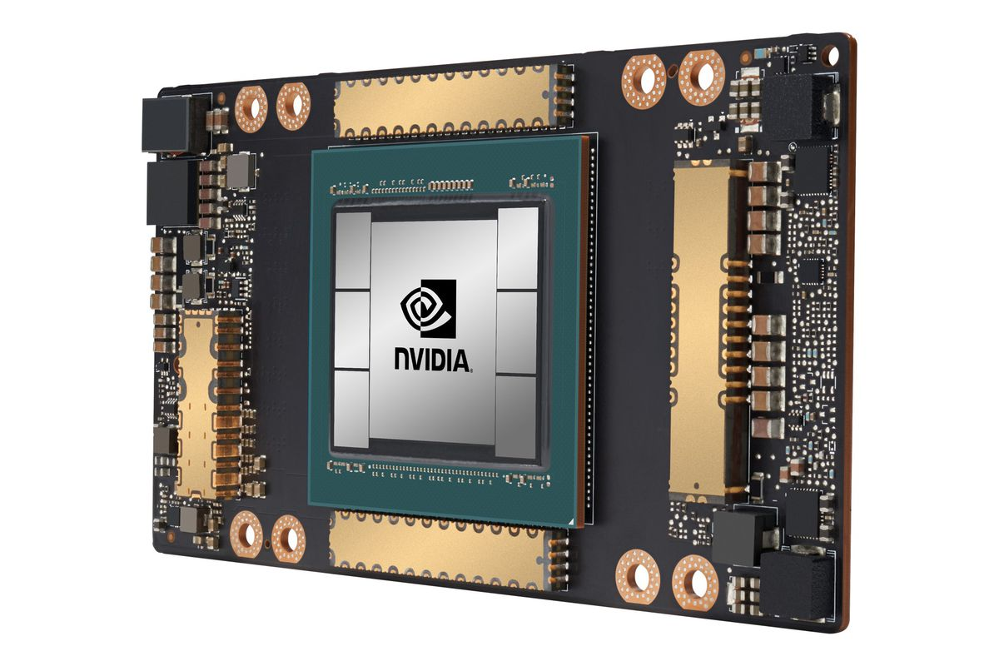
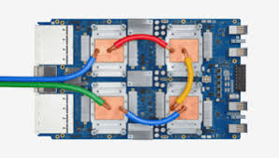
CSCB58:
Computer Organization
Prof. Gennady Pekhimenko
University of Toronto
Fall 2020
The content of this lecture is adapted from the lectures of
Larry Zheng and Steve Engels

Slide 2
CSCB58 Week 1

Slide 3

Who are We?
Instructor:
Assistant Professor Gennady Pekhimenko
Office: BA5232 an IC454 (normally ;))
pekhimenko@cs.toronto.edu
http://www.cs.toronto.edu/~pekhimenko/

Slide 4
Who are We?
TAs:
Bojian Zheng, PhD student (bojian.zheng@mail.utoronto.ca)
Qiongsi Wu, MSc. Student (qiongsi.wu@mail.utoronto.ca)
Anand Jayarajan, PhD student (anandj@cs.toronto.edu)
Mustafa Quraish, PhD student (mustafa@cs.toronto.edu)

Slide 5
How to Connect?
LEC
https://vectorinstitute.zoom.us/j/93537472871 (password: 597255)
PRA (Mon)
https://utoronto.zoom.us/j/94009704386 (password: 708254)
PRA (Tue)
https://utoronto.zoom.us/j/95205933572 (password: 045630)
PRA (Thu)
https://utoronto.zoom.us/j/94993998484 (password: 713436)

Slide 6
Today’s outline
Why CSCB58
What is in CSCB58
How to do well in CSCB58
Start learning

Slide 7
Why take CSCB58?

Slide 8

“Why are you making me take this?”
CSC258 isn’t needed if you’re just a causal technology user
  You can still drive a car, even
  if you don’t understand how
  the engine works

Slide 9

“Why are you making me take this?”
Computer science majors aren’t casual technology users
  At the very least, you’ll need to know
  how the programs you write are affected
  by hardware

Slide 10
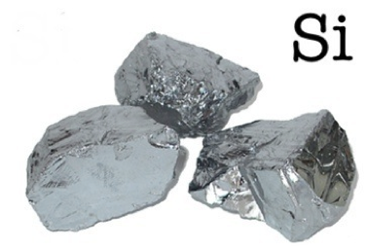
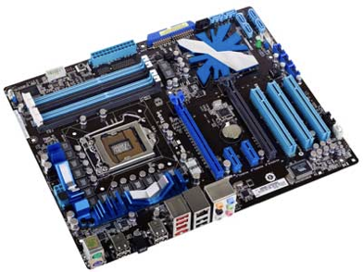

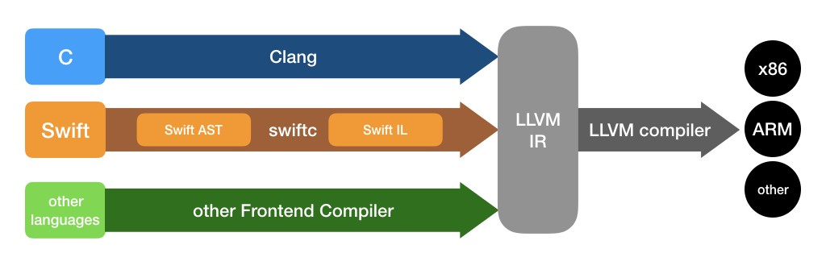
Learning the Magic
Si
Hardware
OS
Compiler
magic
magic
magic
CSCB58
CSCC69
CSD70

Slide 11
More specifically…
How do we express 1’s and 0’s using a piece of silicon?
How does the computer do everything with just 1’s and 0’s?
What is stored in that “fortnite.exe” file, what exactly happens when I double-click on it?
How does the CPU run an if-statement, or for loop, or recursion?
CSCB58 has all the answers!

Slide 12
After learning CSCB58…
You’ll know everything about how a computer is physically built, and you can build one if you want.
With your hardware knowledge, you will be able to engineer the performance of your software like never before.
People who are really serious about software should make their own hardware.
-- Alan Kay

Slide 13
What’s in CSCB58?

Slide 14
The architecture of a computer hardware, level by level, bottom-up
Assembly Language
Processors
compute stuff
Arithmetic Logic Units
Finite State Machines
remember stuff
Devices
Flip-flops
Circuits
Gates
Transistors

Slide 15
We learn the whole real deal
Computing from the ground up:
  From atom level to assembly level
Above the assembly level is the Operating System, which virtualizes the hardware
Almost everything you learn from CS courses are virtualizations/illusions, except for CSCB58

Slide 16
We learn how to handle abstractions
At each level, we see how the previous layer is abstracted
In the end, we want to know how the underlying hardware affects us as programmers … so we can ignore the detail.

Slide 17
How to do well in CSCB58

Slide 18
First of all …
Be interested

Slide 19
Course website
https://cscb58f20.ml/
All course materials are here

Slide 20
Marking scheme

Slide 21
Labs (starting from Week 2)
Hands-on exercises in which you will build real pieces of hardware.
Pre-labs and in-labs are all done individually.
ONLY go to the lab section that you are registered to on ACORN. If you want to switch lab section, find someone who is willing to switch and get permission from Gennady.

Slide 22
Prelab Reports
For most of the labs, you will be required to submit a prelab report (a PDF file) to MarkUs before the labs start
Must be completed individually
Submission deadline is typically before the lab you are taken
To get the mark for the prelab report
  do your work and submit something meaningful
  don’t plagiarize
  not submitting anything would be much better than plagiarizing

Slide 24
Lab software
We will use Logisim (latest version). NOTE: please, use the version that will be provided/referenced by TAs
The reference of the software has been posted on the course website
Task for this week: download the software, read the reference, and familiarize yourself with it

Slide 25
Weekly Quizzes
We will use Quercus for online quizzes
Starting in Week 2 (including Monday PRA)
Useful practices for tests and exams
Quizzes will be every Friday in-class (first 15 minutes)
You’ll be told whether your answer is correct immediately, and you can try up to three times. We will record your highest score

Slide 26
New: Assembly Programming Project
This year, we’ll ask you to write a larger project in assembly than in prior years
The project will be due on the last day of class
You will be asked to write assembly code to build a game
  Memory (storing game state)
  Syscalls (to access input/output)
  …

Slide 27
Tests
No midterm
Final exam
  Some time end of semester
  Will be take-home
  Must get >= 40%
  Details will come later

Slide 28
Discussion board on Piazza
https://piazza.com/class/kemxsy9by7o707
All course announcements will be posted here.
Daily reading is required.

Slide 29

Office hours
Fridays, 12pm (please, give heads up/email if you are coming)

Slide 30
Student Feedback
Give us frequent (e.g., every week) feedbacks on how things are going. It is very useful for improving your learning experience in a timely manner, especially in a current situation
Anonymous feedback form:
  link on the course website
Or even better, just send me an email

Slide 31
Textbook: DDCA
Digital Design and Computer Architecture, 2nd edition, 2012by David Harris, Sarah Harris (1st edition also fine)
Available online at UofT library (link in course info sheet)

Slide 32
A typical week of CSCB58
Wednesday/Friday: go the lectures
By Tuesday 6pm: submit prelab report
Monday/Tuesday/Thursday: labs
Friday: next week’s lab handout released, start working on the prelab.
Saturday/Sunday: keep studying ;)

Slide 33
It will be a lot of work, and a lot of fun!

Slide 35

Let the learning begin

Slide 36
Basic Logic Gates

Slide 37

You already know something…

Slide 38
Logic from math course
Create an expression that is true iff the variables A and B are true, or C and D are true.
G = (A & B) | (C & D)

Slide 39
G = (A & B) | (C & D)
A
A
A&B
A|B
B
B
AND Gate
OR Gate
A
B
G
C
D
You just designed your first circuit in CSCB58!

Slide 40
Gates = Boolean logic
If we know the logical expression, we already know how to put logic gates together to form a circuit
Just need to know which logic operations are represented by which gate!
Let’s meet all the gates

Slide 41
AND Gates
A
Y
B
A | B | Y
0 | 0 | 0
0 | 1 | 0
1 | 0 | 0
1 | 1 | 1
Truth table

Slide 42
OR Gates
A
Y
B
A | B | Y
0 | 0 | 0
0 | 1 | 1
1 | 0 | 1
1 | 1 | 1

Slide 43
NOT Gates
A
Y
A | Y
0 | 1
1 | 0

Slide 44
XOR Gates
A
Y
B
A | B | Y
0 | 0 | 0
0 | 1 | 1
1 | 0 | 1
1 | 1 | 0

Slide 45

Bill Gates

Slide 46
NAND Gates
A
Y
B
A | B | Y
0 | 0 | 1
0 | 1 | 1
1 | 0 | 1
1 | 1 | 0

Slide 47
NOR Gates
A
Y
B
A | B | Y
0 | 0 | 1
0 | 1 | 0
1 | 0 | 0
1 | 1 | 0

Slide 48
Buffer
A
Y
This is not as silly as you might think now, as we’ll see later…
A | Y
0 | 0
1 | 1

Slide 49

AND Gate
A
Y
B
This is just a symbol...
What does it really look like, inside?
How does it work, physically?
What are these?
A
B
Power: high voltage (5V)
Y
+
-
R
Resistor
Ground: low voltage (0V)

Slide 50

Y
A
B
+
-
Switches
R
When and only when both A are B are switched ON, Y has high voltage.

Slide 51
A
Gates
B
Y
+
-
R
Gate is like a switch, but controlled by the voltage of the input signal, instead of by a finger.
Gate A is switched ON when signal A is of high voltage.
When and only when both A and B have high voltage, Y has high voltage.
High voltage is 1 (True), low voltage is 0 (False).
Y is True iff both A and B are True (Y = A & B).

Slide 52
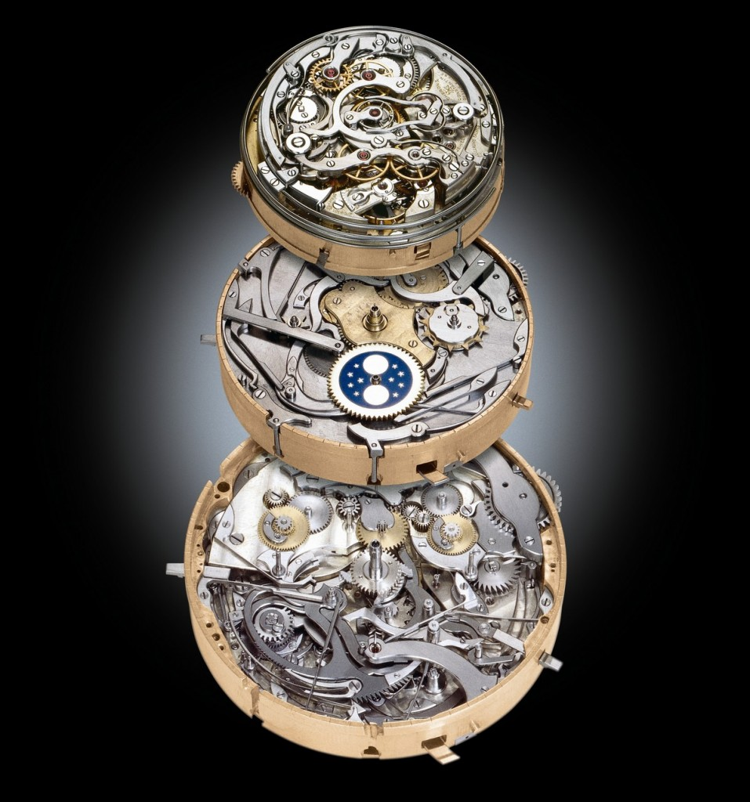
Thinking in hardware
Although CSCB58 has elements that are similar to other courses, it is very different in significant ways
Unlike other software courses, CSC258 is not about creating programs and algorithms, but rather devices and machines
  Very important concept to grasp early in this course!
  For instance: We need to understand what certain terms mean in the context of hardware.

Slide 53
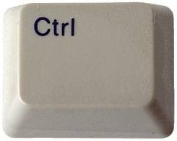
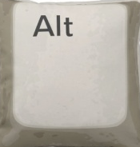
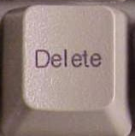
Example: Ctrl-Alt-Delete
Ctrl | Alt | Del | RESTART
0 | 0 | 0 | 0
0 | 0 | 1 | 0
0 | 1 | 0 | 0
0 | 1 | 1 | 0
1 | 0 | 0 | 0
1 | 0 | 1 | 0
1 | 1 | 0 | 0
1 | 1 | 1 | 1
Ctrl
Alt
+
-
Del
RESTART

Slide 54
A
Gate is switched ON when signal A is of high voltage …
Why?
How?
What does the inside of a gate look like?
Answer: There are transistors

Slide 55
Transistors

Slide 56
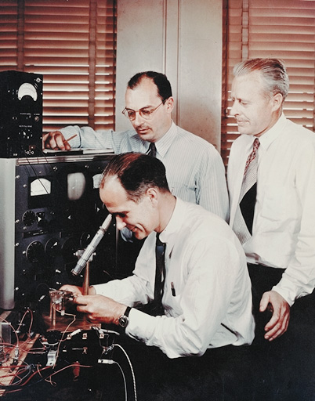
One of the greatest inventions of the 20th century
Invented by William Shockley, John Bardeen and Walter Brattain in 1947, replacing previous vacuum-tube technology.
  Nobel Prize for Physics in 1956.
Building block for the hardware of all your computers and electronic devices

Slide 57
What do transistors do?
Transistors connect Point A to Point B, based on the value at Point C.
  If the value at Point C is high, A and B are connected.
  And if the value at Point C is low, A and B are not.
  Need to know a little about electricity now….
C = 1
A
B
A
B
C = 0
A
B
A
B

Slide 58


Slide 59
Outline of the story
Electricity, basic concepts
Insulators, conductors, in between …, Semiconductors
Impure semiconductors, p-type / n-type
Put p-type and n-type together -- pn-junction
Apply voltage to a pn-junction – principle of transistors
A real-world manufacturing of transistor -- MOSFET

Slide 60
Where do transistors fit?
Logic Gates
made from
Transistors
based on
pn-junctions
made from
Semiconductors
that conduct
Electricity

Slide 61
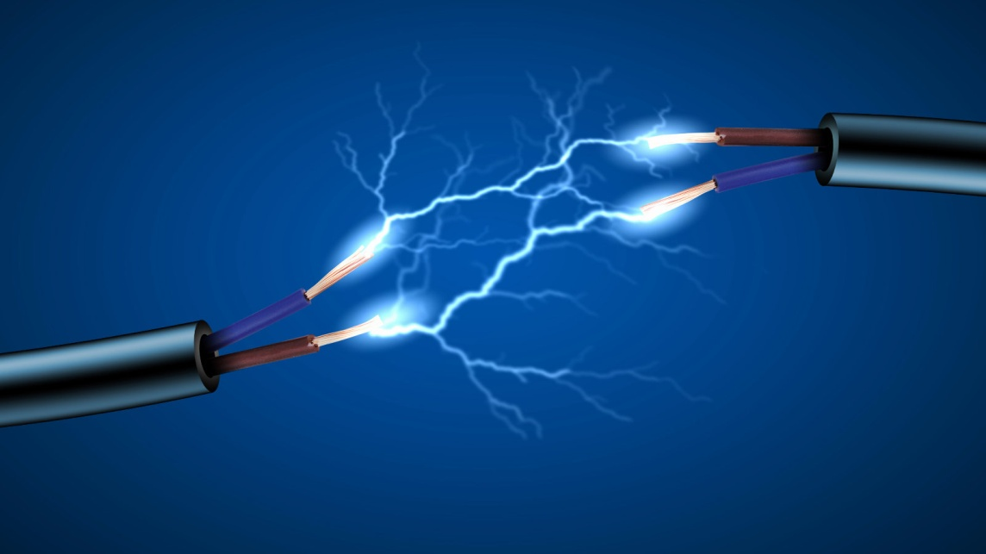
Electricity Basics

Slide 62

Everything is made out of atoms …
Protons are big (hardly move) and positively charged.
Electrons are small (easily move) and negatively changed.
Neutrons are big and of course, neutral.
Overall, an atom is neutral.

Slide 63
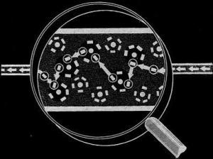
What is Electricity?
Electricity is the flow of charged particles (usually electrons) through a material.

Slide 64

How do electrons flow?
They flow …

Slide 65
How do electrons flow?
Electrons want to flow from regions of high electrical potential (many electrons) to regions of low electrical potential (fewer electrons).
  Like water flows from high to low.
This potential is referred to as voltage (V).
The rate of this flow is called the current (I).
Resistance (I = V / R) is like how narrow the water pipe is.

Slide 66
Direction
The direction of the current is opposite to the direction of the electron movement, because electrons are negatively charged.

Slide 67
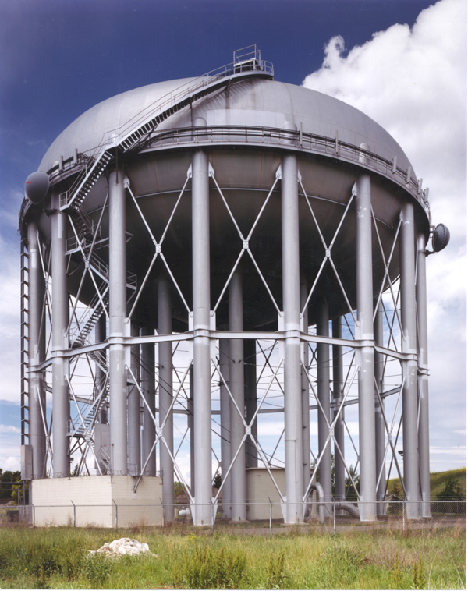
Water Analogy
To help picture this concept of voltage and current, imagine a reservoir:
  Electrons flow from high to low potential like water would flow from the reservoir to the ground.
  Voltage is like the elevation of the water above the ground.
  Current is the rate at which the water flows.
The relationship between voltage (V) and current (I) is called resistance: R = V/I

Slide 68
A Note about Current
Even though current is caused by electrons flowing through a material, the convention is to measure current as the movement of positive charges.
  Protons don’t actually move. When electrons move from point A to point B, the result is that B becomes more negative and A becomes more positive.
  Scientists historically viewed current in terms of this creation of positive charge in a material.
  It’s not completely clear why scientists decided this. Just go with it ☺

Slide 69
More on Resistance
Electrical resistance indicates how well a material allows electricity to flow through it:
  High resistance (aka insulators) don’t conduct electricity at all.
  Low resistance (aka conductors) conduct electricity well and are generally used for wires.
Semiconductors are somewhere in between conductors and insulators, which makes it interesting…

Slide 70
Outline of the story
Electricity, basic concepts
Insulators, conductors, in between …, Semiconductors
Impure semiconductors, p-type / n-type
Put p-type and n-type together -- pn-junction
Apply voltage to a pn-junction – principle of transistors
A real-world manufacturing of transistor -- MOSFET

Slide 71
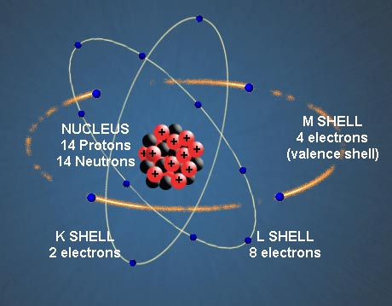
Semiconductors

Slide 72
Here comes the chemistry

Slide 73
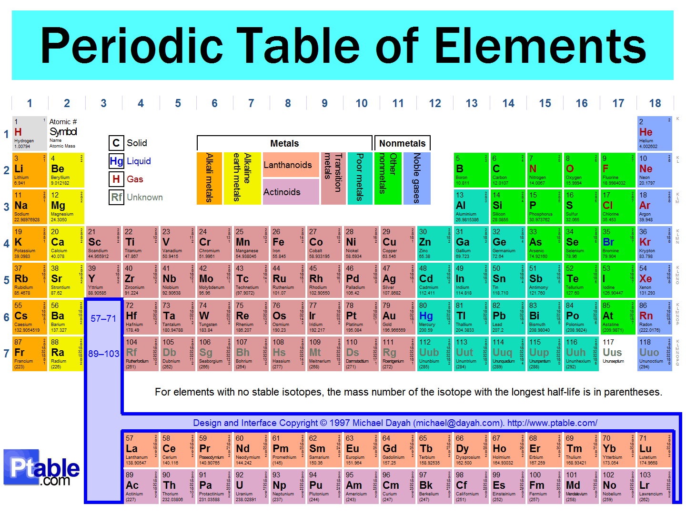
silicon
Germanium

Slide 74
Conductivity of Semiconductors
Semiconductor materials (e.g., silicon and germanium) straddle the boundary between conductors and insulators, behaving like one or the other, depending on factors like temperature and impurities in the material.

Slide 75
Impurity

Slide 76
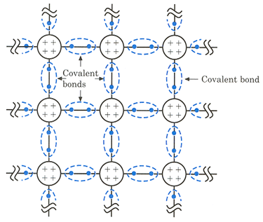
Pure semiconductor is pretty stable
Each atom has 4 valence electrons, forming bonds with other atoms, and the structure is pretty stable.
At room temperature, very close to insulator.

Slide 77
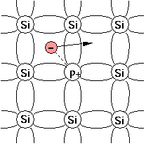
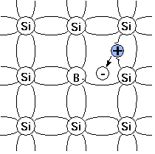
Encourage semiconductor’s conductivity
N-type:
Add some atoms with 5 valence electrons, such as Phosphorus.
An extra electron!
P-type:
Add some atoms with 3 valence electrons, such as Boron.
A missing electron, a.k.a., a “hole”, like a positive electron!

Slide 78
Encourage semiconductor’s conductivity
The extra electrons and the holes are charge carriers, which can move freely through the materials.
Thus the conductivity is encouraged.
This process of adding stuff is called doping, (n or p type).

Slide 79

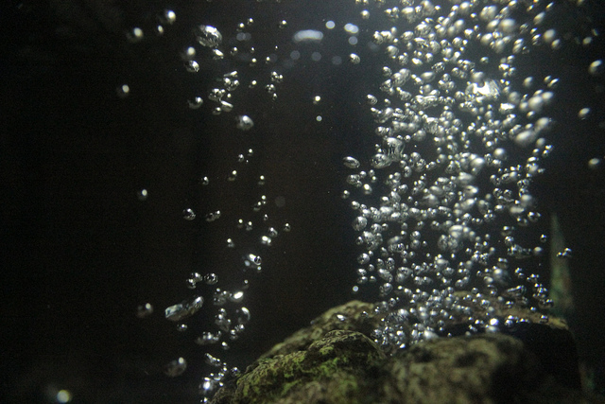
Free electrons move like
Free holes move like

Slide 80
Outline of the story
Electricity, basic concepts
Insulators, conductors, in between …, Semiconductors
Impure semiconductors, p-type / n-type
Put p-type and n-type together -- pn-junction
Apply voltage to a pn-junction – principle of transistors
A real-world manufacturing of transistor -- MOSFET

Slide 81
PN-junctions

Slide 82
Bringing p and n together
What happens if you brought some p-type material into contact with some n-type material?
The electrons at the surface of the n-type material are drawn to the holes in the p-type.
Si
Si
Si
Si
P
Si
Si
P
Si
Si
P
Si
-
-
-
n-type
Si
P
-
Si
Si
Si
Si
Si
Si
Si
Si
Si
P
-
Si
Si
Si
Si
Si
B
Si
Si
B
Si
Si
Si
p-type
-
-
-
Si
Si
-
B
Si
Si
Si
Si
B
-
Si
Si
Si
B

Slide 83
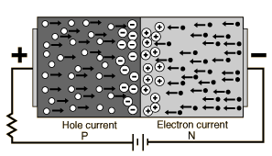
p-n Junctions
When left alone, the electrons from the n section of the junction will fill the holes of the p section, cancelling each other and create a section with no free carriers called the depletion layer.
Once this depletion layer is wide enough, the doping atoms that remain will create an electric field in that region.

Slide 84
Electrons’ initial movement (attracted by holes)
Because lost electron
n-type
Si
Si
Si
Si
P
Si
Si
P
Si
Si
P
Si
-
-
-
Si
P
-
Si
Si
Si
Si
Si
Si
Si
Si
Si
P
-
Si
Si
Si
Si
Si
B
Si
Si
B
Si
Si
Si
-
-
-
Si
Si
-
B
Si
Si
Si
Si
B
-
Si
Si
Si
B
Because gained electron
p-type

Slide 85
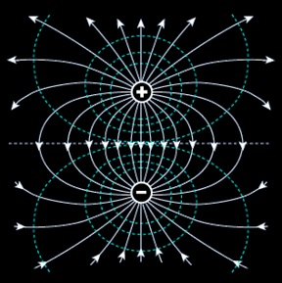
Diffusion increases the width of depletion layer, and drift draws it back. An equilibrium is reached, when the depletion layer is of a certain width.
“Diffusion”
Electrons’ initial movement (attracted by holes)
n-type
Electron’s movement drawn by the electric field
Electric field
p-type
“Drift”

Slide 86
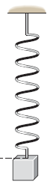
Analogy: Spring with weight
“Diffusion”
“Drift”
Attracted by gravity (hole)
Drawn by spring force field
An equilibrium is reached when the spring is stretched by a certain length.

Slide 87
Summary of pn-junction
P
N
When we put p and n together, they will form a depletion layer with electric field in it.
The depletion layer grows up to a certain width, until equilibrium is reached.

Slide 88
Outline of the story
Electricity, basic concepts
Insulators, conductors, in between …, Semiconductors
Impure semiconductors, p-type / n-type
Put p-type and n-type together -- pn-junction
Apply voltage to a pn-junction – principle of transistors
A real-world manufacturing of transistor -- MOSFET

Slide 89
Apply voltage to a PN-junction
It could be applied in two possible directions
Positive voltage to the P side
Positive voltage to the N side

Slide 90
Forward Bias (Positive voltage to P)
P
N
Negative charges sucked out of depletion layer
Positive charges sucked out of depletion layer
Depletion layer becomes narrower

Slide 91
Reverse Bias (Positive voltage to N)
P
N
Negative charges injected into depletion layer
Positive charges injected into depletion layer
Depletion layer becomes wider

Slide 92
Apply forward bias
Depletion layer narrower
Easier to travel through
Better conductivity
Like switch connected
Apply reverse bias
Depletion layer wider
Harder to travel through
Worse conductivity
Like switch disconnected
That’s how transistors work!

Slide 93
Outline of the story
Electricity, basic concepts
Insulators, conductors, in between …, Semiconductors
Impure semiconductors, p-type / n-type
Put p-type and n-type together -- pn-junction
Apply voltage to a pn-junction – principle of transistors
A real-world manufacturing of transistor -- MOSFET

Slide 94
Creating transistors
Transistors use the characteristics of p-n junctions to create more interesting behaviour.
Three main types:
  Bipolar Junction Transistors (BJTs)
  Metal Oxide Semiconductor Field Effect Transistor (MOSFET)
  Junction Field Effect Transistor (JFET)
The last two are part of the same family, but we’ll only look at the MOSFET for now.

Slide 95
  Metal Oxide Semiconductor Field Effect Transistor

Slide 96
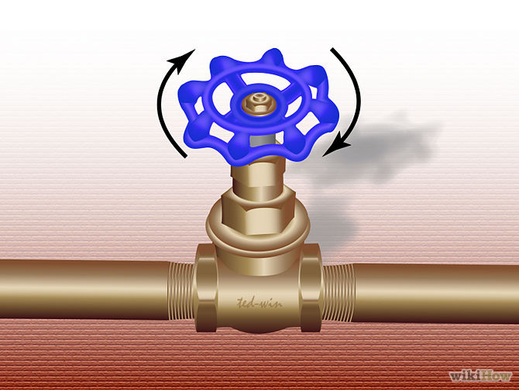
Gate
Source
Drain

Slide 97
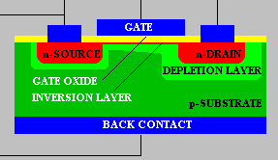
Metal
Oxide
Insulator
Conductor, can apply electric charge to it
N-type
P-type
Semiconductors, doped
Source
Gate
Drain

Slide 98
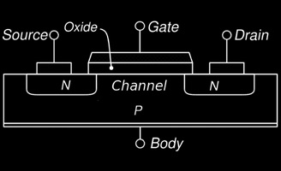
The MO of MOSFETs
Metal Oxide Semiconductor Field Effect Transistors are composed of a layer of semiconductor material, with two layers on top of the semiconductor:
  An oxide layer that doesn’t conduct electricity,
  A metal layer (called the gate), that can have an electric charge applied to it
  These are the M and O components of MOSFETs.

Slide 99
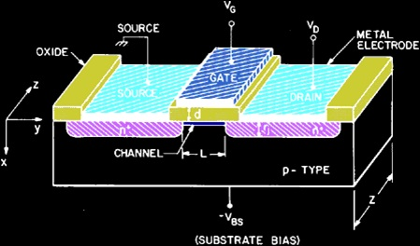
The S of MOSFETs
The semiconductor sections are two pockets of n-type material, resting on a substrate layer of p-type material.
A voltage is applied across the two n-type sections, called the drain and the source. No current will pass between them though, because the p section in between creates at least one reverse-biased pn junction.

Slide 100
Applying voltage to NPN
+ –
n
n
p
n
n
p
depletion layer
reverse biased
+ –
n
n
p
depletion layer

Slide 101
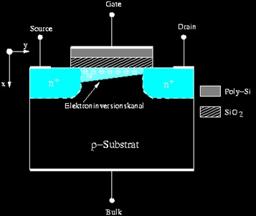
n-channel MOSFETs
However, when a voltage is applied between the source and the metal plate (the gate), positive charges are built up in the metal layer, which attracts a layer of negative charge to the surface of the p-type material.
This layer of electrons creates an n-type channel between the drain and the source, connecting the two and allowing current to flow between them.
  the wider the channel, the higher the current

Slide 102
Applying voltage to NPN
Gate (metal layer over oxide layer)
+ –
+ –
+ –
n
n
n
+
+
+
+
+
+
+
n
p
p
-
-
-
-
-
-
-
-
-
-
-
-
-
reverse biased
n-type channel
n-type channel creates path between source and drain for current to conduct!

Slide 103
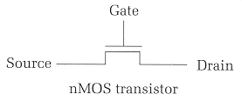
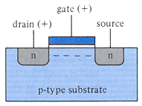
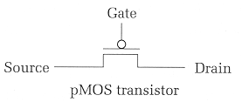
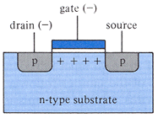
nMOS vs pMOS
Two types of MOSFETs exist, based on the semiconductor type in the drain and source, and the channel formed.
  nMOS transistors (the design described so far) conduct electricity when a positive voltage (5V) is applied to the gate.
  pMOS transistors (indicated by a small circle above the gate) conduct electricity (i.e., act as a closed switch) when the gate voltage is logic-zero.

Slide 104
Transistors to Logic Gates

Slide 105
Transistors to Gates
MOSFET Truth Table
MOSFETs can make current flow, based on the voltage values in the gate and drain.
  i.e. the truth table on the right.
One final step: combining MOSFETS to create high and low voltage outputs, based on high and low voltage inputs.
  General approach: create transistor circuits that make current flow to outputs from high or low voltage, based on transistor input values.
V_{DS} | V_{GS} | I_{DS}
Low | Low | Low
Low | High | Low
High | Low | Low
High | High | High

Slide 106
Create gates using a combination of transistors
V_{cc}
Physical data:
  “High” input = 5V (aka V_{cc})
  “Low” input = 0V
  Switching time: ~20 picoseconds
  Switching interval ~10 ns
A
Y
A
Y
NOT Gate

Slide 107
Transistors into gates
Note: Vcc = “Common Collector Voltage”
= high voltage (5 V)
V_{cc}
V_{cc}
V_{cc}
V_{cc}
V_{cc}
A
A
B
A
A
B
B
B
Y
Y
B
Y
A
B
A
A
A
B
B
AND
OR
XOR

Slide 108


NAND is the most awesome logic gate
It’s cheaper to build
All other logic functions (AND, OR, …) can be implemented using only NAND, i.e., it is functionally complete
Challenge for home: implement AND, OR, NOT, XOR using only NAND.

Slide 109
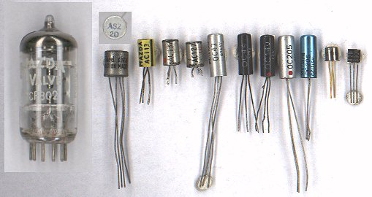
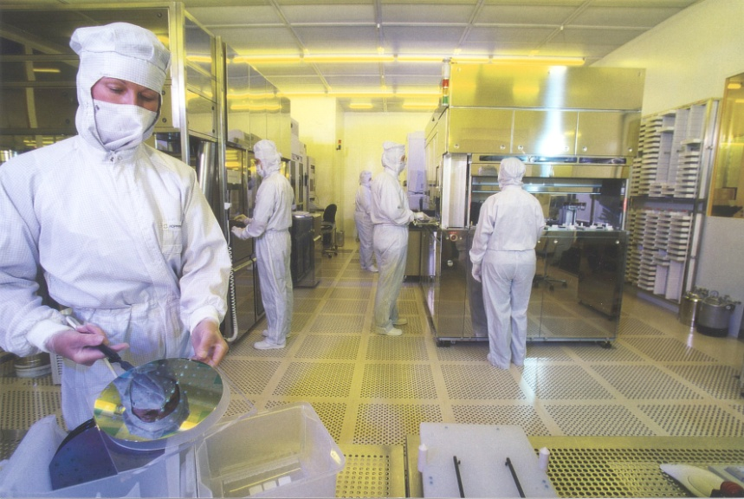
Transistor Fabrication
Transistors are not formed by pushing large chunks of n- and p-type semiconductors together.
Transistors are now made by bombarding silicon with doping substances to create the layers for each junction
  Surface is oxidized in between stages to ensure that only the necessary sections are doped.

Slide 110
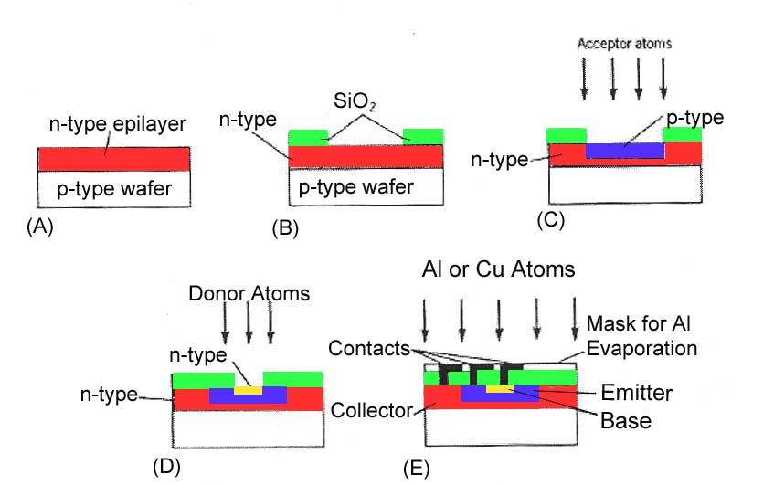
Fabrication Process

Slide 111
CSCB58:
Computer Organization
Prof. Gennady Pekhimenko
University of Toronto
Fall 2020
The content of this lecture is adapted from the lectures of
Larry Zheng and Steve Engels

